Slide 1
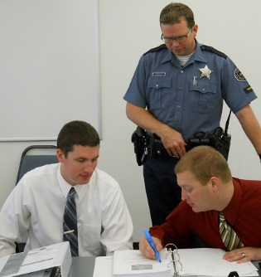



Session 1
Introduction
and
Overview

Slide 2

Learning Objectives
State goals and objectives of training
Describe training schedule and activities
Describe current DWI problem
Identify elements of drug problem

Slide 3
Learning Objectives
Define and describe impaired-driving enforcement programs
Understand roles and responsibilities of DRE and how this course supports DEC Program

Slide 4


Slide 5
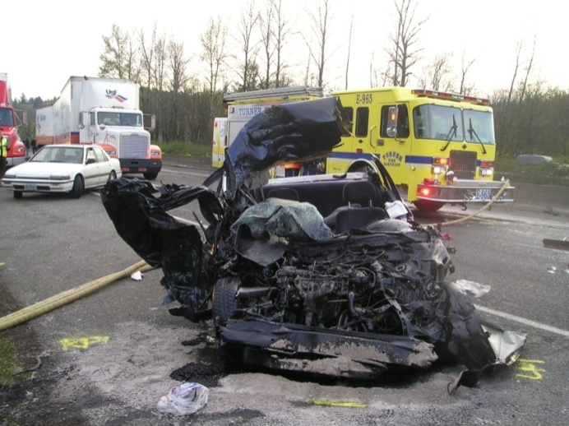
Course Goal
Increase deterrence of DWI violations; thereby reducing the number of crashes, deaths, and injuries caused by impaired drivers.

Slide 6
DWI Fatalities

Slide 7

Alcohol-impaired drivers kill one person every 45 minutes
An average of
people die every day from alcohol-impaired crashes
Alcohol-impaired crashes kill 1 person every
minutes
32
45

Slide 8
NHTSA/IACP-Supported Impaired Driving Programs
Training: SFST; ARIDE; DEC Program; Prosecuting the Drugged Driver; ARIDE Refresher; DRE Expert Testimony
Enforcement: Selective Traffic Enforcement
Prosecution/Judges: Traffic Safety Resource Prosecutors; Judicial Education

Slide 9

SFST Training

Slide 10
2020 National Survey Drug Use and Health (NSDUH)
Slightly less than half of Americans consider themselves drinkers
6.4% describe themselves as heavy drinkers
37.3 million people used illicit drugs in the past month

Slide 11
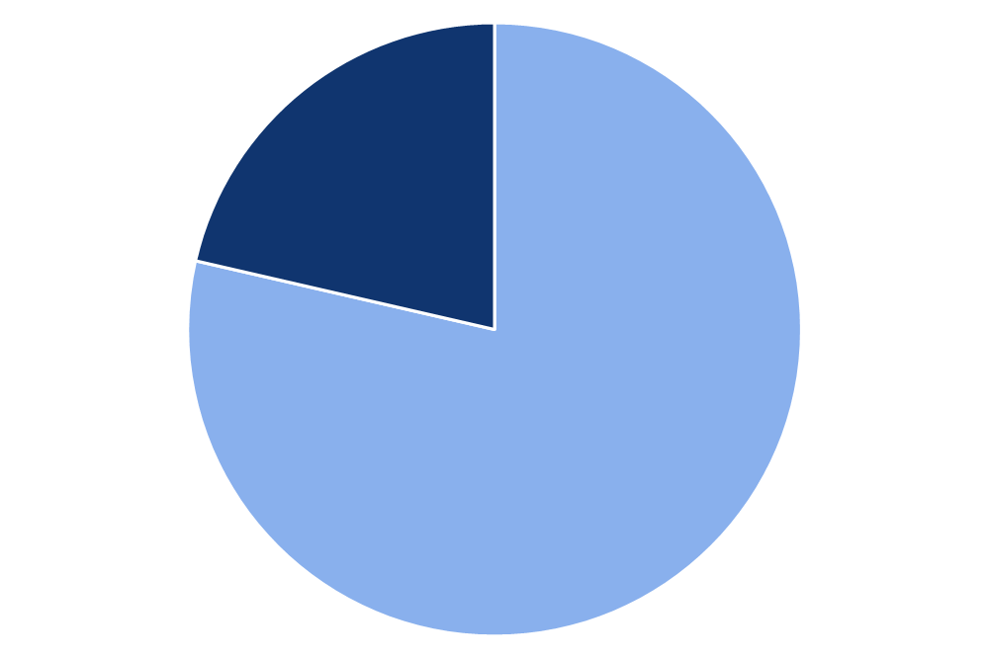
Alcohol and Drug Use
Marijuana
49.6M
Rx Pain Reliever Misuse
9.3M
No Past Year
Illicit Drug Use
Hallucinogens
7.1M
Past Year
Illicit Drug Use
59.3M People
(21.4%)
Rx Tranquilizer or Sedative Misuse
6.2M
Cocaine
5.2M
Rx Stimulant Misuse
5.1M
Methamphetamine
2.5M
217.6M People
(78.6%)
Inhalants
2.4M
Heroin
902,000
0 10 20 30 40 50 60
Number of Past Year Users

Slide 12
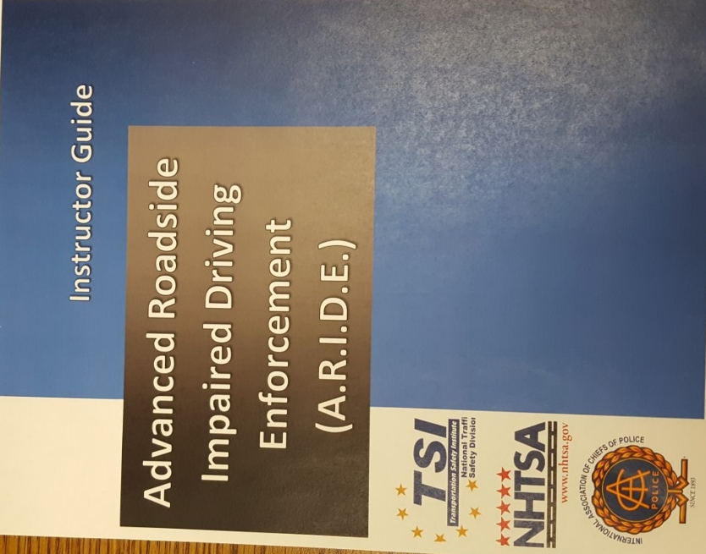
Advanced Roadside Impaired Driving Enforcement (ARIDE)

Slide 13
ARIDE Goal
Observe, identify, and articulate the signs of impairment related to drugs, alcohol, or a combination of both in order to reduce the number of impaired driving incidents, serious injury, and fatal crashes.

Slide 14
Drug Evaluation and Classification (DEC) Program
The ultimate goal of the DEC Program is to train officers to be DREs to help prevent crashes and avoid deaths and injuries by improving enforcement of drug-impaired driving investigations.

Slide 15
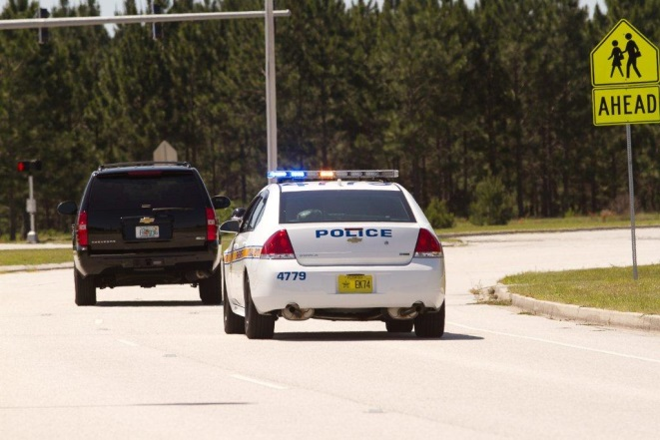
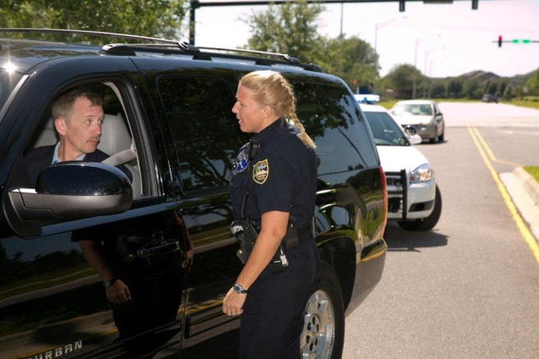
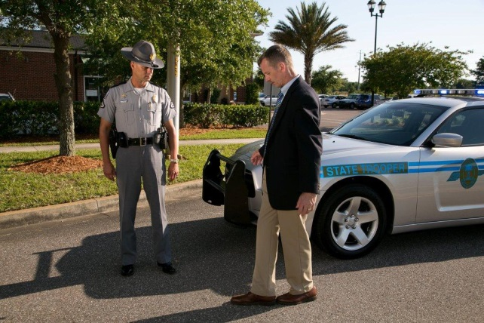
DWI Detection Phases
Phase One
Phase Two
Phase Three
Pre-Arrest Screening
Vehicle in Motion
Personal Contact

Slide 16
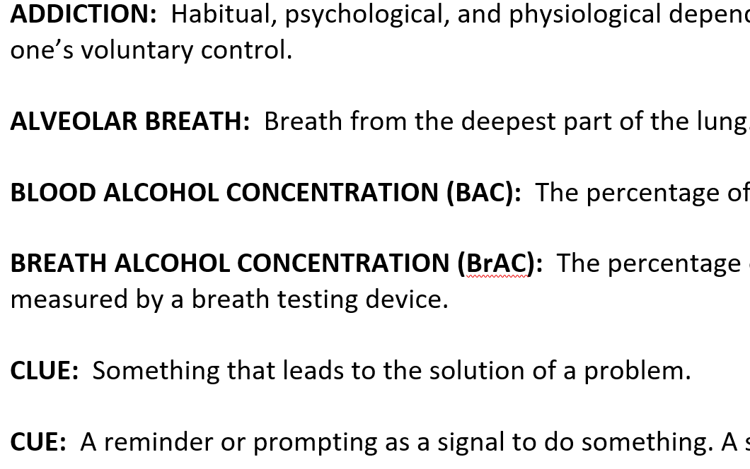
Glossary of Terms

Slide 17
Questions?

