Slide 1
Toxicology Laboratory Updates
Washington State Toxicology Lab
Washington State Patrol
Brian Capron

Slide 2
Laboratory Staffing Updates
New Laboratory Manger: Dr. Brianna Peterson
Two toxicologists still on maternity leave
Lisa Noble (return November)
Rebecca Flaherty (return December)
Four new toxicologists hired:
Amanda Chandler- finishing training
Lyndsey Lowe- doing case work
Katie Knorr- doing case work
Andrew Gingras- in training

Slide 3
Laboratory Staffing Updates
Currently have 7 toxicologists performing work on driving cases and testifying in trials (WA and AK)
Supervisor position filled by Lisa Noble who returns next month
Administrative position still open
Lab will not be fully staffed until late December when last person returns from maternity leave
Two new hires are doing case work (death cases) while the other two are finishing their training
Dawn Sklerov has returned and will be starting case work in a few weeks

Slide 4
Validated Methods
We have introduced over 10 new validated methods in the past few years with more in the future
Validated methods undergo rigorous scientific testing to ensure that we are providing the best possible results to our customers
Validation is an important necessity for laboratory accreditation
Validated methods produce high-quality results that are easier to defend in court
Validated methods take months to be developed and tested (time consuming)

Slide 5
Toxicologist Certifications
Newly introduced methods require toxicologists to become certified to perform them
Usually a three to four stage process
First stages require testing calibrators and controls
Last stages require testing spiked samples
Results undergo peer review by QA department
Toxicologists receive an authorization letter to perform the testing
Trying to get all toxicologist to perform their own work on all driving cases (court rulings)

Slide 6
New Testing Policy in 2013
Effective January 1, 2013:
All driving cases will be tested for alcohol and drugs regardless of alcohol level (change from the past)
All vehicular assault/homicide cases will undergo full toxicology testing
Causing/unknown drivers in fatalities will undergo full toxicology testing
Pedestrians will undergo alcohol and drug testing
All testing results will appear on reports if the test has been performed (even negative results)

Slide 7
New Testing Policy in 2013
Changes require the toxicologist to perform more testing on every sample (turn around times)
As a result, we are seeing many more drivers with alcohol levels >.10 that also have drugs present
If you suspect alcohol only, please request “blood alcohol only” in writing on the request form otherwise we are required by our policy to perform drug testing as well

Slide 8
Toxicology Lab-YTD (Jan-Dec ‘12)
Year | % change YTD | 2012 YTD | 2011 YTD | 2010 YTD
# total cases | - | 10,995 | 10,962 | 10,547
postmortem | - | 4,975 | 4,964 | 4,592
DUI/DRE | ↑ 3% | 5,838 | 5,682 | 5,524
other case types | ↓ 43% | 182 | 319 | 431
TAT-testing | ↓ 3 days | 13 days | 16 days | 21 days
DUI/DRE cases | ↓ | 9/20 days | 14/22 days | 15/29 days
TAT-lab report | ↓ | 15 days | 19 days | -
# analysts | ↓ | 11 | 12 | 11
# court cases | ↑ 6% | 419 | 396 | 345
# court hours | ↓ 6% | 2,151 hr | 2,292 hr | 2,030 hr
# discovery requests | ↓ 35% | 272 | 417 | 437

Slide 9
Toxicology Lab- 2012 DUI/DRE summary
 | 2012 stats (N=5,838) | 2011 stats (N=5,682)
THC (metabolite) | 18% (29%) | 20% (29%)
Methamphetamine | 10.5% | 9.6%
Alprazolam | 6.1% | 6.4%
Oxycodone | 3.9% | 4.2%
Diazepam | 3.6% | 4.5%
Zolpidem | 3.3% | 3.2%
Methadone | 3.2% | 3.9%
Clonazepam | 3.0% | 3.5%

Slide 10
Toxicology Lab-YTD (Jan-Aug ‘13)
Year | % change YTD | 2013 YTD | 2012 YTD | 2011 YTD
# total cases | ↑ 3.4% | 7,599 | 7,349 | 7,418
postmortem | ↑ 2.2% | 3,413 | 3,342 | 3,350
DUI cases | ↑6.8% | 3,373 | 3,159 | 2,932
DRE cases | ↓16% | 606 | 723 | 901
Other case types | ↑ 65% | 206 | 125 | 235
TAT (median) | 5 days | 19 days | 14 days | 15 days
# analysts | ↓ 6 FTE | 6 | 12 | 12
# court cases | - | 294 | 297 | 252
# court hours | ↓5% | 1,529 hrs | 1,608 hrs | 1,459 hrs

Slide 11
Toxicology Lab-THC Statistics (YTD)
Data | Jan-July 2013 | Jan-July 2012 | Jan-July 2011
THC DUI/DRE cases | 850 (27%) | 575 (19%) | 618 (17%)
Percent male | 81% | 77% | 85%
Age | 14-74 yr (avg 29) | 16-66 yr (avg 28) | 16-65 yr (avg 28)
% of cases < 21 yr | 27% | 24% | 33%
THC concentration | 2-77 ng/mL | 1-58 ng/mL | 1-59 ng/mL
 | (avg 8.2 med 5.7) | (avg 7.6 med 5.8) | (avg 6.2 med 4.5)
Combined with other drugs
Alcohol | 276 (32%) | 151 (26%) | 104 (17%)
Methamphetamine | 65 (8%) | 33 (6%) | 42 (7%)
Alprazolam | 36 (<5%) | 30 (5%) | 26 (<5%)
Oxycodone | 34 (<5%) | 24 (<5%) | 24 (<5%)

Slide 12
Toxicology Lab: I-502 Impact

Slide 13
Toxicology Lab: I-502 Impact

Slide 14
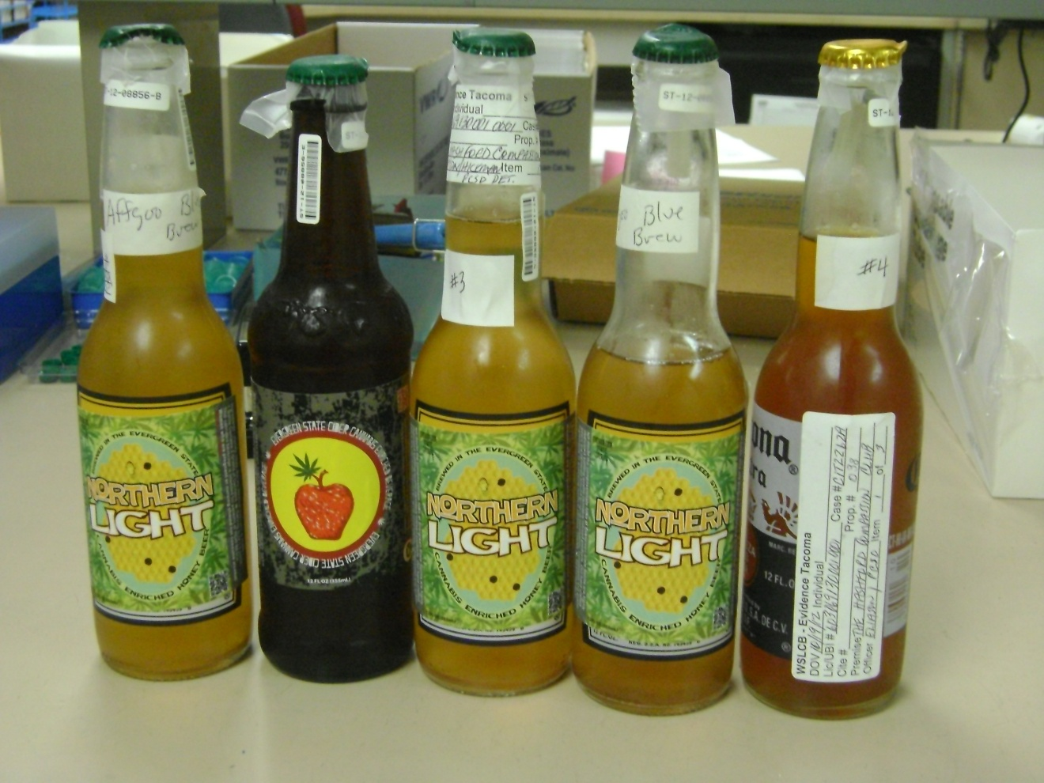
Toxicology Lab- LCB Evidence

Slide 15
Toxicology Lab- THC case
History
∙ 45 year old male
∙ SPD case- stopped for vehicle license violation
∙ Strong odor of marijuana in car and on subject
∙ Driver showed impairment on FST’s, had watery/red eyes
∙ Admitted past Marinol use and that passenger had been smoking marijuana
Testing
∙ THC 84 ng/mL
∙ carboxy-THC 720 ng/mL
Comments
∙ Passive inhalation: THC <1-2 ng/mL (~20 mins) with a corresponding low carboxy-THC

Slide 16
Drugs we send out for testing
Synthetic cannabinoids
Buprenorphine (Suboxone)
Lithium
Risperidal
Bath salts*
Psilocybin
Gabapentin
LSD
Methocarbamol
Mitragynine (Kratom)*

Slide 17
EMIT testing limitations
Testing used to see if any drug classes are positive/negative
Categories include:
Cocaine metabolite
Opiates
Benzodiazepines
Barbiturates
Cannabinoids
Amphetamines
Phencyclidine
Propoxyphene* (no longer testing for)
Methadone
Tricyclic anti-depressants

Slide 18
EMIT testing limitations
Class specific, not compound specific
Not completely comprehensive (Ambien, Benadryl)
Each drug has a “cut-off” level
Drugs may be present below the “cut-off”
“Cut-off” established through validation testing
Designed to reveal clinically significant levels
Some compounds cross-react (THC, Amphetamines)
Some drugs are poor reactors and may not produce a positive result unless the level is significantly high

Slide 19
EMIT testing limitations
Benzodiazepines (specific to Diazepam): Alprazolam, Clonazpeam and Lorazepam react poorly so we do confirmations on elevated responses
Amphetamines (specific to Amp/Meth): Amines often do not screen “positive”, but we move to confirmation testing when an elevation is seen
Phencyclidine: large amounts of Dextromethorphan can causes positive response (use GC/MS)
Opiates (specific to Morphine): may not confirm positive if only morphine glucuronides are present

Slide 20
Quantitation limits
Amines: 0.05 mg/L
Barbiturates: 0.5 mg/L
Benzodiazepines: 0.01 mg/L
Cannabinoids: THC 2 ng/mL*, carboxy-THC 10 ng/mL*
Cocaine: 0.01 mg/L
Carisprodol/Meprobamate: 1.0 mg/L
Fentanyl: 2.5 ng/mL
Methadone: 0.01 mg/L
Opiates: 0.01 mg/L* (HYM/6-AM: 2 ng/mL) added Oxymorphone* to the method
PCP: 0.01 mg/L
Zolpidem: 0.01 mg/L

Slide 21
Case #1
Stopped for erratic driving
Strong smell of alcohol
Resisted arrest and faked seizures
Submitted as an alcohol only case
Toxicology results:
Ethanol = .25 g/100mL
Hydrocodone = 0.16 mg/L
Topiramate = 5.6 mg/L

Slide 22
Case #2
Stopped for driving on the shoulder
Strong odor of intoxicants
Submitted as an alcohol only
Felony DUI
Toxicology results:
Ethanol = .12 g/100mL
THC = 8 ng/mL
Carboxy-THC = >200 ng/mL

Slide 23
Case #3
Stopped for speeding
Refused SFST’s
Obvious signs of impairment
Request form states 8 prior DUI’s
Submitted as an alcohol only
Toxicology results:
Ethanol = 0.19 g/100mL
THC = 6.1 ng/mL
Carboxy-THC = 100 ng/mL

Slide 24
Looking Forward
Continue to develop new methods to detect emerging drugs seen in the driving population
Electronic submissions forms and electronic reports is a future goal
ASCLD/LAB accreditation
Fully staffed lab within the next year
New laboratory instrumentation (LC/MS/MS)
Continue to increase communication between the laboratory and the DRE program

Slide 25
Helpful reminders
Please include the DRE face sheet when submitting the sample for testing
This is important because we do specific testing based upon your observations
Please list the drugs suspected so the appropriate testing can be performed
Remember some drugs do not react well on the initial screening
Please call the laboratory if you have any questions or concerns

Slide 26
Questions
Contact information:
206-262-6100
brian.capron@wsp.wa.gov

