Slide 1
Fatality Collision Investigation
Role of the DRE
Detective Sergeant Stacy Moate, WSP Bellevue CID
425-401-7745 Stacy.Moate@wsp.wa.gov

Slide 2
Objectives
Understand the role of the investigator
Understand the role of the DRE
How the DRE affects the investigation
Why a DRE is important in collision investigation
What investigators need in a report from a DRE

Slide 3

Why is this training important?
Notes:
Any ideas?
Discussion…..
Because we are dealing with life and death. We are there to gather the evidence to speak for those who no longer can. We are there to get information. Because it is our job!
They amount of effort we put into a case is noticed by many, fellow officers, supervisors, command staff, courts, media, and most importantly…the victim and their families. If we do not do a complete and thorough investigation it reflects negatively on all involved.

Slide 4
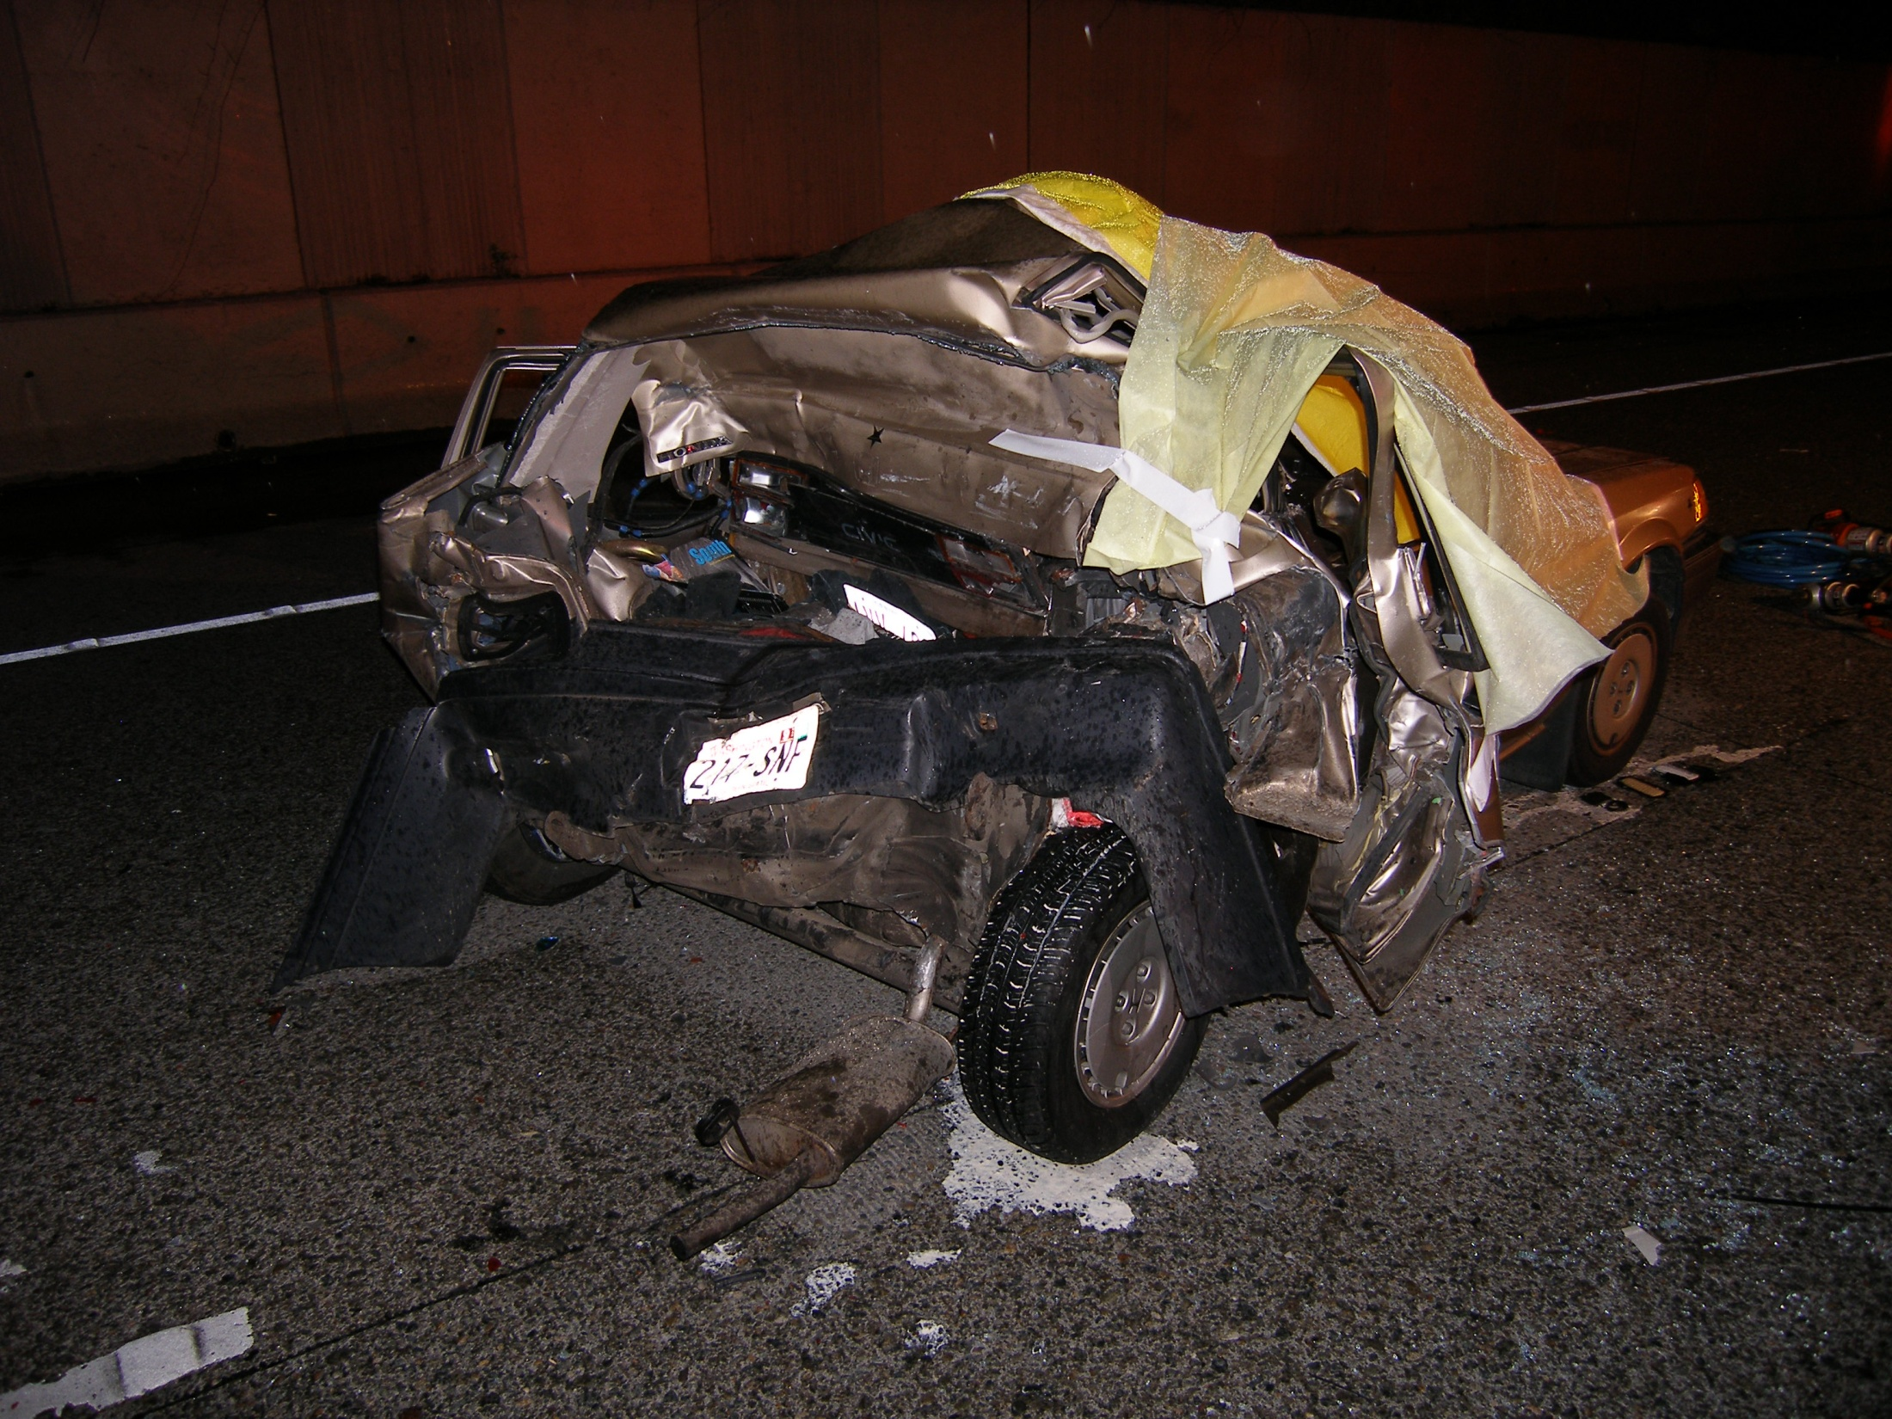
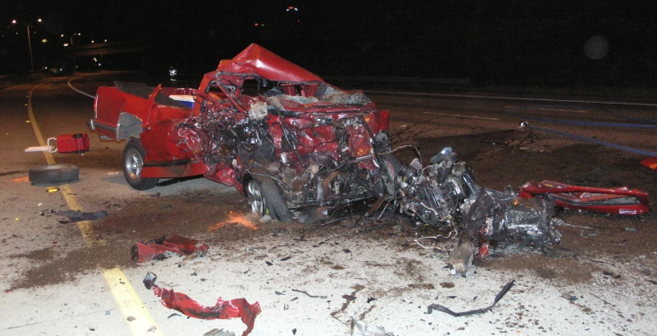
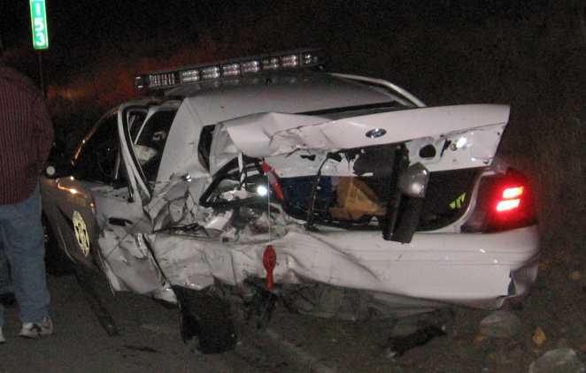
Center of Disease Control and Prevention
In 2010, 10,228 people were killed in alcohol related collisions, this is
nearly 1/3 of all traffic related fatalities.
In 2010, 1.4 million drivers were arrested for driving impaired, this is
only 1% of the 112 million self-reported episodes of impaired driving
by US adults.
Drug impaired drivers account for approximately 18% of motor
vehicle deaths.
* http://www.cdc.gov/MotorVehicleSafety/Impaired_Driving/impaired-drv_factsheet.html
Notes:
With marijuana being legal I would guess this last figure will increase over time (in Washington) I saw a dramatic increase in the number a marijuana related DUI arrests in the first few weeks following the legalization.

Slide 5
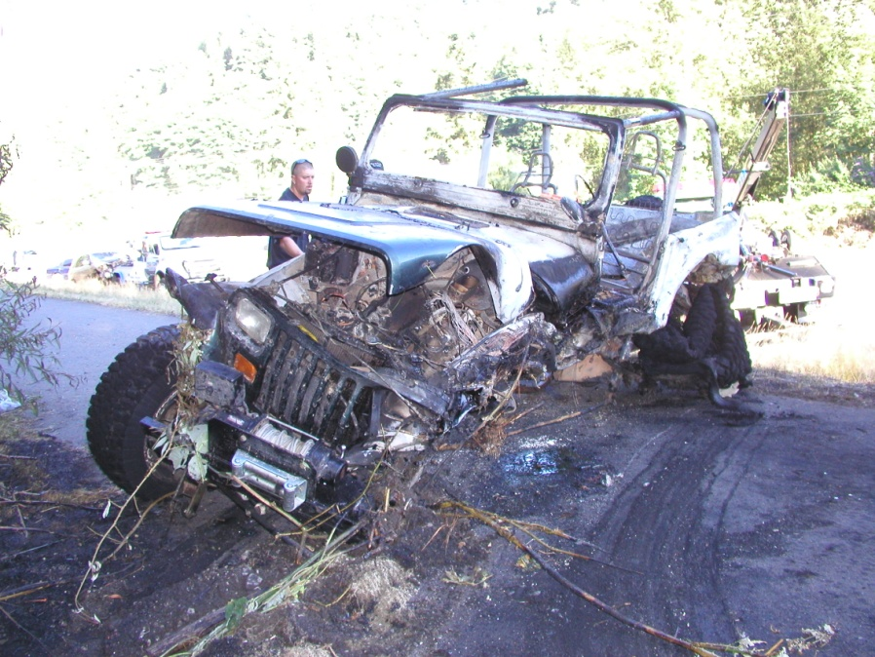
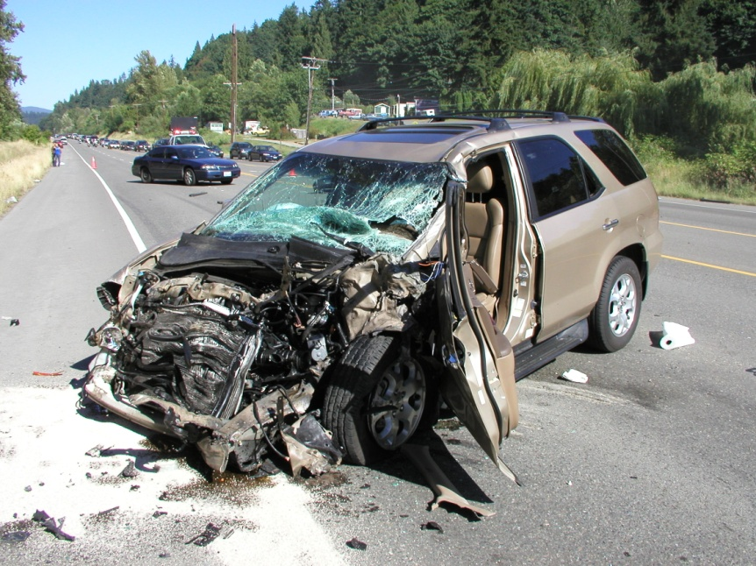
Role of an investigator
To respond to and investigate serious injury/fatality/
felony/patrol car collisions
Effective communication with others to ensure a thorough investigation
Complete a thorough investigation
Recommend or refer charges to the court
Notes:
Whether it is a collision that requires detective response or just patrol response a DRE should be utilized if there are serious or fatal injuries. Every fatal and serious injury collision needs to be taken seriously and a complete and thorough investigation completed. We do these everyday but for the people involved this is once in a life time dramatic event and we must recognize this.
Collision investigators can not do this alone and depend on those who are experts in their part of the investigation. I am not going to pretend to know what a CVD Trooper does for a semi inspection and I am not going to try to do a drug evaluation. I know what an impaired person looks likes but I could not tell what class of drug they are on, that’s why I as an investigator depend on the DRE.

Slide 6
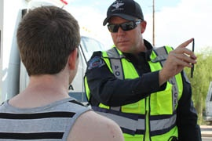
Role of a DRE
Evaluate impaired driver for type of drug impairment
Assist investigators with felony/fatal collision investigations
Thorough evaluation of surviving drivers for any impairment
To support and assist other officers with investigations
Write a detailed report about your observations
Notes:
Input from DRE’s…….What you have to say regarding impairment can make or break a case and you should take that responsibility seriously.
Sometimes I get complaints from DRE’s about the need to evaluate ALL drivers, my explanation for this need is that it shows we are not jumping to conclusions, it shows that we are completeing a thorough investigation with out picking a suspect from the beginning.

Slide 7
When to Respond to Collision Scenes
Required versus Suggested
* WSP policy
Notes:
10.09.060 Requests for DRE
DRE’s SHALL be requested for assistance and respond in the following situations:
- A collision in which the driver has no signs of alcohol impairment, but has some observable signs of intoxication by drugs.
- In any felonious or fatality collision a DRE SHALL respond to the scene and evaluate the surviving driver(s). Exceptions must be approved by the appropriate district command.
20.00.090 Use of CTS’s
CTS’s in the Field Operations Bureau SHALL be utilized for:
- Fatality collisions
- Felony collisions
- Patrol car collisions
- Serious injury collisions where contributing negligence on the part of two or more drivers is present
- Collisions which occur as a result of pursuit or emergency operation of a patrol vehicle, whether or not the patrol vehicle was involved in the collision.
These are when they are required to come to a scene by the WSP regulation manual. Other departments may have different guidelines. The WA traffic safety commission would like to see a DRE respond and evaluate all surviving drivers in all fatality collisions.
The WSP regulation manual does not prohibit DREs from responding to other types of collisions if the officers cannot figure out how it happened, there is just that feeling that something is not right. Utilize the resources you have available.

Slide 8
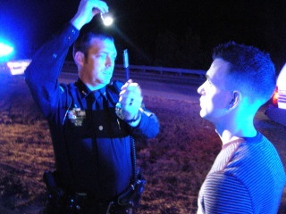
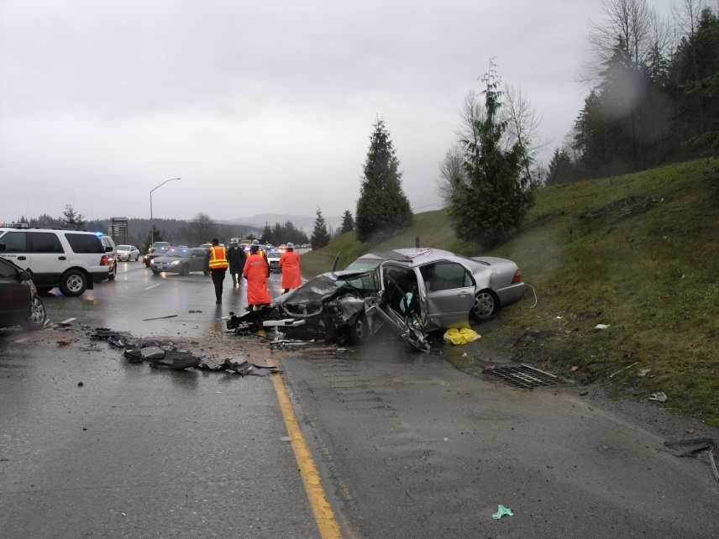
Cooperation
Why do DREs and investigators need to know what the other is doing?
Notes:
Both DREs and investigators are experts in their fields and both have knowledge and expertise that is invaluable to a felony/fatal collision investigation.
Both DREs and investigators need information from the other to conduct a thorough investigation of a collision.
Some of the things they need to know: Please tell me if there is more, that way I can educate my investigators.
Details
Dynamics
Known medication, suspected drugs, evidence of drug use, history of drug use
Is there signs of impairment, undetermined if impaired, not impaired
Any significant changes at the collision scene or at the hospital
?????????

Slide 9
Sorry if it’s you
Notes:
I am going to give some examples of successful and not so successful investigations. I wouldn’t admit it was yours until you know which way I’m going.
My intention is not to call you out but to learn from experience.

Slide 10
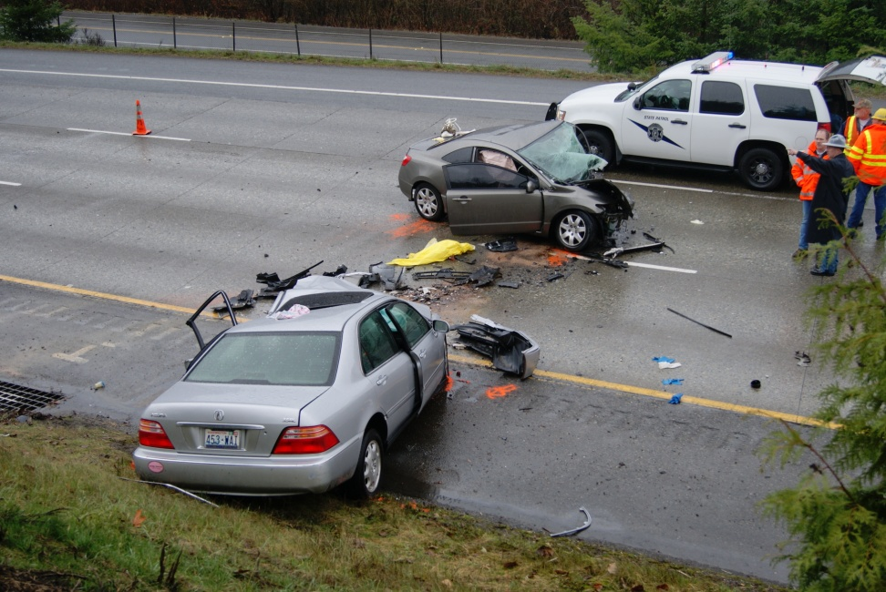
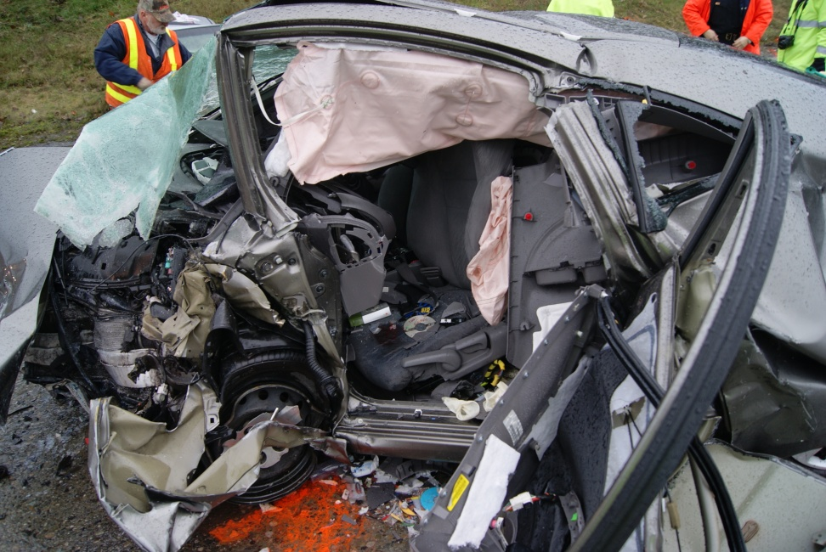
Rachel’s Crash
Notes:
This is an example of why CTSs and DREs need to work closely together at serious collision scenes.
On December 15, 2009 the light silver Acura driven by Janet, was traveling EB I-90 when she left the roadway and crossed up and over the grass median. Janet entered the westbound lanes traveling EB and struck Rachel head on in the left lane. Inside the car there was three coffee travel mugs with liquid that appeared to be wine, smelled like it and the PBT tested positive for alcohol. Due to the observation of wine in the mugs no DRE evaluation was done on Janet, because people at the scene assumed she was intoxicated by alcohol. Janet had NO odor of alcohol on her breath but after interviewing witnesses Janet appeared to be very impaired. Janet’s blood came back with no alcohol but high levels of Oxy and Ambien.
Should a DRE have been called? Under the WSP reg. manual it was required, there was impairment with no odor of alcohol and a victim that we were not sure was going to survive….Yes a DRE should have responded. Janet was alert and conscious and would have had the ability to complete parts of the evaluation.
The CTS/CID and the DRE would have needed to communicate the dynamics of the collision and the signs of impairment observed. 9-1-1 callers had been calling reports erratic driving for approximately 6 miles. There were reports of Janet drifting across all 4 lanes of travel from shoulder to shoulder, even striking the guardrail at one point. She went up and then down the other side of the grass embankment which was a steep 11 feet down to where she entered the WB lanes, It took her approximately 4 seconds to leave the EB and lanes and travel to impact, she never applied the brakes and had steering input, this tells me she was probably passed out. This all should have been communicated to a DRE.
I am not sure why a DRE did not respond. Thankfully in this case a blood draw was conducted based on signs of impairment and the dynamics of the collision.

Slide 11
Notes:
The driver drifted off the roadway across the left shoulder up the grassy berm median and down the other side into the westbound lanes of travel. Janet bottomed out as she left the grass and entered the left shoulder of the westbound lanes, yet she never applied the brakes.
This is indicative of an impaired driving collision.

Slide 12
Rachel’s Crash

Slide 13
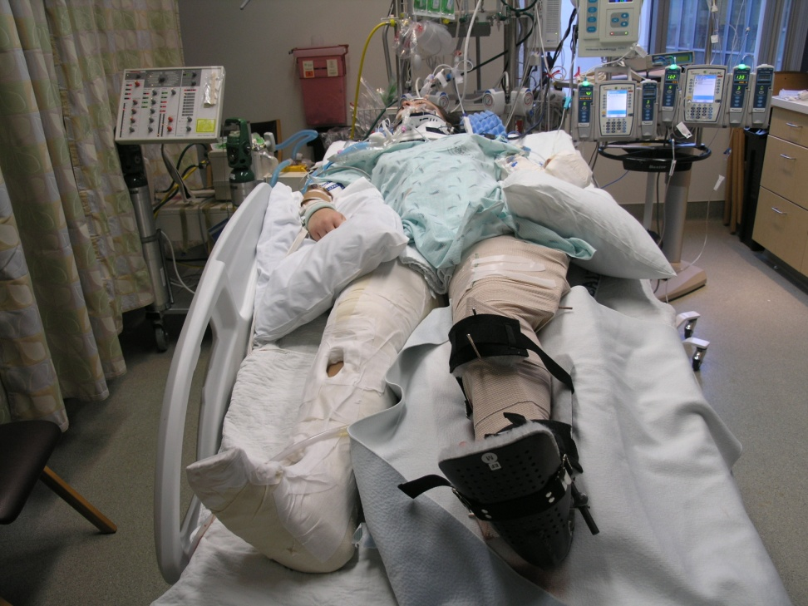
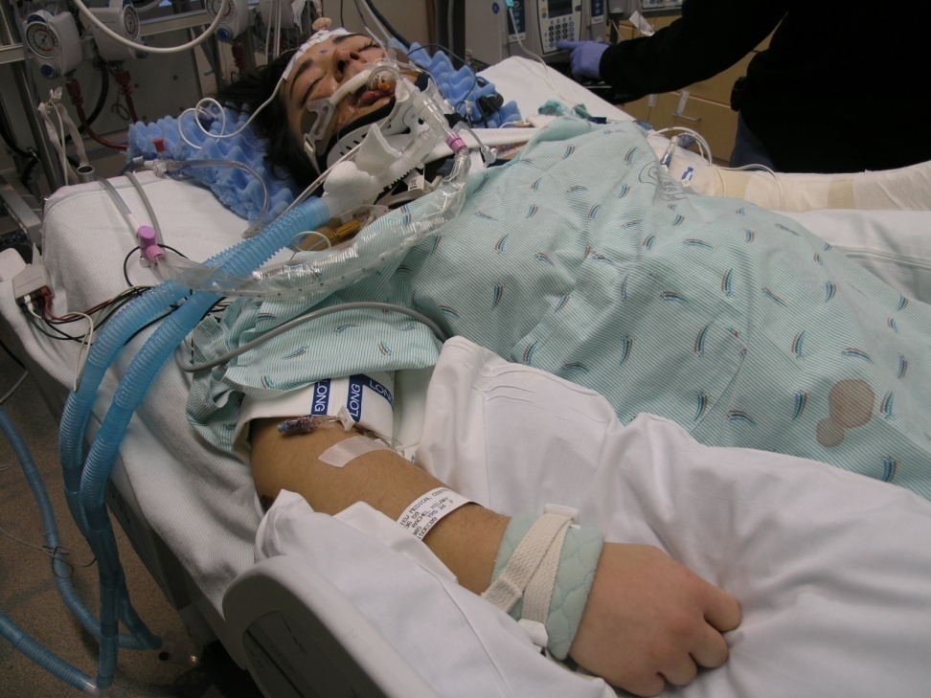
Rachel spent 5 months in the hospital recovering from her injuries.
The driver who hit Rachel was under the influence of Ambien and Oxy.
Notes:
At sentencing Janet asked for leniency stating she accidently confused her Ambien for her Oxy the morning of the collision and did not intend to drive under the influence. When Janet’s blood was tested it showed she had both Ambien and Oxy in her system. This would indicate that Janet took both prescriptions on the morning of the collision which contradicts Janet’s statement. As a result of Janet’s decision to drive impaired, Rachel, who did not take any drugs or alcohol that day, was the one to pay the price.
There were very minimal impairment observations noted in officer reports about Janet. Witness statements after the fact provided more insight into her level of impairment, but they are not experts.

Slide 14
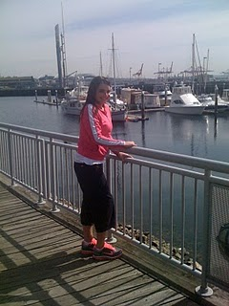
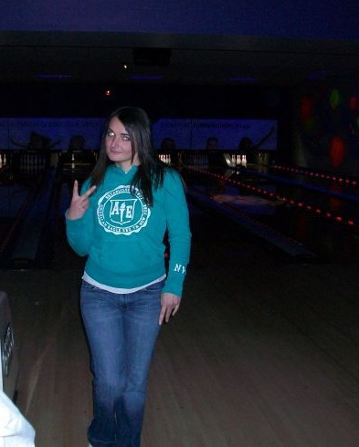
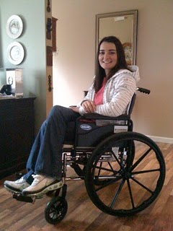
Rachel A Year After The Collision
Notes:
Rachel made a great recovery but will never be back to where she was before the accident. Rachel was a star college softball player and can no longer play. Janet received 6-10 months work release and 1 year community custody upon her release. It is interesting to note that Janet is eligible to qualify for an ignition interlock upon her release from jail so she can keep her license. Keeping that in mind the troubling fact is ignition interlock does not work when a person was impaired by drugs.

Slide 15

Rachel Three Years After The Collision
Notes:
2013 update…..Rachel got married this summer and was just hired as the an elementary PE teacher in the Bellevue School District, her dream hob and what she went to school for. She shows almost no outward signs of injuries she sustained but she said she does still suffer from stiff joints and has some physical limitations.

Slide 16
Communication and Coordination Components of a Successful Investigation
Investigators should communicate directly to DRE prior
to their arrival at the hospital or at the scene of the
collision.
This communication should be direct not through a
sergeant or dispatch.
DRE should communicate directly to CID investigator
regarding the observations made of the drivers,
evidence at the scene, and dynamics of the collision.
Notes:
If the DRE evaluates all the drivers, or at least makes observations it may show impairment on others then just the causing driver, it may help to explain things at the scene that did not add up. It may assist in determining if there was more then one driver contributing to the collision.
Discuss the pit falls of not talking directly…things are lost in translation…The CTS will be able to describe the dynamics of the collision better then a dispatcher…the sergeant has other things to focus on while at the scene.

Slide 17
Investigator’s Responsibility
Good communication with the DRE prior to the DREs’ investigation of any drivers
Description of the events of the collision
- slow response
- no response
- erratic/manic driving
- high speed/slow speed collision
- behavior after the collision
- any indicators of drugs or alcohol in the car
- i.e. drug paraphernalia, alcohol containers, ect.
Notes:
Is there other things that collision investigators can give the DRE to be helpful?

Slide 18
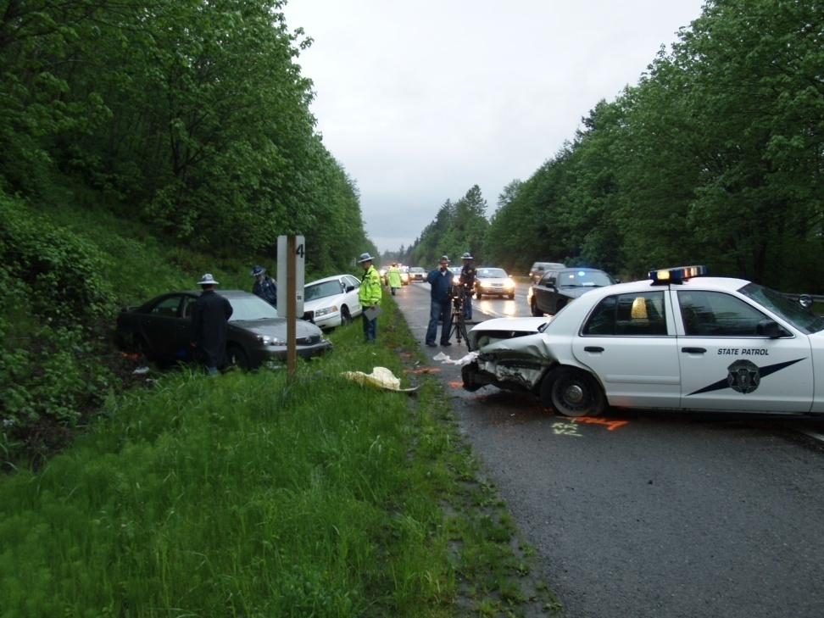
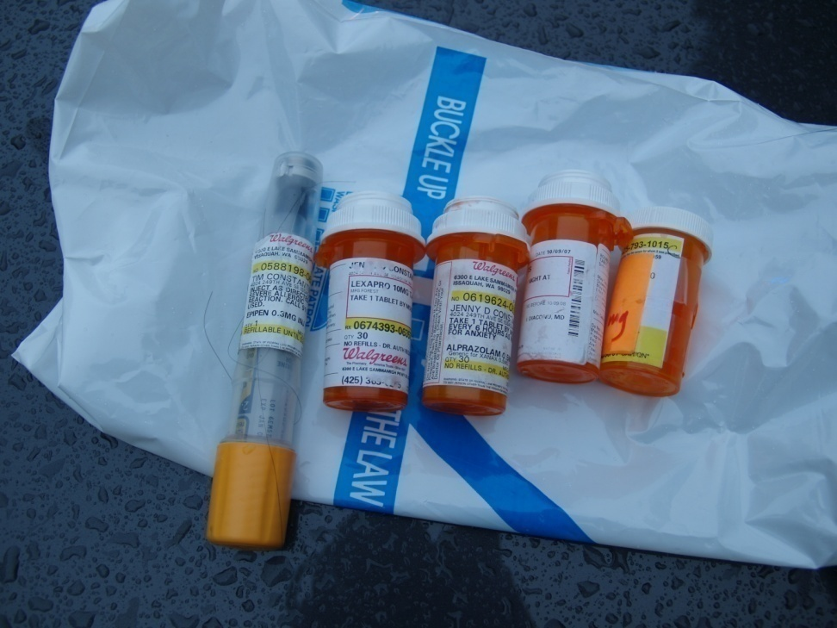
Pursuit/Assault collision
Notes:
*** Good example of communication*****
911 had received multiple calls of a possible DUI on I-90, the callers advised the driver was weaving all over the roadway. Trooper Olson located the vehicle and when he initiated a traffic stop the driver fled. Trooper Olson pursued the vehicle until the driver intentionally swerved at a Trooper who was on the shoulder attempting to deploy spike strips. The Trooper jumped out of the way and was narrowly missed by the suspect who then rear ended the Troopers vehicle on the shoulder.
There were two DREs at the scene. One DRE located multiple prescription medication bottles inside the vehicle. This information was passed on to the DRE who contacted the suspect. The DRE made good observations and wrote a detailed ROI explaining why a DRE eval was not completed and described what signs of impairment he was able to observe as the suspect laid unconscious on a back board. The DRE was able to say that the observations he was eventually able to make were consistent with CNS depressants which was consistent with the type of medication located in the vehicle.
There was good communication between someone at the scene and the DRE.
The suspect had tried to commit suicide. She was sent to mental health court rather then regular court.

Slide 19
DRE’s Responsibility
Evaluate the suspect driver
Evaluate all surviving drivers
Advise investigators of their observations
Write a detailed report; regardless of findings
Include a DRE evaluation form
Only if all 12 steps completed. If unable to complete
the 12 steps then the evaluation form is not
necessary
Notes:
Have a wrap up phone call conversation.
Ask what needs to be done with the surviving victims; i.e. Give them the investigators name or call them a ride or offer help.
Sometimes we might need your help to determine PC for a VA or VH and a blood draw. Other times we might have PC and will conduct the blood draw and then will still have you do the eval….Any concerns with this?

Slide 20
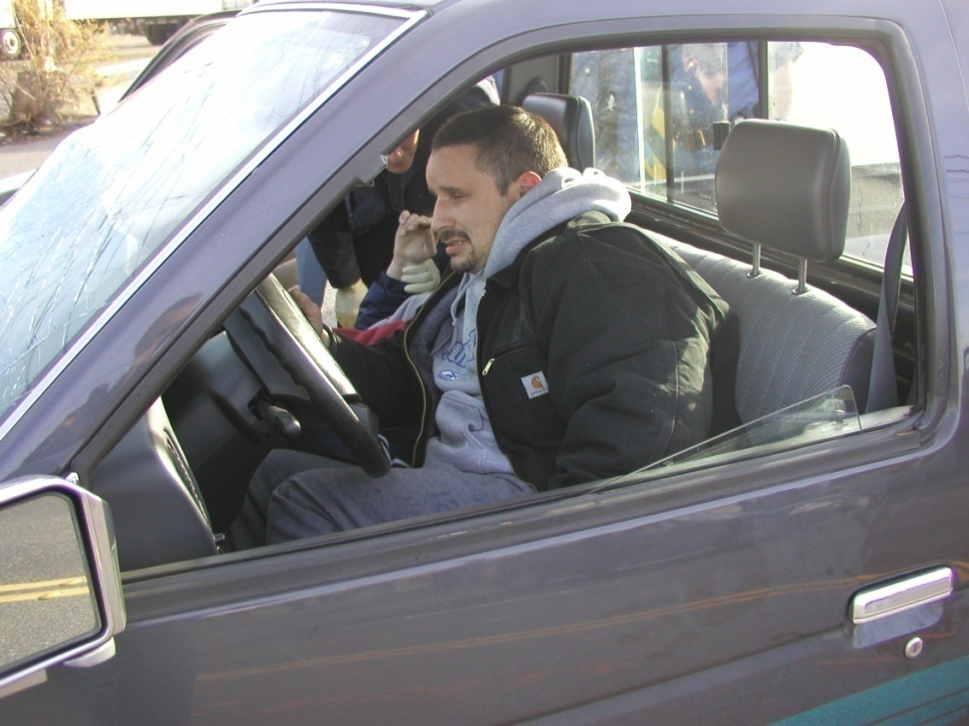
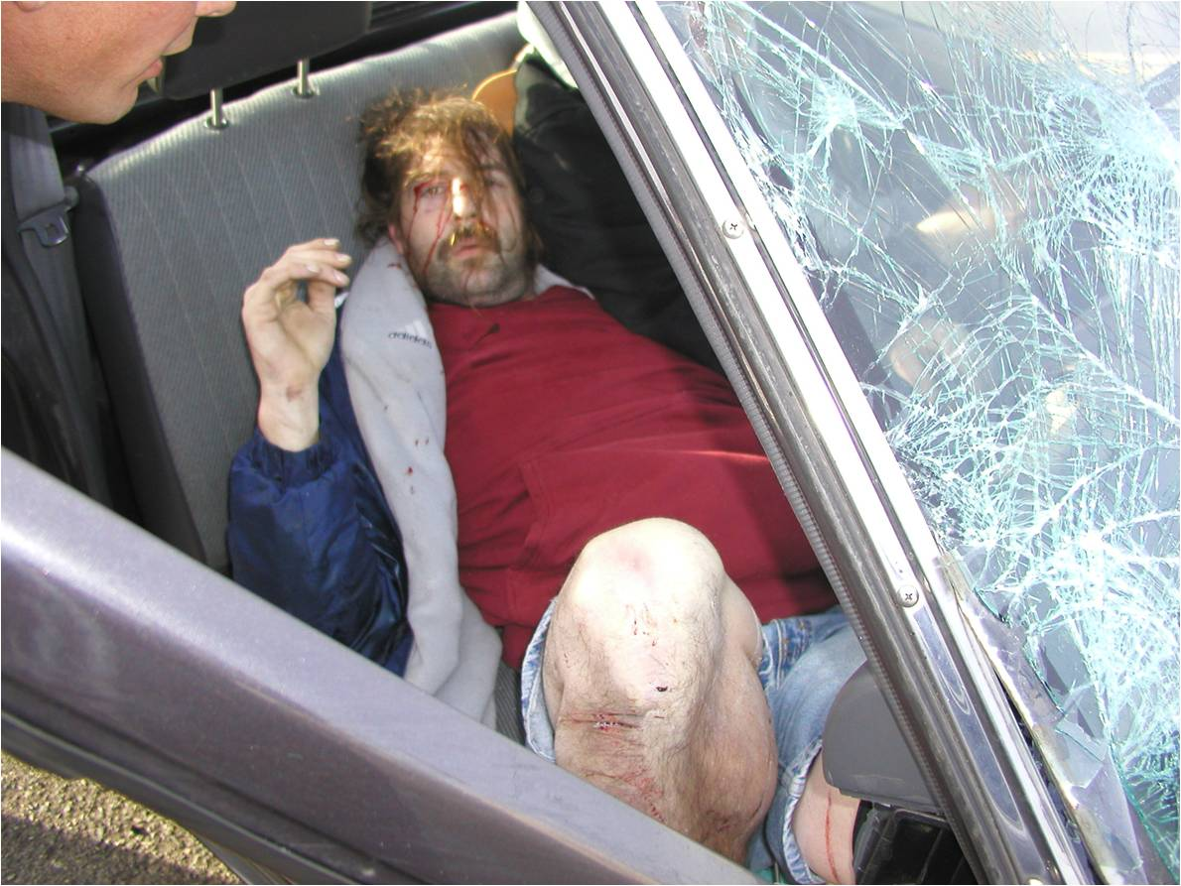
Don’t Do Drugs
Notes:
In this collision a trooper initiated a traffic in Seattle and the driver fled. He did not make it very far before he entered an entrance ramp going the wrong direction and was hit head on by a Roto Rooter truck. The driver was under arrest for felony eluding, and vehicular assault under the reckless prong. Why was a DRE evaluation not done in this collision. There was a DRE at the scene and yet no DRE eval was completed. We don’t profile but our experience would suggested that there might be drug impairment involved in this crash. Medical records on the passenger showed he was under the influence of Meth, we will never know what the driver was under the influence of because no blood draw was done. There was no communication between CTS and DRE, who again, was at the scene assisting.
It is important to look for the DUI prong in VA and VH because it makes any future DUI a felony. Don’t ignore the DUI part just because you also have another prong. We want repeat offenders to be held accountable in the future and if we fail to gather the necessary evidence then future DUI’s will be treated as misdemeanors.
According to the WSP reg. manual a DRE was required to respond to this scene. There was a DRE at the scene, but he did not do an evaluation or make observations while there. The DRE also failed to write a report about what involvement he took on in the investigation. This was a complete lack of a thorough investigation.

Slide 21
Types of Evaluations in Felony or Fatality Collisions
Full evaluation whenever possible
If injured or at the hospital
confirm identity
suspect information
preliminary investigation
eye examination
vitals
opinion
* If there is a refusal then write a detailed report of the observations you made during the contact. Contact the lead investigator.
Notes:
Opinion
- If possible give an opinion as to the type of drug
- If unable to determine type of drug then just ‘yes’ or ‘no’ or ‘undetermined’ for impairment
Important to relate injuries (seat belt marks) to make sure we are evaluating a driver and not a passenger. Head injuries are good pieces of information that needs to be shared with the DRE investigating or visa versa.
Nothing will make all persons involved look dumb or incompetent if we process a passenger for the crime and let the driver escape the proper or same evaluation.

Slide 22
When Evaluations Cannot Be Done
Explain in detail why
- Too injured
- Medical treatment
- Time lapse (blood dirty from treatment, drug effects are diminished)
Write a detailed report as to why an evaluation
cannot be done and explain the observation you
made during the contact

Slide 23
“It Is My Opinion As A Drug Recognition Expert That…..”
DREs have the authority to have an opinion of
impairment
DRE’s can give an expert opinion of why this is
their conclusion.
DRE’s opinions can be tied to why it is consistent
with the dynamics of the collision
Notes:
****This is where our two jobs really come together to complete a thorough investigation*****
Different findings….impaired, not impaired, unable to determine impairment…..
DREs also have the authority to say a person is ‘not impaired’ and can reach an expert opinion of why this statement is true.
Final opinion is UNABLE to reach an opinion and that is due to……….
*Don’t label this one as ‘not impaired’, there is a difference.
If your not sure then don’t make a “No impairment” conclusion. Explain why you cannot reach a reach a conclusion, i.e. back board, pain meds, head injury….

Slide 24
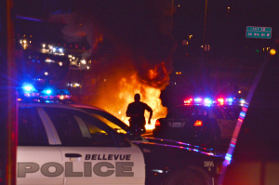
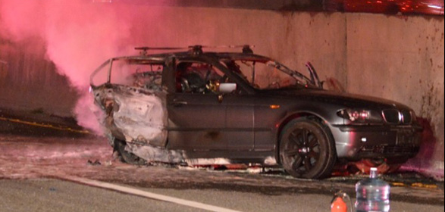
DRE Evaluation Finding
“Not Impaired”
Explain your conclusion
Because they’re not impaired?
Because you cannot do a sufficient
evaluation to make judgment?
Because of time lapse?
Because medicine was administered by
hospital or medics?
Notes:
Did the CTS/CID miss something in the information they
passed on from the scene that could be helpful for you to
reach a conclusion?
Are there follow up questions that need to be asked of
those at the scene?
What about…Undetermined……not able to complete enough of an eval? Injured? Explain

Slide 25
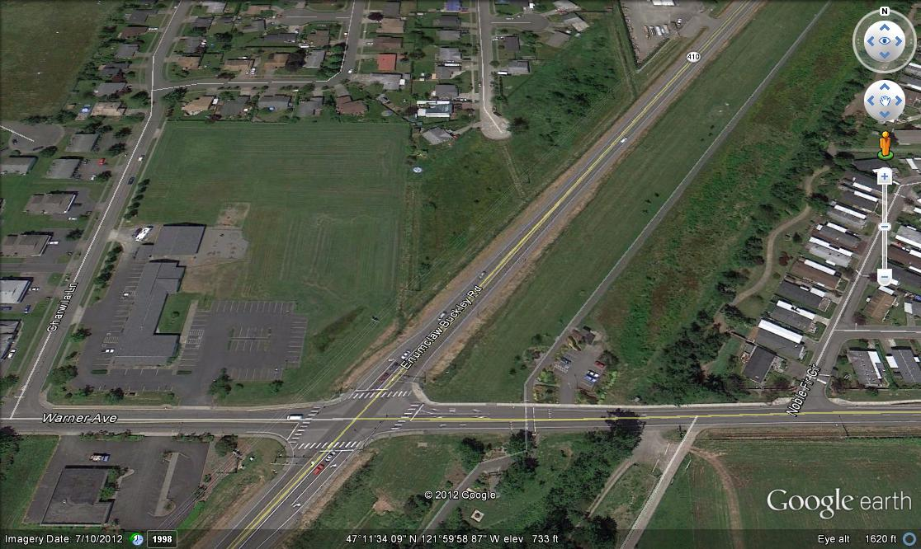
Car vs. Ped Vehicular Homicide
Notes:
Victim and his girlfriend were walking holding hands on the shoulder of a rural state route in King County when the suspect drifted onto the shoulder striking the victim. The victims hand was ripped out of his girlfriends hand as he was struck by the vehicle, she was uninjured. The collisions occurred in November 2012 at 1955 hours.
****Case NOT adjudicated*****

Slide 26
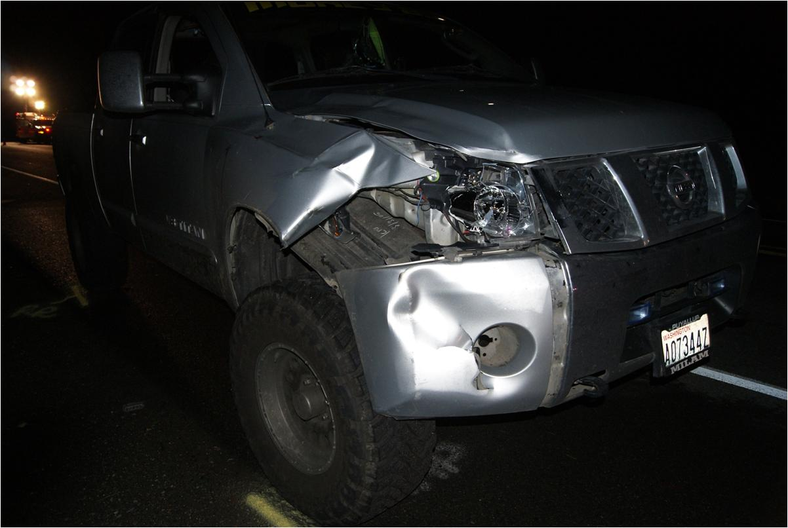
Suspect struck the deceased with the right front corner of his pick-up truck.
Notes:
A couple of more inches and there would have been a second fatality, victims girlfriend.

Slide 27
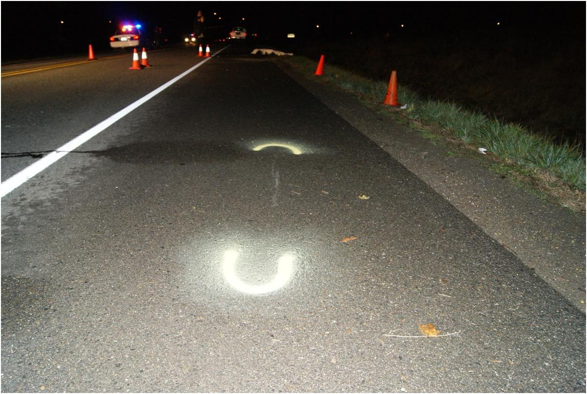
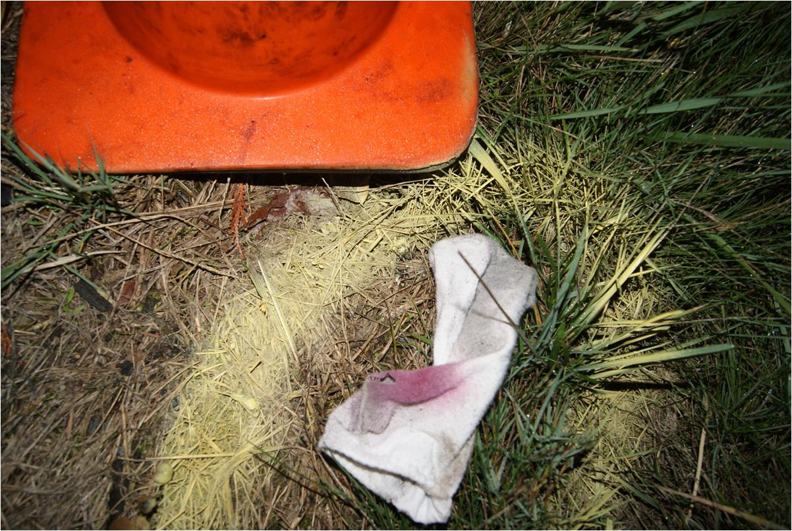
Smear from victims sock
Evidence places the victim 4 feet off the roadway clearly on the shoulder
Victims sock

Slide 28
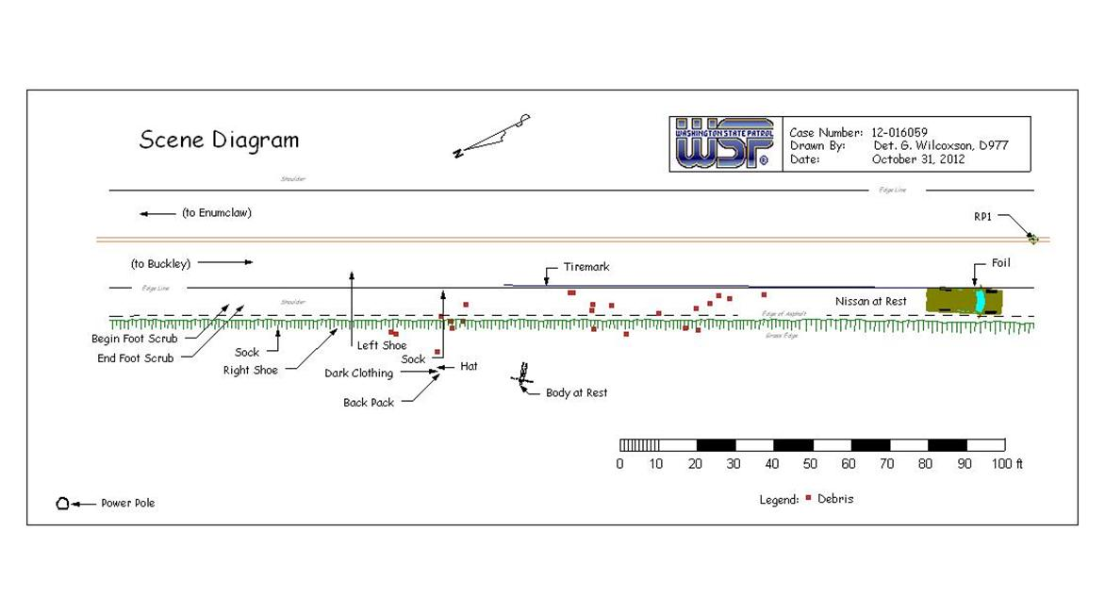

Slide 29
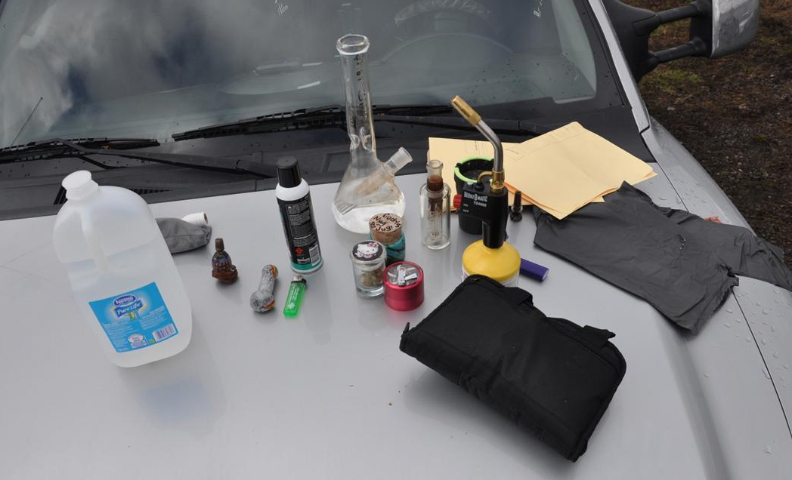
Paraphernalia located in the suspects vehicle
Notes:
Many of these items were visible in the vehicle at the collision scene. They were removed pursuant to a search warrant

Slide 30
Signs of Impairment
Lane travel on straight, level roadway
Inattention
Driving on shoulder – 4.5 feet over fog
line
Post crash braking only
Changing story on pedestrian location
(3rd officer)
Cell phone records of drug activity
Routine toker
Frequent pot user
Possession of marijuana inside
vehicle
Admittance of smoking marijuana
within last 4 or 5 hours
“Prescription” expired
As of current law, under age
Suboxone (3rd officer, 2nd officer) –
differing times taken
Drug paraphernalia inside vehicle
(grinder, torches, etc.)
Never called 911 on his phone
Constricted pupils
Face flushed color (1st officer)
Walk and turn
Did not touch heal to toe on all
steps (1st officer & 2nd officer)
Improper turn (1st officer)
Stepped off the line up and back
(2nd officer)
Modified finger to nose (2nd officer)
Right index finger, ¼-inch to the
right of the tip
Watery, bloodshot eyes (2nd officer) –
crying
Noticeable eye lid tremors (3rd officer,
2nd officer)
Romberg balance forgot to say “stop”
(2nd officer)
Highly emotional (crying, jumping up
and down)
Elevated pulse (2nd officer)
Right eye lack of convergence (2nd
officer)
Notes:
These are the observations made by the officers at the scene, many of them by the DRE as well, based on this it is hard to understand how the DRE came back with a ‘NOT impaired” opinion. The official eval was done a while after the incident, my understanding is that marijuana is a tough one to evaluate but even with all these signs of impairment the finding of not impaired destroyed this case.
I am not trying to knock the DRE, they made a determination but that does not explain away the above list observations when they make a not impaired determination.

Slide 31
Positive toxicology results
Oxycodone (0.17 mg/L)
Carboxy-THC (140 ng/mL)
THC (9.5 ng/mL)]
Notes:
Suspect willing to agree to plea guilty to DUI, and reckless endangerment but not to the VH. He was going to plea to the VH until the DRE report said not impaired, even though there is substantial evidence of impairment.
How, with all these signs of impairment does that equal not impaired? Unfortunately these two words destroyed this case. Clearly he has drugs in his system, Oxy and Marijuana, but this evidence will never be admitted into court because of two words, not impaired, that don’t match up to the physical evidence.

Slide 32

When to Do The Blood Draw?
Immediately
Notes:
If you have PC to arrest for vehicular assault or vehicular homicide then you can draw the blood (absent exigent circumstances get a warrant)
DRE evaluation does not dictate whether a blood draw is done.
If you don’t have PC for VA or VH then wait for DRE.
Remember that once under arrest then Miranda must be read before DRE eval.
If we, the investigator, have PC then we will direct the officer at the hospital to conduct the blood draw immediately even if DRE eval has not been done yet.
***remember once under arrest then miranda must be read before eval.

Slide 33
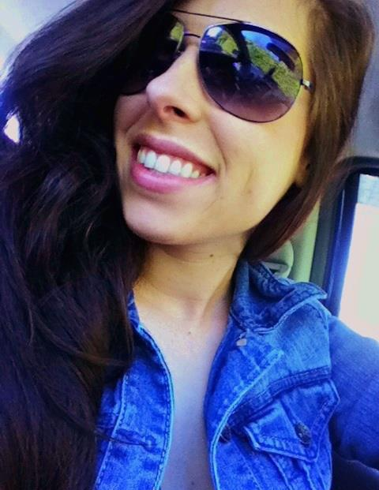
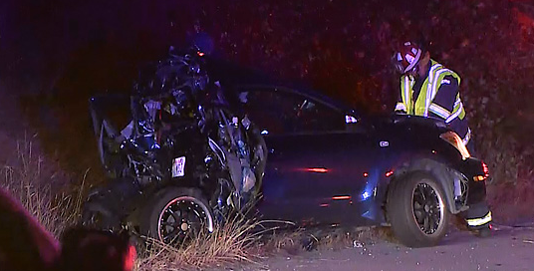
Voluntary Blood Draw
After an opinion of NO IMPAIRMENT is reached:
Ask for a voluntary blood draw on non-causing driver
EXPLAIN: Protects them in future civil cases
Shows thorough investigation
Notes:
Occurres regularly in car/ped collisions. Do not ask for voluntary if there is felony charges, get a warrant.
Commercial Motor Vehicles are/MAYBE mandated to submit to certain medical tests but we should also request voluntary blood sample.
In this 405 crash a DRE eval was done on the driver of the semi and it was determined that he was not impaired. The driver was asked to submit a voluntary sample and he did. The blood confirmed the DRE’s conclusion of Not Impaired.

Slide 34
Documentation of Signs of Impairment
The DREs are only part of the investigation; yet an integral part. DREs are the experts dealing with impairment or non-impairment.
DRE’s are responsible for documenting signs
of impairment
Notes:
DREs are not necessarily there to determine Probable Cause but to document sign of impairment
Don’t depend on the DRE, Troopers can still make observations and determine probably cause.

Slide 35
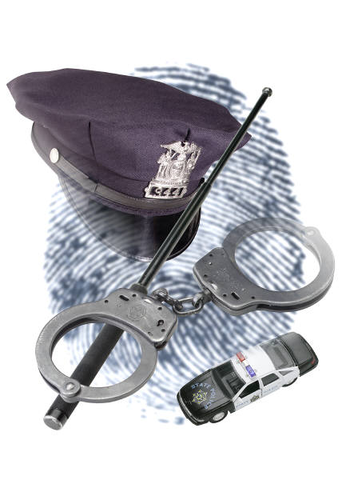
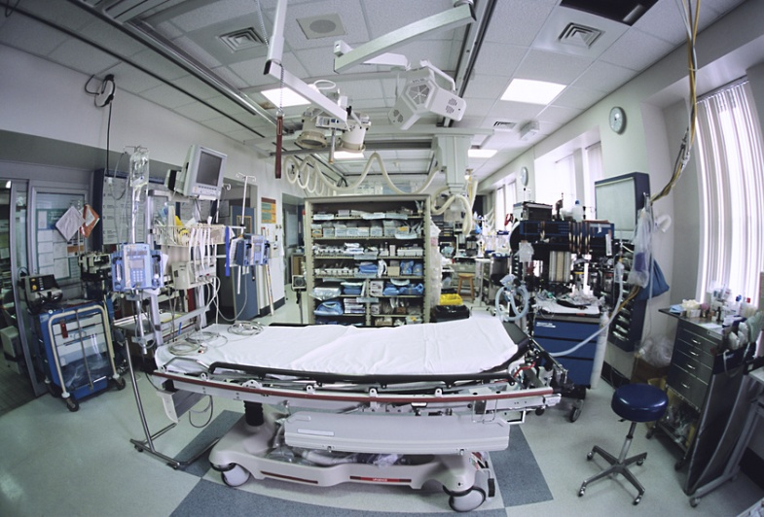
Hospital Etiquette
Hospital responsibility
POLICE RESPONSIBILITY
Notes:
Hospital responsibility
If a suspect is brought in for a blood draw then they are required to treat the
suspect as a patient and triage them.
If signs of trauma then they need to clear them medically before the blood
draw may be done
Police responsibility
Check in with the head nurse.
Explain to the hospital staff why you are there.
Explain they are under arrest for VA or VH and do not have the right to refuse once the warrant is obtained or if exigent circumstance are present.
Be patient but explain the time constraint.
If the Staff is uncooperative then ask for the head nurse to respond.
Be polite! Report any issues to the scene or lead investigator.
It’s not a good or normal practice to THREATEN to arrest hospital staff or EMS personnel if legal blood draws are not obtained or the AUTHORITY of the officer is questioned.

Slide 36
H.I.P.A When can information be released
When necessary to minimize an imminent danger.
When necessary to identify or locate a suspect, fugitive,
material witness, or missing person.
When it is follow up to a case initially reported by police.
When the information relates to the discharge of a patient and
police request notification of release of the patient.
The information relates to the victim of a crime and involves
minimization of imminent danger.
Notes:
Anytime you investigate a collision and aid transports the injured from the scene, according to HIPA you have directed the person to the hospital so they have to release certain information to you. They should provide name, location in hospital, and extent of injuries. They do not have to tell you every injury just the over all extent of injuries.
We have had issues in the past with officer threatening to arrest nurses and doctor, we DON’T want to do this. The head nurse can help a lot so if you are having problems ask for the head nurse.
Discussion

Slide 37
Clearing The Scene Or Hospital
DRE and Lead Investigator should have ONE last conversation prior to clearing the investigation.
Final permission should be noted in the officer’s/Trooper’s report on the ‘official release’ from investigating further.

Slide 38
Conclusion
When Should This Training Be Used?
At any and all serious (debilitating) injury, fatality, vehicular homicide, and vehicular assault collisions
Why?
Because it’s our job, duty, and oath
The public expects and deserves a thorough and complete investigation
Sometimes even victims actions play a role in the collision and
impairment needs to be investigated
Helps cover the victim if they are not impaired
Notes:
MAYBE had the victim NOT been impaired this collision could have been avoided or changed the outcome. There can be mutually exclusive causes in the collision or charges. Victim can still be DUI and have another pull out in front of their vehicle that leads to fatal collision of the one who failed to yield.
Sometimes what would normally be a fatality collision is prevented because of medical treatment. Doesn’t mean we will ignore the proper investigation. Just because you think the causing driver might die, complete as thorough of a job as you can because they might survive.

Slide 39
Why is this training important?
Notes:
Any ideas?
Discussion…..
Because we are dealing with life and death. We are there to gather the evidence to speak for those who no longer can. We are there to get information. Because it is our job!

Slide 40


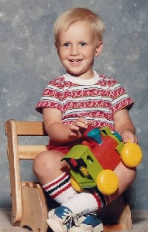
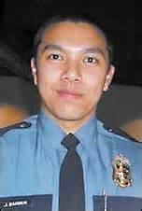
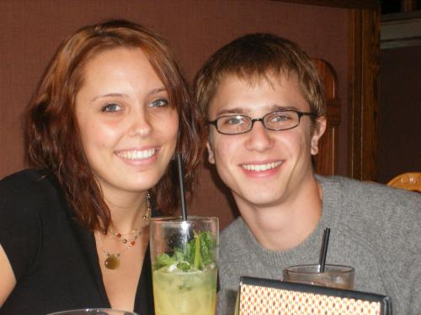

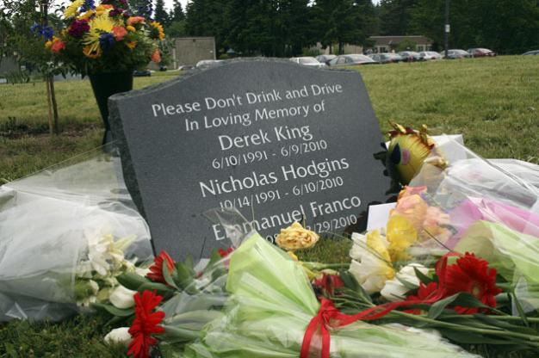
Because of them

