Slide 1
2012

Slide 2
National Conference
August 15-18th, 2012
Westin Hotel/Silver Cloud Hotel
This will be our DRE In-Service
Notify your SGT and/or lock in your schedule
Attempting to send as many DREs as possible
(200-230) Currently 242 DREs now

Slide 3
Roommates
I will use this years lodging list to be the starting point for the conference
UNKNOWN if single rooms will be available or affordable to the DRE Program
Please Read emails on the topic and respond
Thanks!

Slide 4
Video

Slide 5
WSP TAR Code #20
Measuring DRE activity

Slide 6
Once upon a time……
Current trend is the counting of all activity by DREs by looking at their Alcohol DUI arrests
DREs where accepted and selected because they were self-starters and had produced well in DUI arrests
As a DRE those numbers may appear to have dropped. It is okay to ask WHY?
The only measurement device is Alcohol DUI arrests made by the individual.
Missing the effort made in finding, assisting, or processing, and other DRE duties.

Slide 7
Measurement Uncertainty
Is it proper to measure a DREs production or involvement in DUI arrests by only using these?
Self-Initiated stops
Calls for service
Alcohol Arrests
Simple Answer: NO!

Slide 8
And the winner is!?
Who get’s the credit for the DUI when a DRE does a full evaluation on a suspect?
Is it possible to do a DRE evaluation and still make traffic stops or DUI Arrests?
Is arresting DUIs important?
Is arresting Drug Impaired Drivers Important?

Slide 9
STAT CODE 20
Uses 7 Fields –See Sheets
Variety of DATA is gathered
One of the hardest I fought for is TIME (Field 7)
Time code 3170 is still in effect.

Slide 10
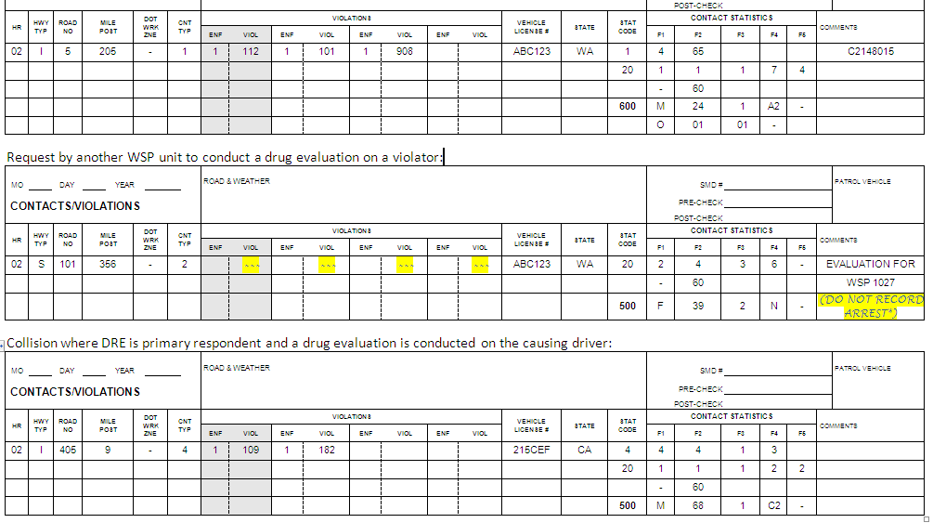
EXAMPLES

Slide 11
USE THE TAR CODE NOW
Tell YOUR SGT about it
Talk to your Office staff about it as well
Let me know if issues are discovered

