Slide 1
DRE/SFST Instructor In-Service
September 20, 2011
Sgt J.P. McAuliffe

Slide 2
DRE Instructors preparing for 2012
There will be no DRE Schools for this WTSC grant cycle.
In return we will be hosting the 2012 DRE National Conference in Seattle August 15-18th.
GOAL:
1) Generate some enthusiasm and reward principles in the WA DRE Program.
2) Deepen the DRE School applicant pool for the next DRE School in late 2012/early 2013.

Slide 3
DRE Says “What?”
PAST
An area makes a request
Instructors asked for
“Help, I need……”
Class is finalized
Daily Bulletin, ACCESS, CJTC web site
Class is taught
Training hours reported to DRE Program
FUTURE
INSTRUCTOR will clear their schedule
Lead Instructor will seek staffing and location
(this is the challenge)
Class is finalized
Daily Bulletin, ACCESS, CJTC web site
Class is taught
Training hours reported to DRE Program

Slide 4
Wait…the world is ENDING, right?
DRE Instructors will be challenged to instruct the many different facets of DRE.
1) ARIDE
2) Community Events /Requests
3) DID
4) DITEP
5) Roll Call Training
6) Generate your own (Moses Lake Example)

Slide 5
What’s in it for me?
DRE State Coordinator/ 2012 DRE National Conference Committee will be deciding:
Who’s attending
Lodging location
Conference participation or assignment
2012 DRE Instructors Priority:
The support of the DRE curriculum but also the overwhelming support to the SFST Instruction too!

Slide 6
SFST Program
Sergeant John McAuliffe

Slide 7
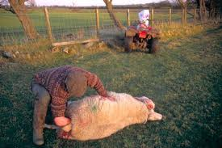
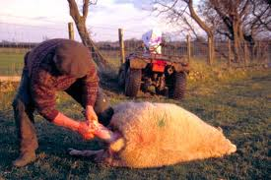
…how we got started

Slide 8
SFST Instructors
What can they teach?
What they cannot…
SFST Basic
SFST Refresher
SFST Instructor Development
Wet labs
SFST proficiency check-offs at A.R.I.D.E.
Drug Impaired Driving (DID)
A.R.I.D.E. (except proficiencies)
DRE curriculum

Slide 9
SFST Program Annual Report
68 New SFST Instructors
159 SFST/DUI classes taught
1138+ Students trained
CJTC now incorporates wet labs into their curriculum
Central electronic database that records all officers and their SFST/DUI training

Slide 10
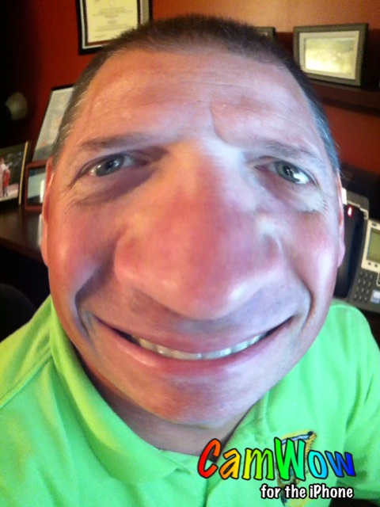
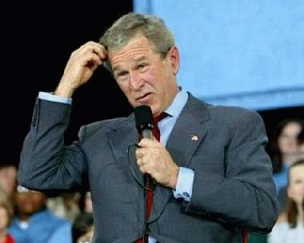
SFST Refresher
What is it, and who needs it?

Slide 11
WTSC Requirements
Mandated for all WSP F.O.B. personnel
Contractual for allied agencies who want overtime
September 2013 cut-off
If you were DRE or ARIDE trained between 2010 and the present, you are good to go!

Slide 12
SFST Refresher
4 or 8 hour block?
SFST Proficiency is included
Flexibility to personalize the NHTSA version

Slide 13
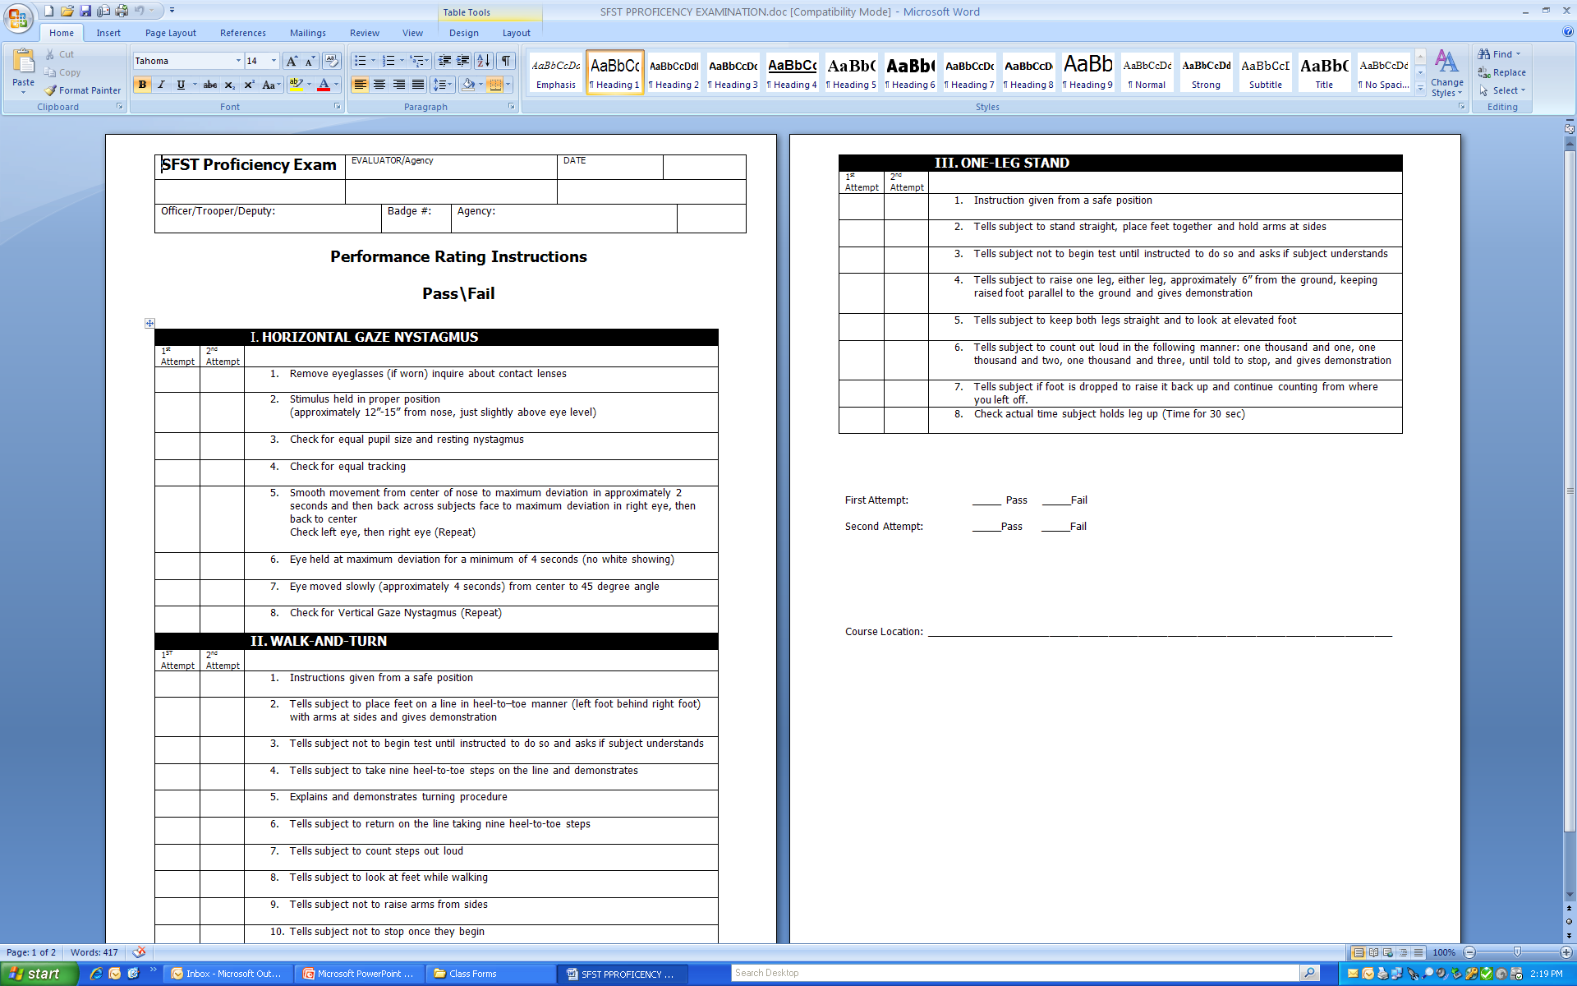
SFST Proficiency

Slide 14
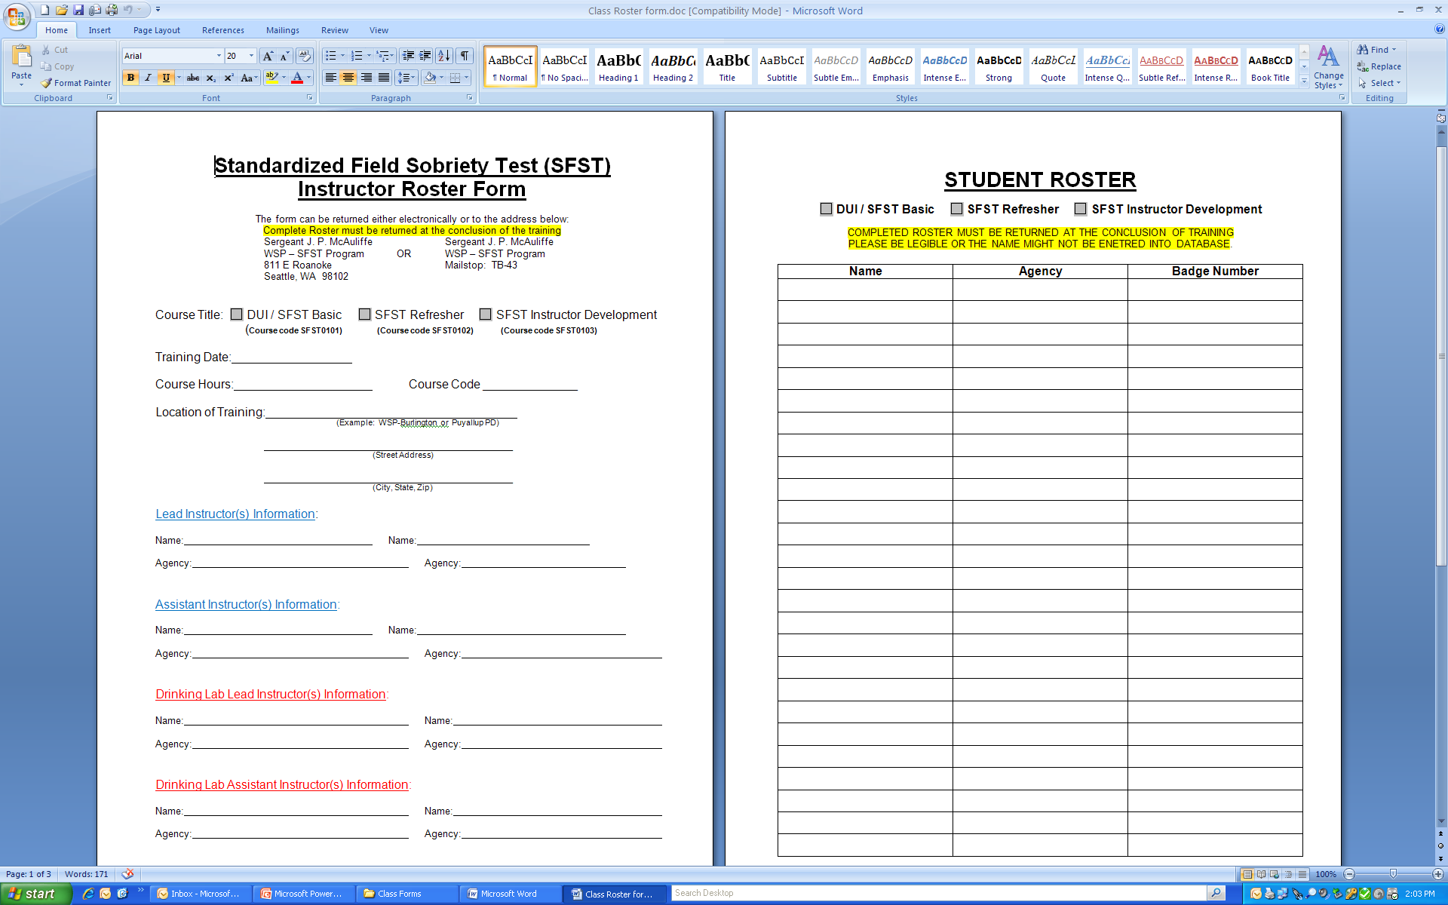
Class Roster

Slide 15
Course Codes
SFST Basic – SFST0101
SFST Refresher – SFST0102
SFST Instructor Development – SFST0103
TSRP Regional Academy Training – TSRP0104
SFST Instructor In-Service – SFST0105

Slide 16
Πλεασε ωριτε λεγιβλψ
Please write legibly
Please write legibly

Slide 17
Entering classes into database
E-train

Slide 18
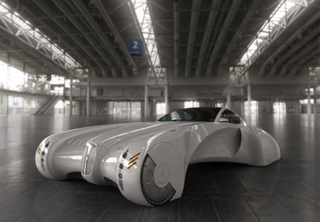
What’s ahead in the future?

Slide 19
Impaired Driving Website
Public Access
Law Enforcement – On-line training, DUI updates, FAQ’s
SFST Instructor – Course curriculum, class schedules, training hours
SFST Coordinator

Slide 20

Target Zero

Slide 21
Alcohol/Drug Caused Fatalities

Slide 22
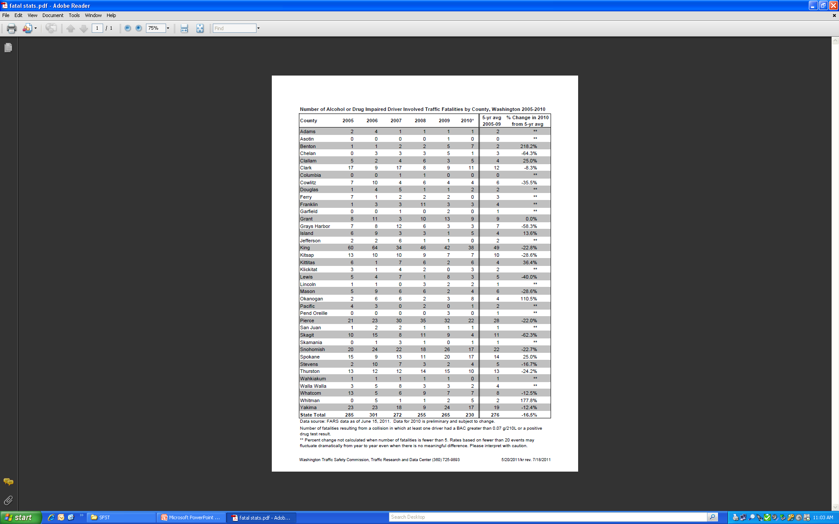

Slide 23




Target Zero Teams Project
Month 12 Progress Report
Lowell Porter, WTSC
TZTP Project Manager
July 28, 2011

Slide 24




Target Zero Teams Project
Desired Outcome
Project goal: 80 fewer traffic deaths in King, Pierce, and Snohomish Counties –.
This goal—a 40% reduction—is based on the Nighttime Enforcement Emphasis Team (NEET) Pilot Project conducted in Snohomish County.

Slide 25
Target Zero Teams Analysis
At the current rate we meet or exceed our original 24 month projections.
County | Originally Projected Reduction | 12 Mo. Actual Reduction | New 24 Mo. Estimated Reduction | % of 24 Mo. Projected Reduction
King | 38 | 44 | 88 | 232%
Pierce | 28 | 18 | 36 | 129%
Snohomish | 14 | 8 | 16 | 114%
Totals | 80 | 70 | 140 | 175%

Slide 26
Target Zero Teams Project
County Outcome Analysis:
We project a $336M reduction in crash costs. (FHWA Cost Estimates, 2007).
County | 12 Mo. Actual Fatal Red. | Fatal Crash Cost | Crash Cost Avoidance
King | 44 | $4.2 Mill/ Fatality | $184,800,000
Pierce | 18 | $4.2 Mill/ Fatality | $75,600,000
Snohomish | 8 | $4.2 Mill/ Fatality | $33,600,000
Totals | 70 | - | $294,000,000

Slide 27


TZTP Output
Analysis Through Month 12
The WSP TZTP Trooper productivity through the first 12 months of the project:
Outputs | Pierce | King | Snohomish | Total
DUI Arrests | 1,049 | 1,344 | 1,110 | 3,402
Speeding | 764 | 870 | 1,737 | 3,371
Seat Belts | 440 | 233 | 260 | 933

Slide 28
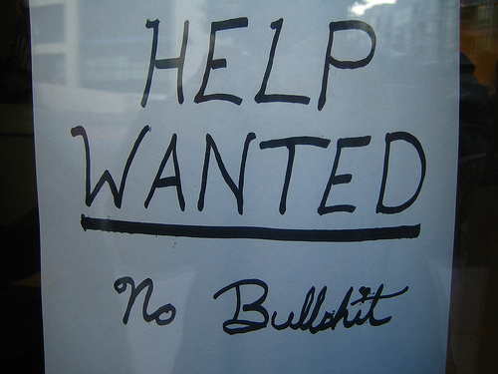
SFST wants your help…

Slide 29

Impaired
Driving Section
Seattle:
206 720-3018
TSRP
DRE
IIL
BAC
SFST

Slide 30
Miscellaneous stuff…
Class schedules
Teaching/Training hours
Updated Resumes
CJTC Wet lab/10/11/11 WSP Wet Lab – 11/03/11
“Additional Tests?”
SFST Instructor Development Class – 11/14 – 11/18, 2011

Slide 31
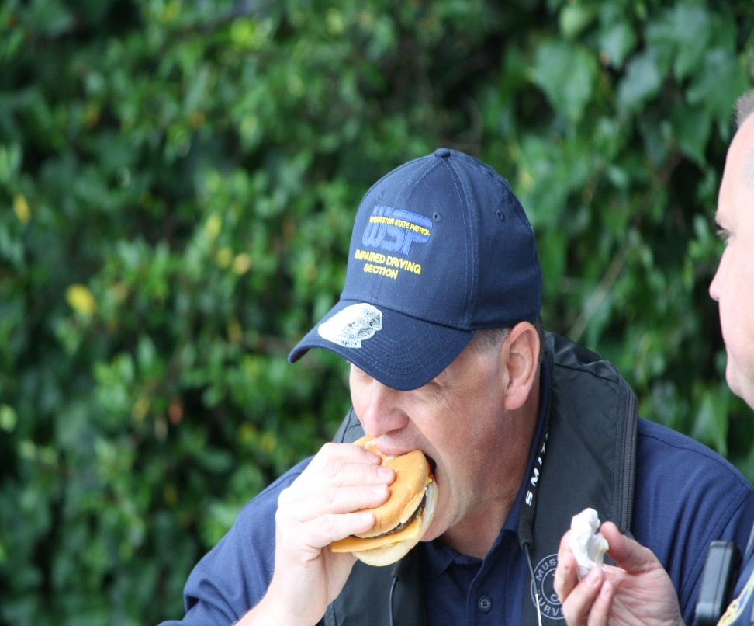
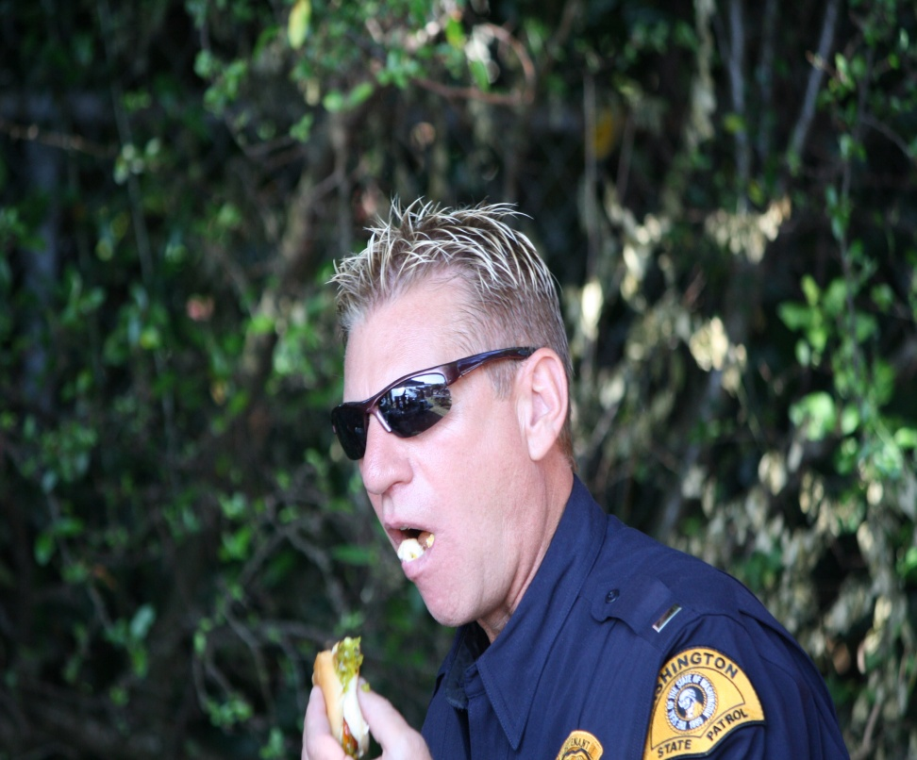
Let’s take a break!

