Slide 1
Impaired Driving Presentation
DRE In-Service
September 21, 2011

Slide 2
Introduction
Trooper Ryan Raymond
Washington State Patrol
Sergeant Josh Sainsbury
Grant County Sheriff’s Office

Slide 3
Reasons for the Project
4 fatality collisions from July 15, 2010 to February 19, 2011
7 kids from ages 15 to 18 and another at the age of 22 (8 total fatalities)
All 4 collisions involved speed (slowest measured at 96 mph)

Slide 4
Solutions
15 schools contacted in Grant County
21 presentations
5,890 attendees with majority being student body and faculty
Used 2 crashed cars as educational tools
Moses Lake Memorial Parade Day and Grant County Fair
Obtained a grant from State Farm Ins Co
Obtained trailer signage from Signs Now

Slide 5
Project Intent
Change 1 students choice per school
The reality of impaired driving and collisions that occurred within our local communities
Change the perception of local law enforcement

Slide 6
Our Presentation
1 hour assembly
Introduction
Qualifications (DRE explanation)
DUI Laws and DRE Drug Catagories
Overview of Local State and County collisions resulting in fatalies
Our Request
Closing & Questions

Slide 7
Drug Categories
CNS Depressants
Prozac, Soma, Ambien, Xanax, & Diazepam
CNS Stimulants
Methamphetamine, Cocaine, & Adderall
Hallucinogen
LSD, Psilocybin Mushrooms, & Ecstasy
Dissociative Anesthetic
PCP & Ketamine

Slide 8
Drug Categories continued
Narcotic Analgesic
Heroin, Vicodin, Oxycontin, & Methadone
Inhalant
Gasoline, Paint, & Dust Off
Cannabis
Marijuana & Hashish

Slide 9
DUI
Driving under the influence of alcohol and/or drugs
Legal Limit .08 (over 21)
Legal Limit .02 (under 21)
No Legal Limit with Drugs

Slide 10
WARNING
THE FOLLOWING PRESENTATION WILL SHOW GRAPHIC PICTURES OF ACTUAL CRASHES AND DECEASED SUBJECTS INVOLVED. FEEL FREE TO LOOK AWAY OR LEAVE IF NEEDED. YOU MAY KNOW PEOPLE INVOLVED IN THE COLLISIONS.
All collisions shown in the presentation occurred in Grant County and are a result of alcohol and/or drug impairment.

Slide 11
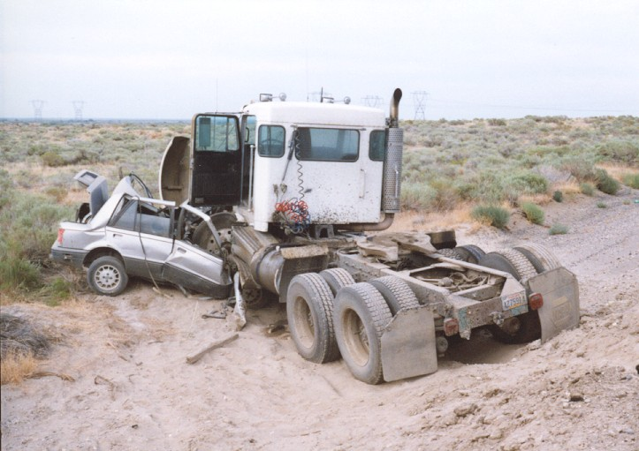
Vehicle vs. Semi
Frenchman Hills Rd, North of Royal City
Notes:
Frenchman Hills Rd between Dodson Rd and Rd J SW

Slide 12
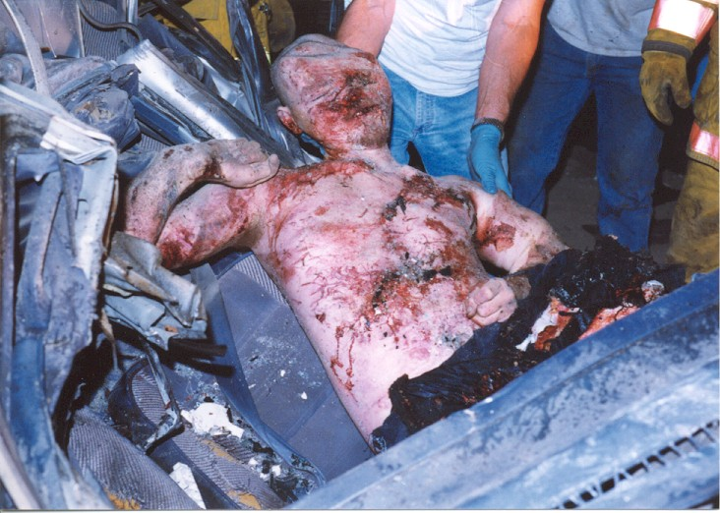
DUI Drugs LSD & Methamphetamine

Slide 13
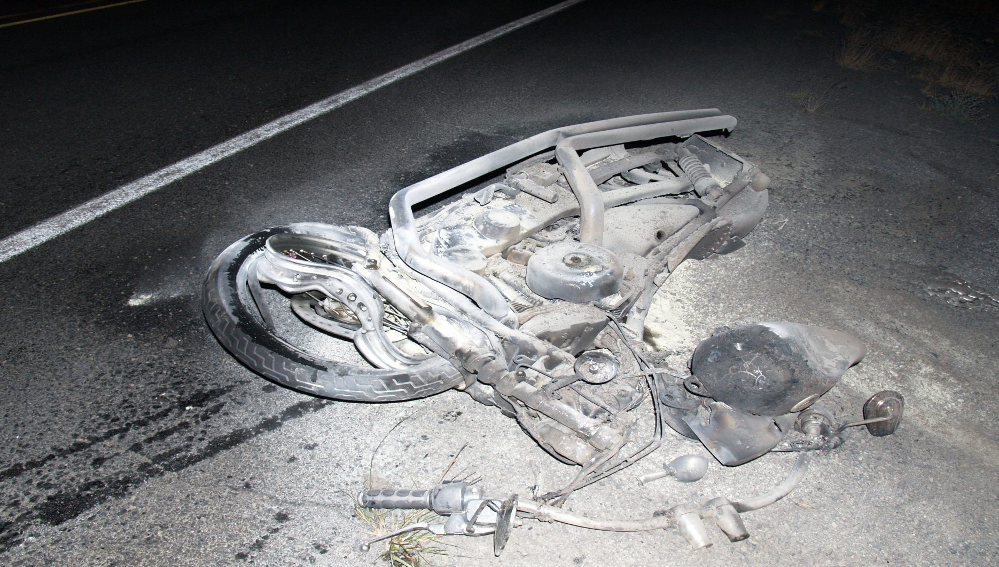
Vehicle vs. Motorcycle
SR 17, North of Soap Lake

Slide 14
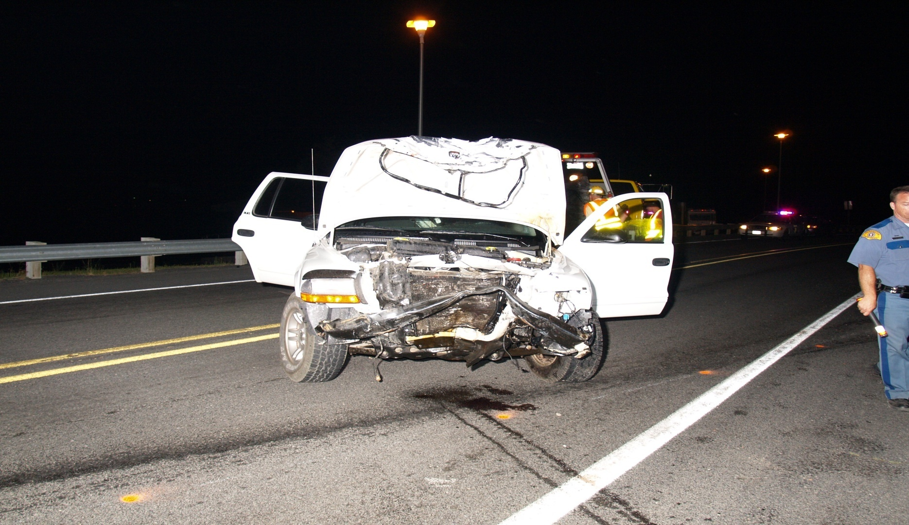
Vehicular Homicide Marijuana & Alcohol

Slide 15
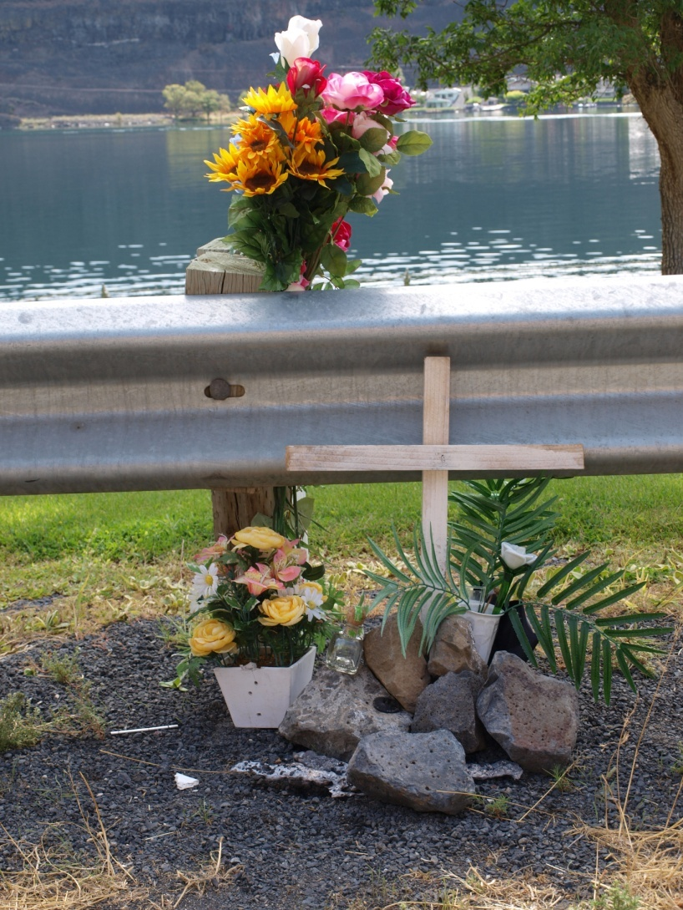
Victim Memorial

Slide 16
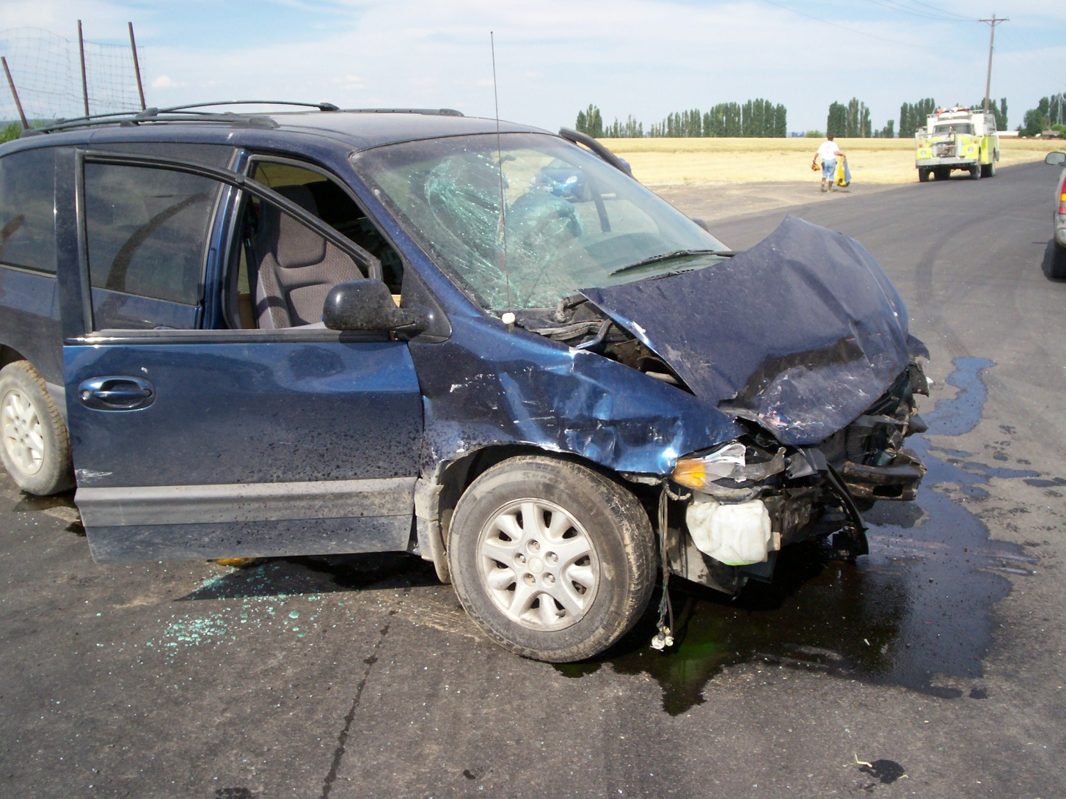
2 Vehicle Collision 2 Fatalities & Alcohol Involved
RD 13 SE @ RD D SE, East of Royal City

Slide 17
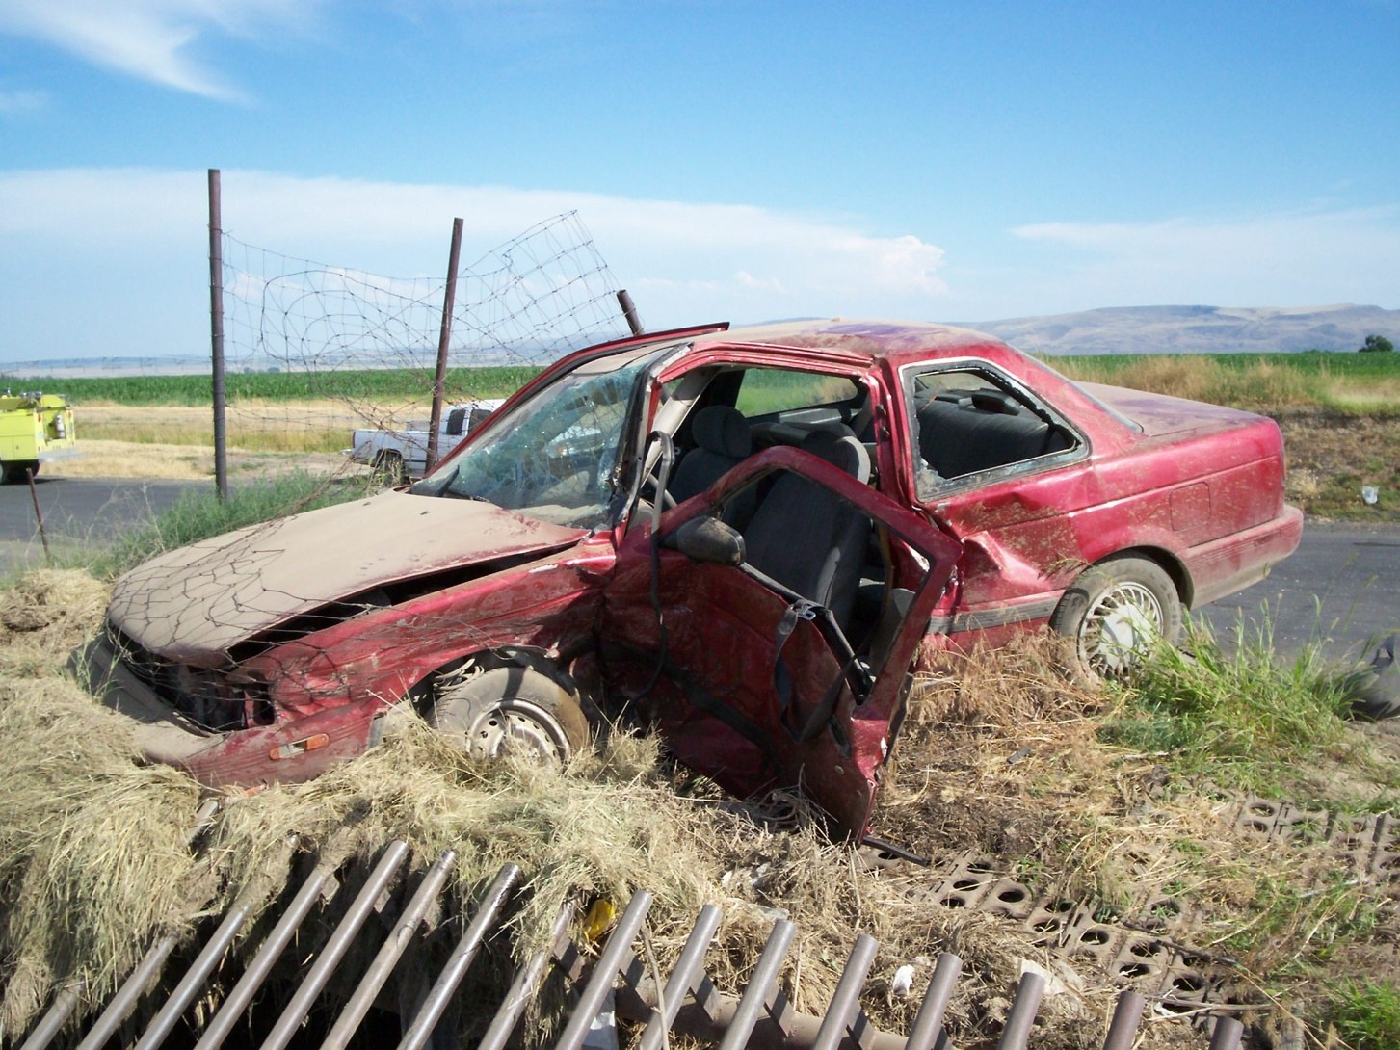
Victim Vehicle

Slide 18
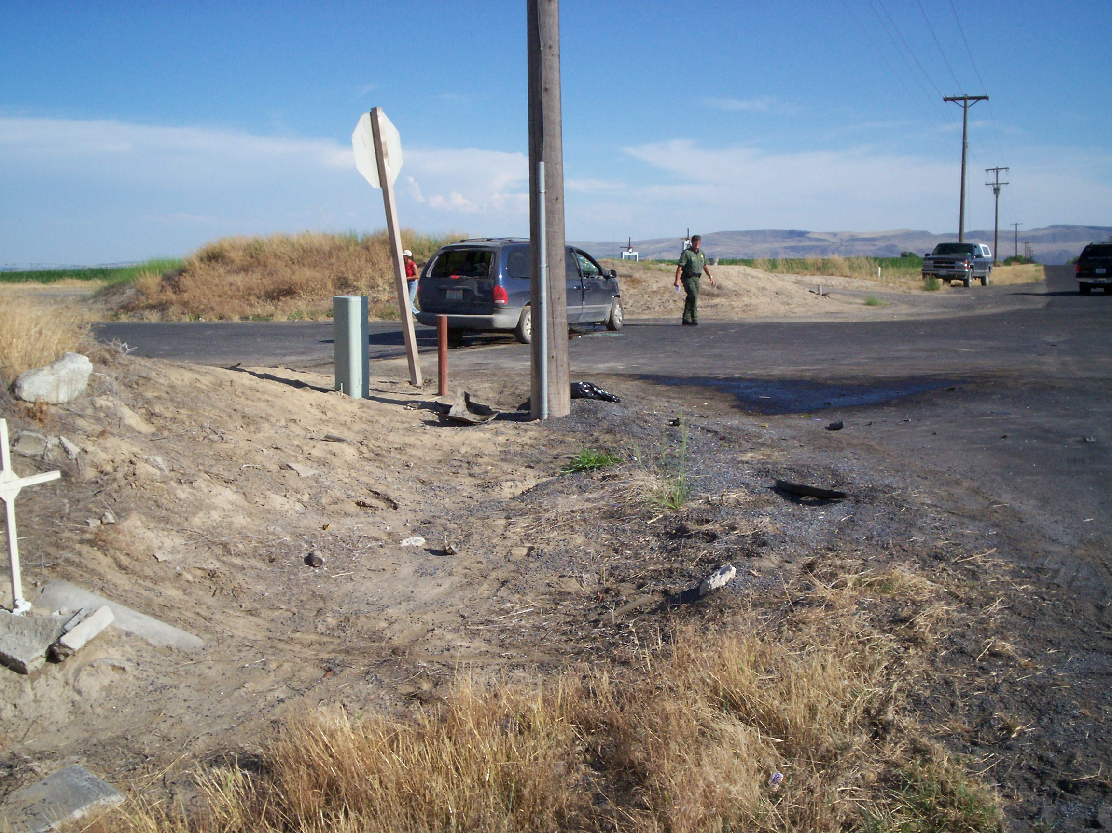
Pregnant victim and 3 year old were ejected and she impacted the stop sign

Slide 19
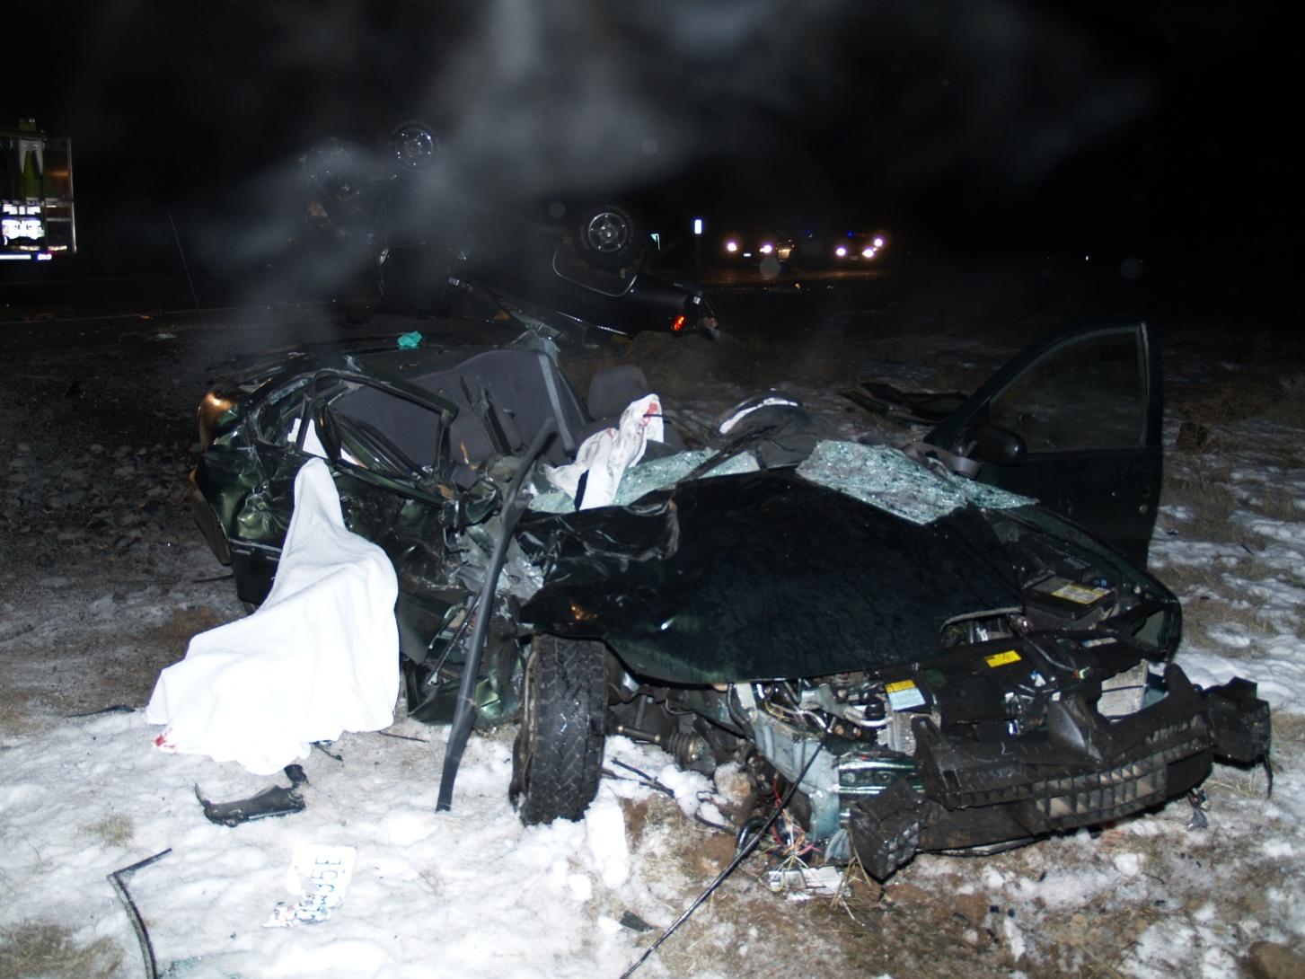
2 Vehicle Head-on Collision
SR 17, South of Soap Lake

Slide 20
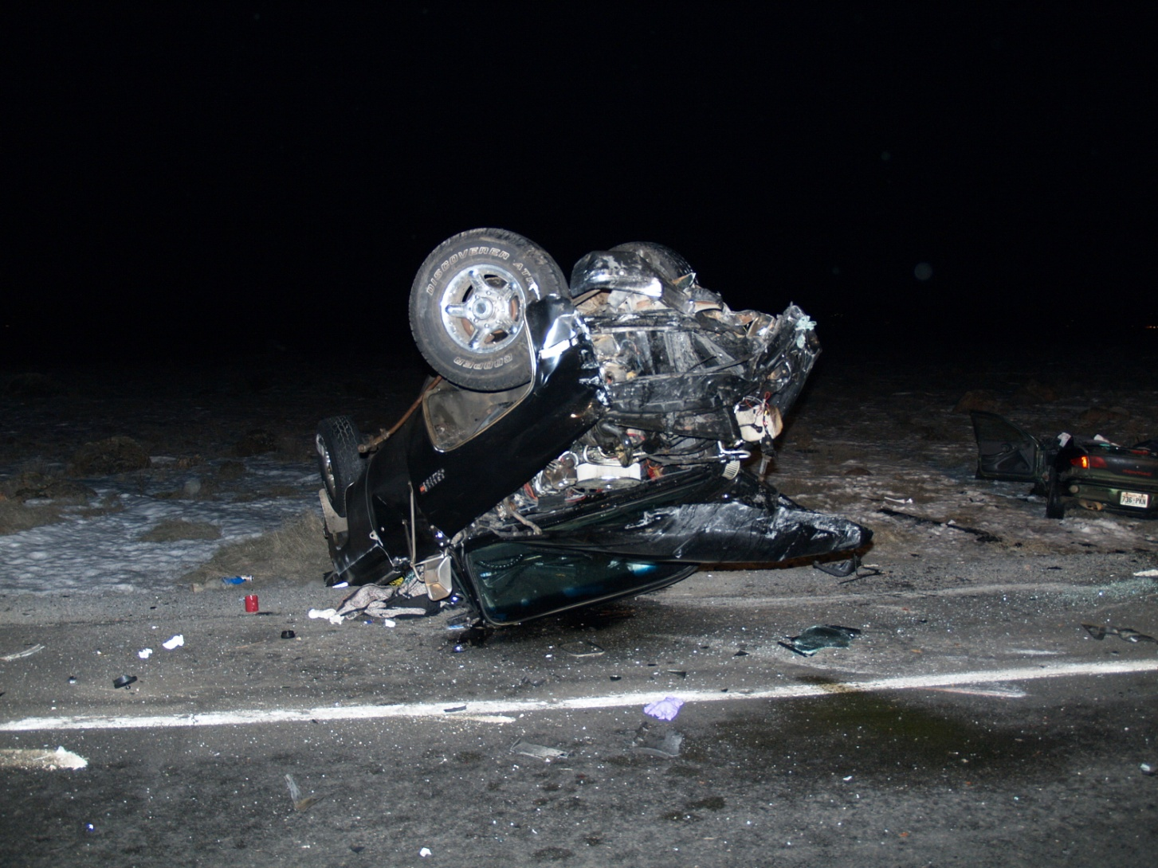
Vehicular Homicide Prescription Drugs & Alcohol
Notes:
20

Slide 21
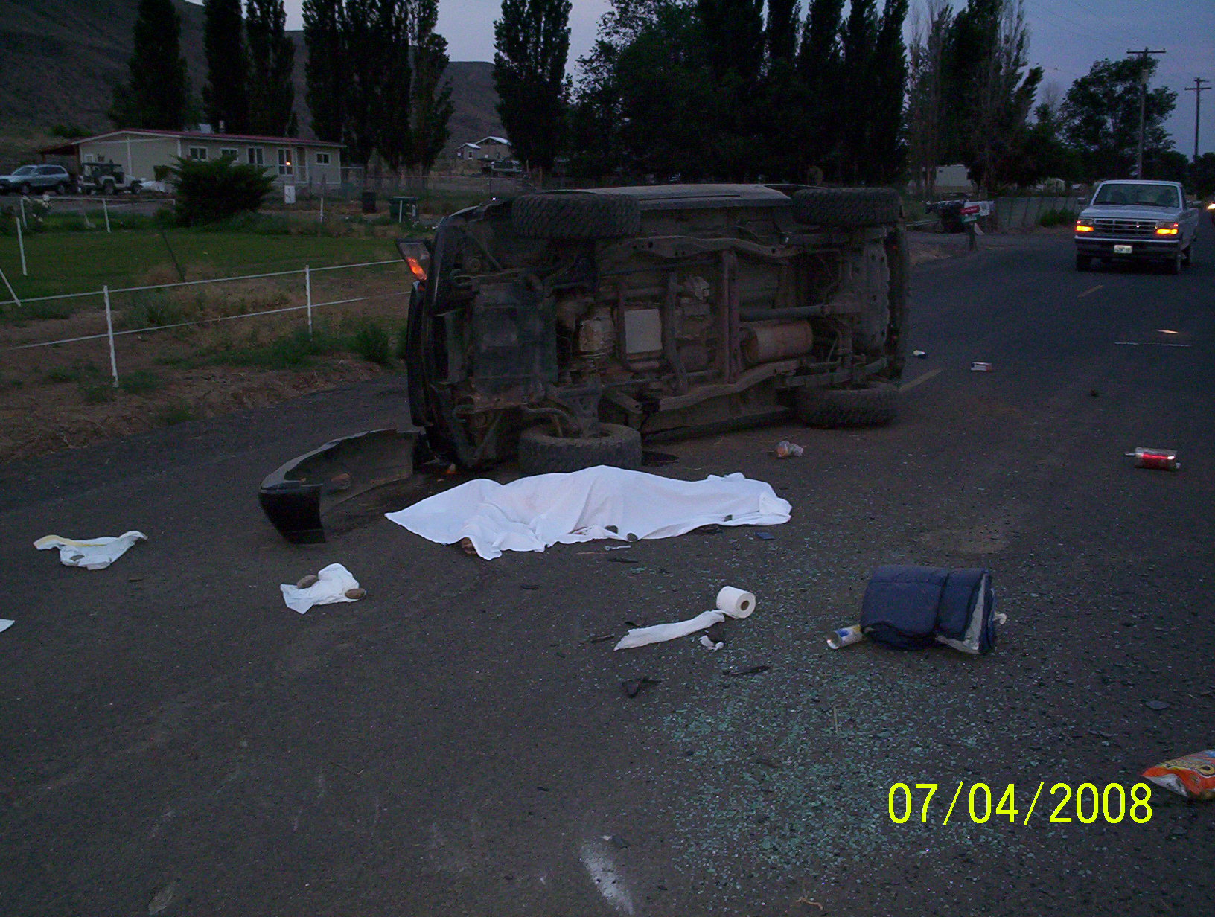
1 Vehicle Rollover (Driver was DUI Alcohol)
Lower Crab Rd SW, South of Royal City

Slide 22
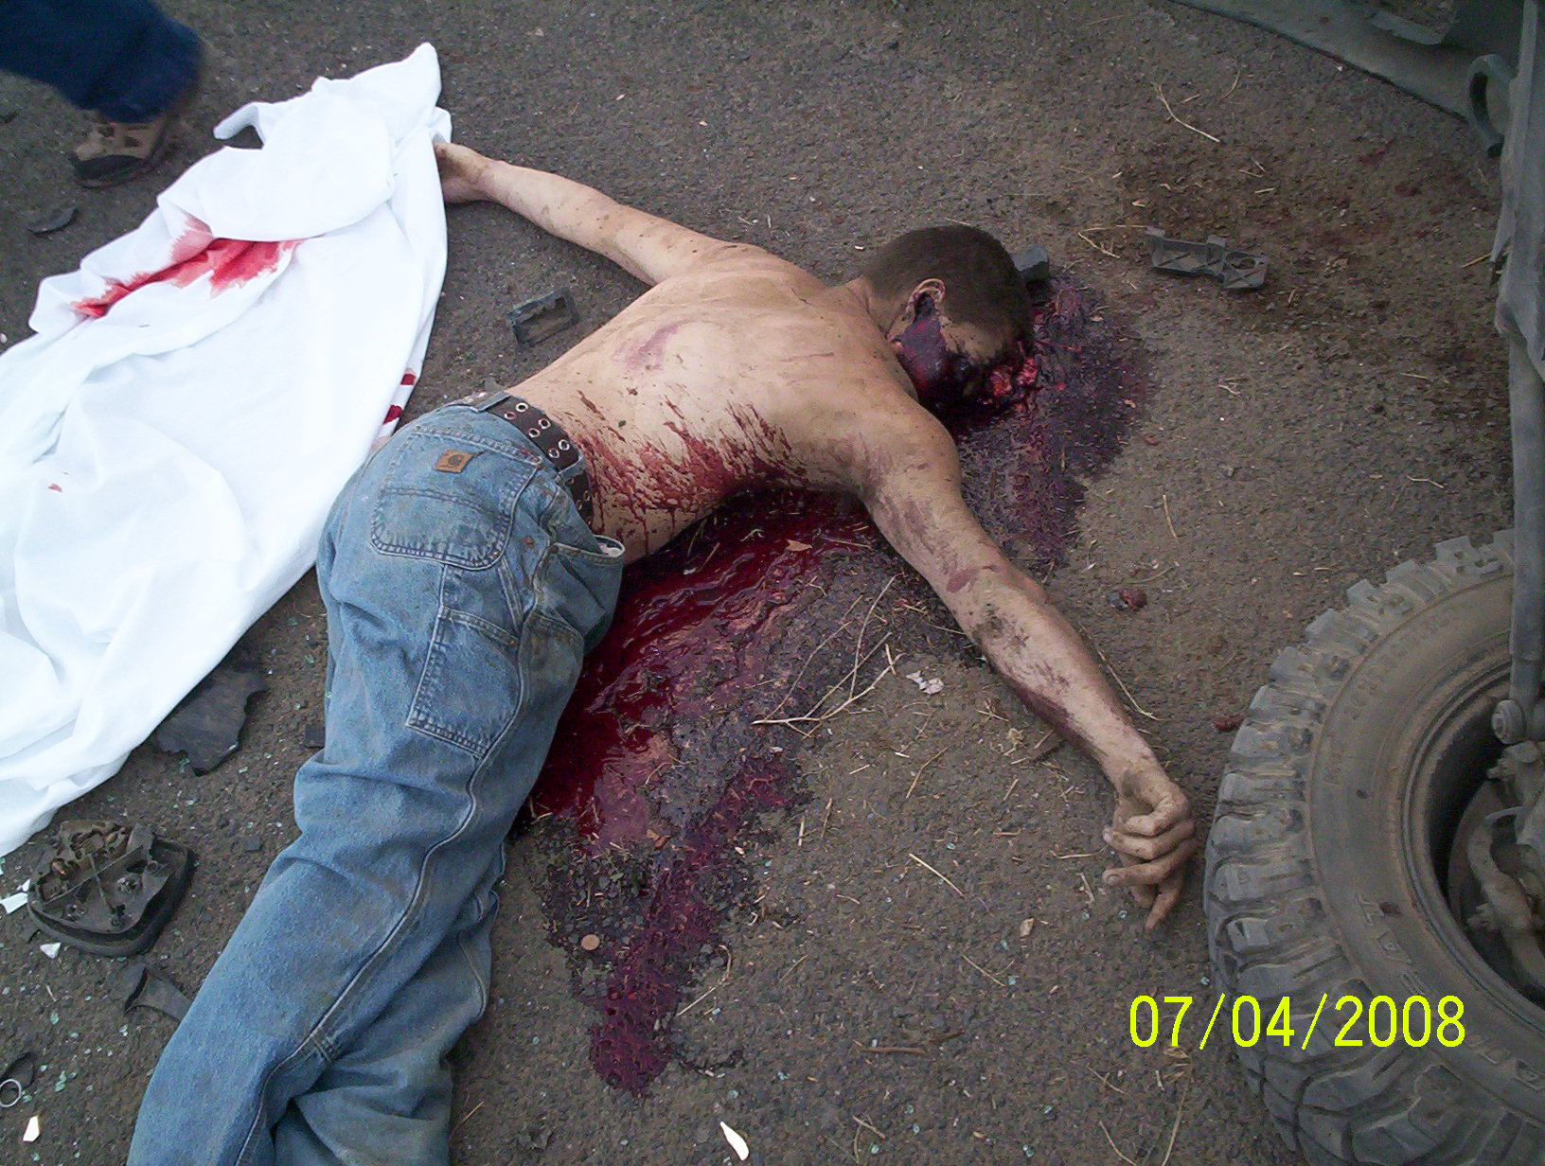
Alcohol (.35 BAC)

Slide 23
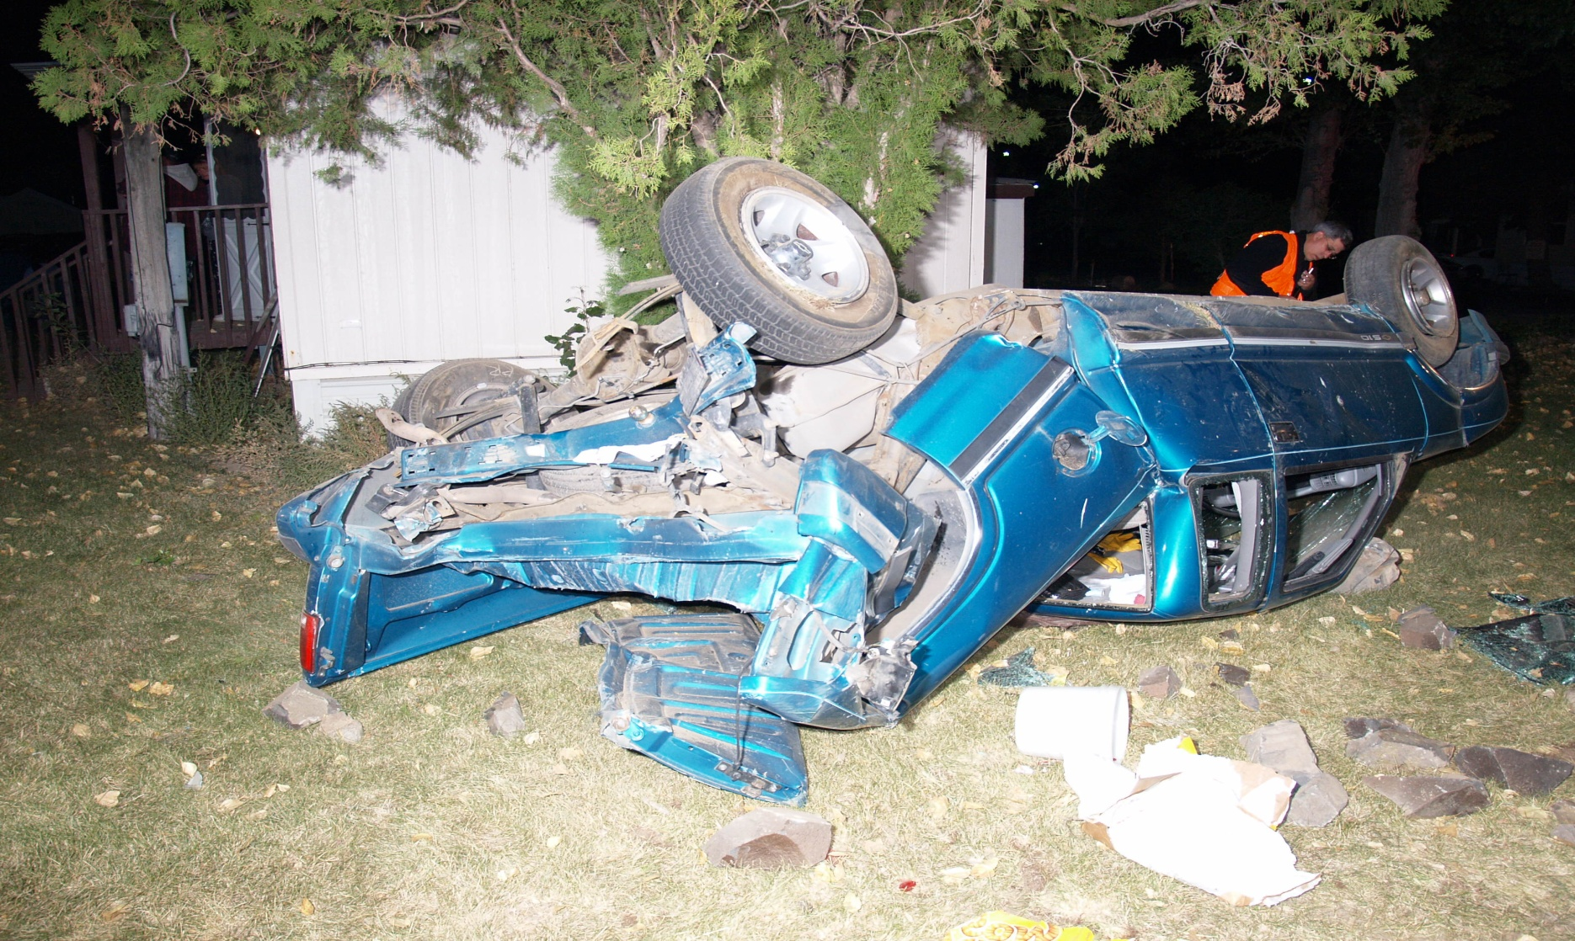
2 Vehicle Collision Victim Vehicle
SR 28 between Ephrata & Lakeview

Slide 24
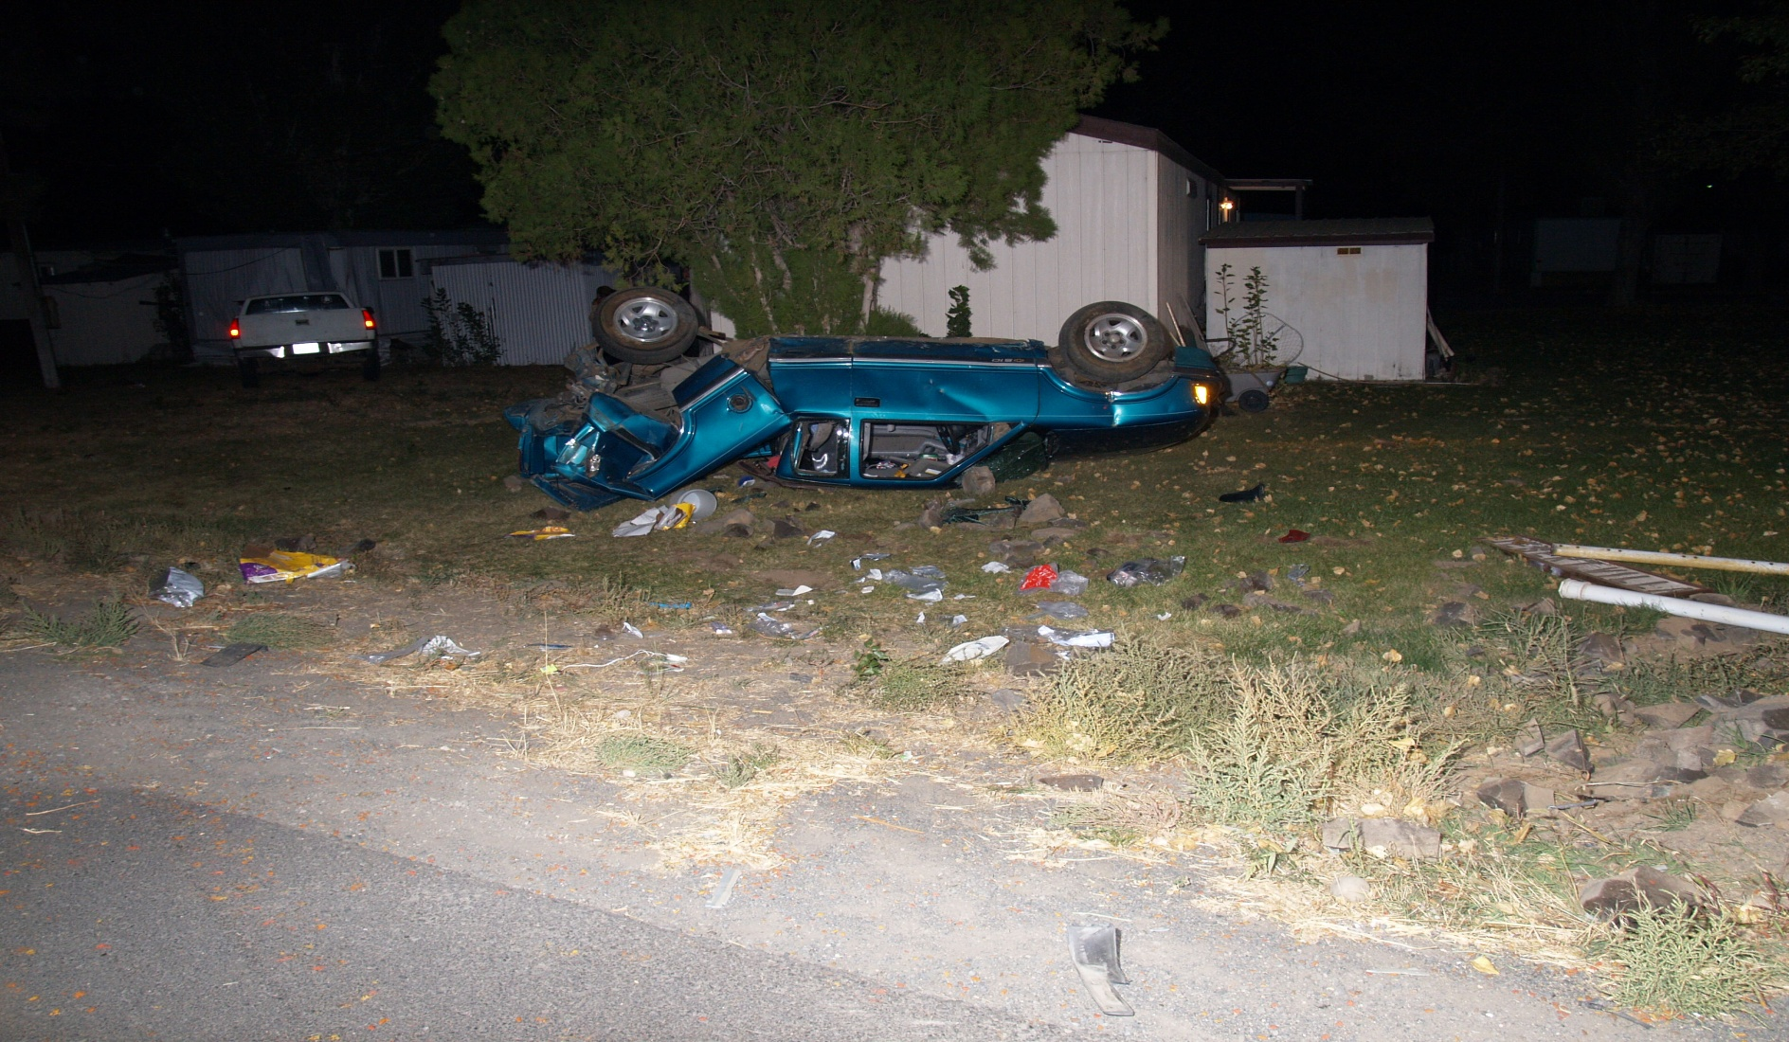
Vehicular Homicide

Slide 25
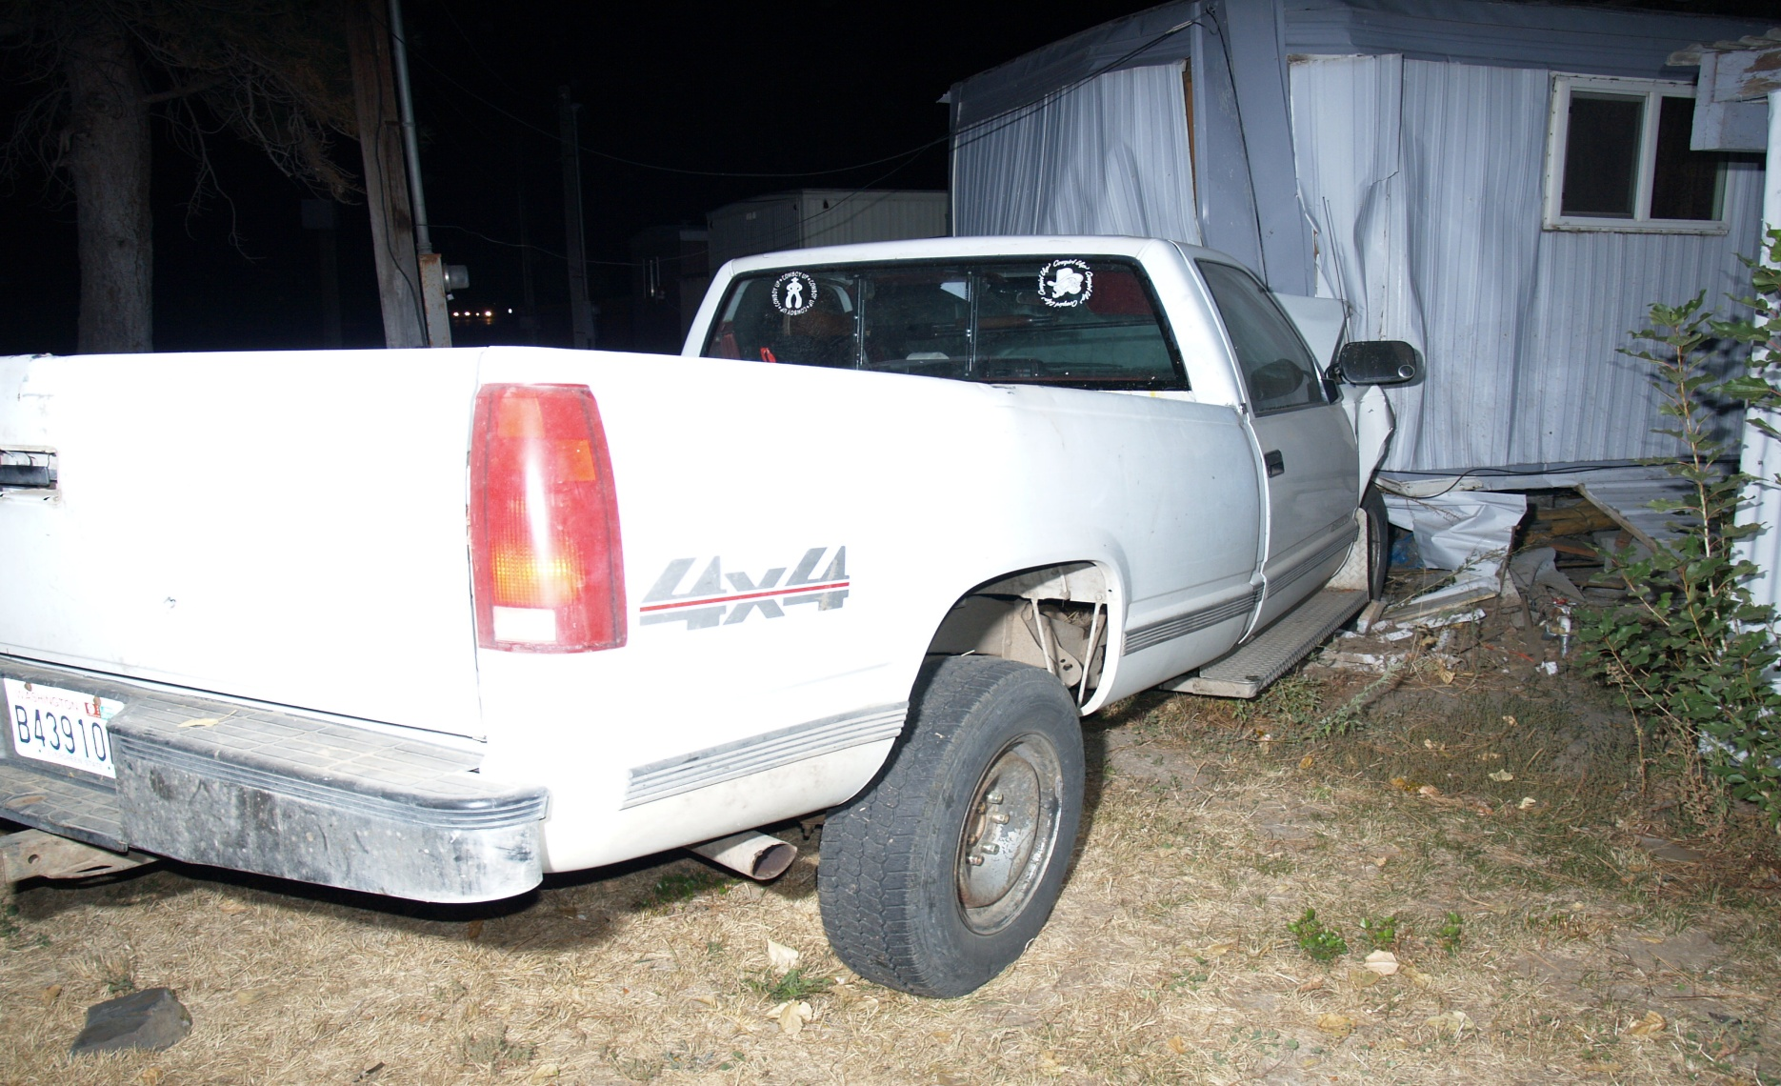
Causing Vehicle Prescription Drugs & Alcohol

Slide 26
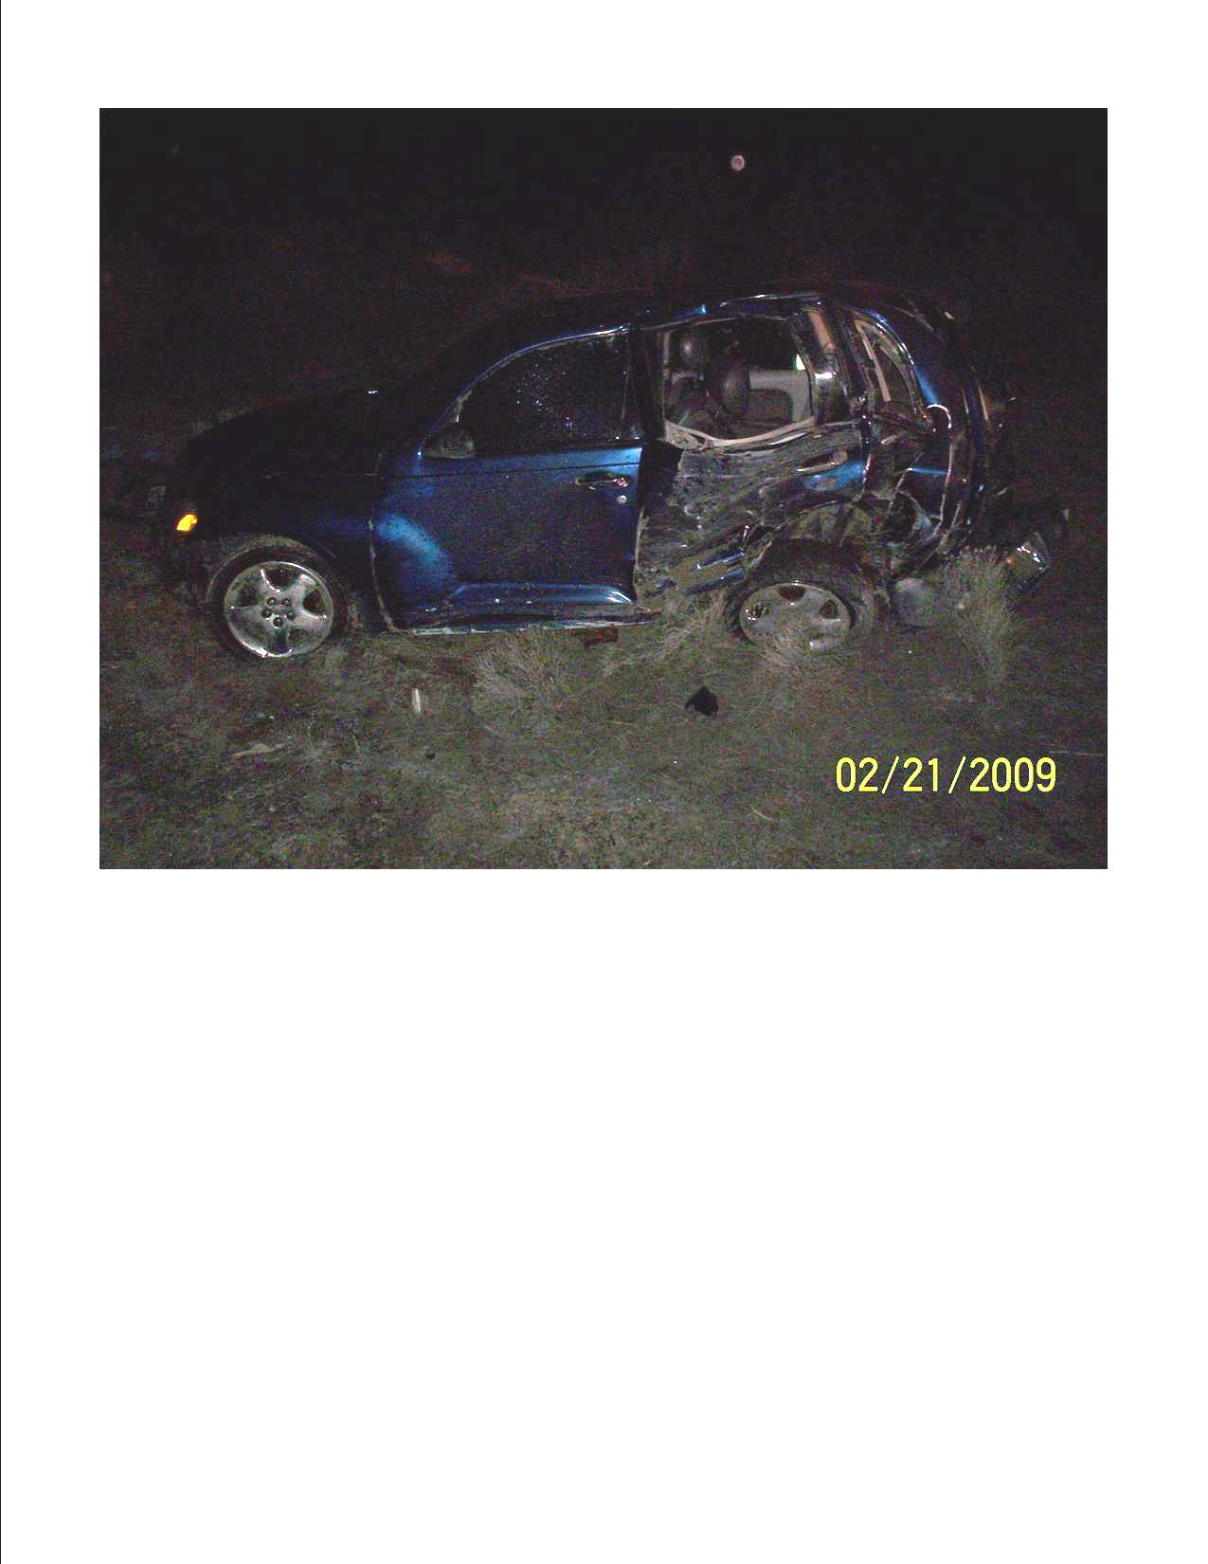
1 Vehicle Collision Alcohol & Speed
Dodson Rd @ RD 1 SW, South of I-90

Slide 27
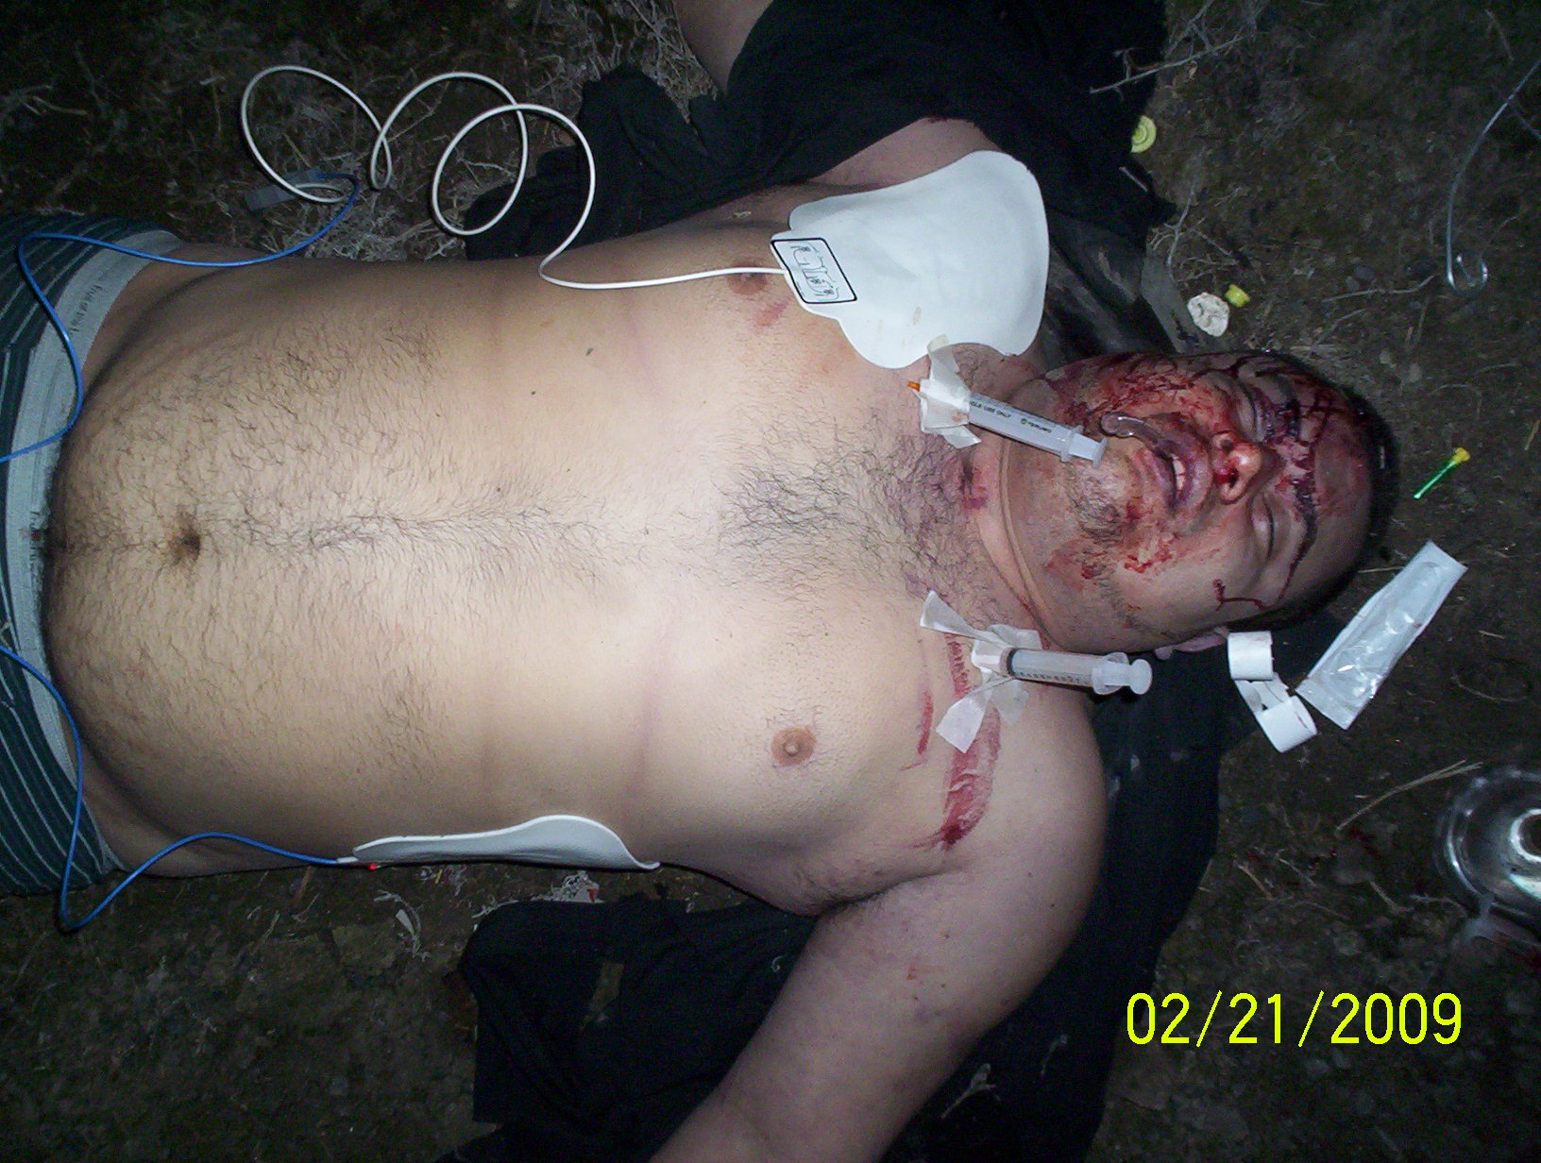
Driver Ejected (.20 BAC)

Slide 28
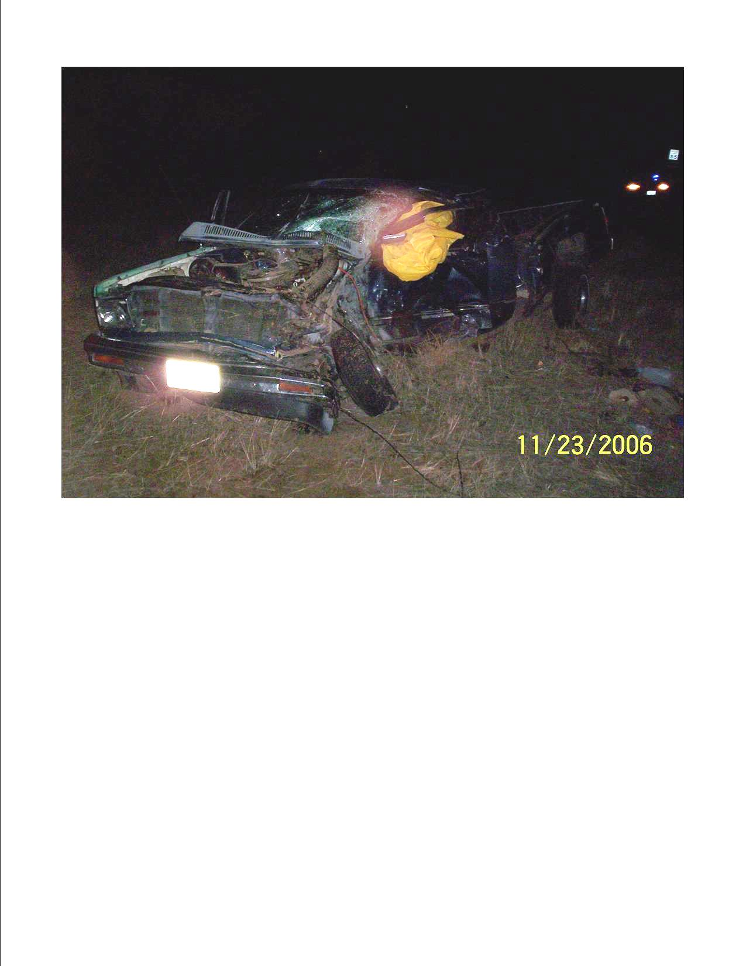
2 Vehicle Fatal Collision
RD 9 NW @ RD E NW, Southwest of Ephrata

Slide 29
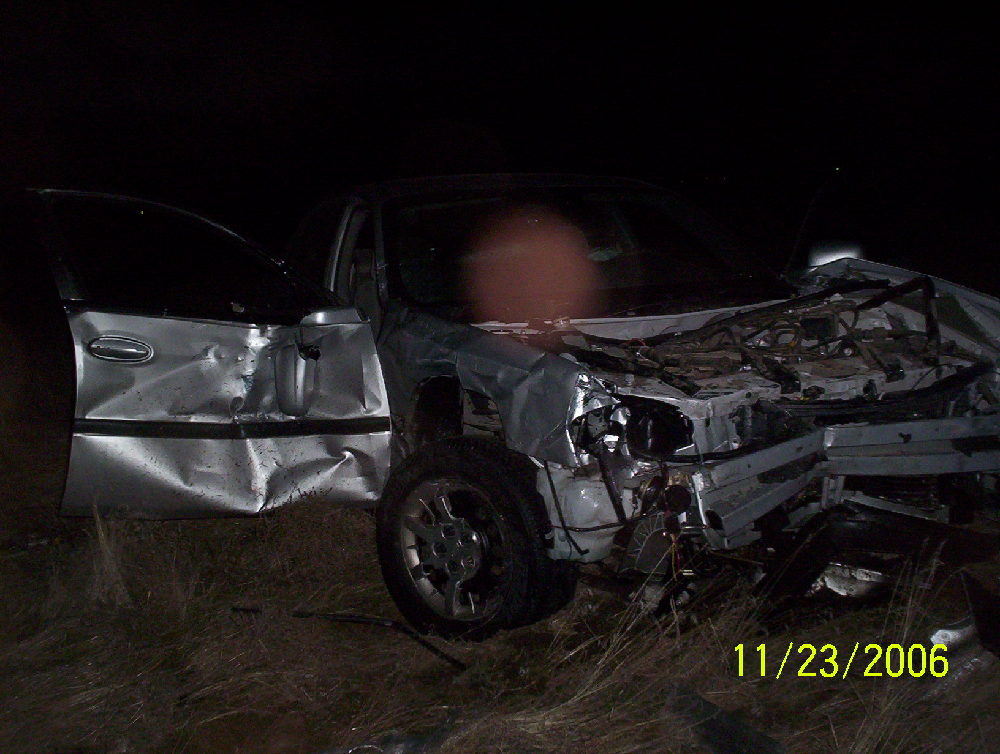
Victim Vehicle

Slide 30
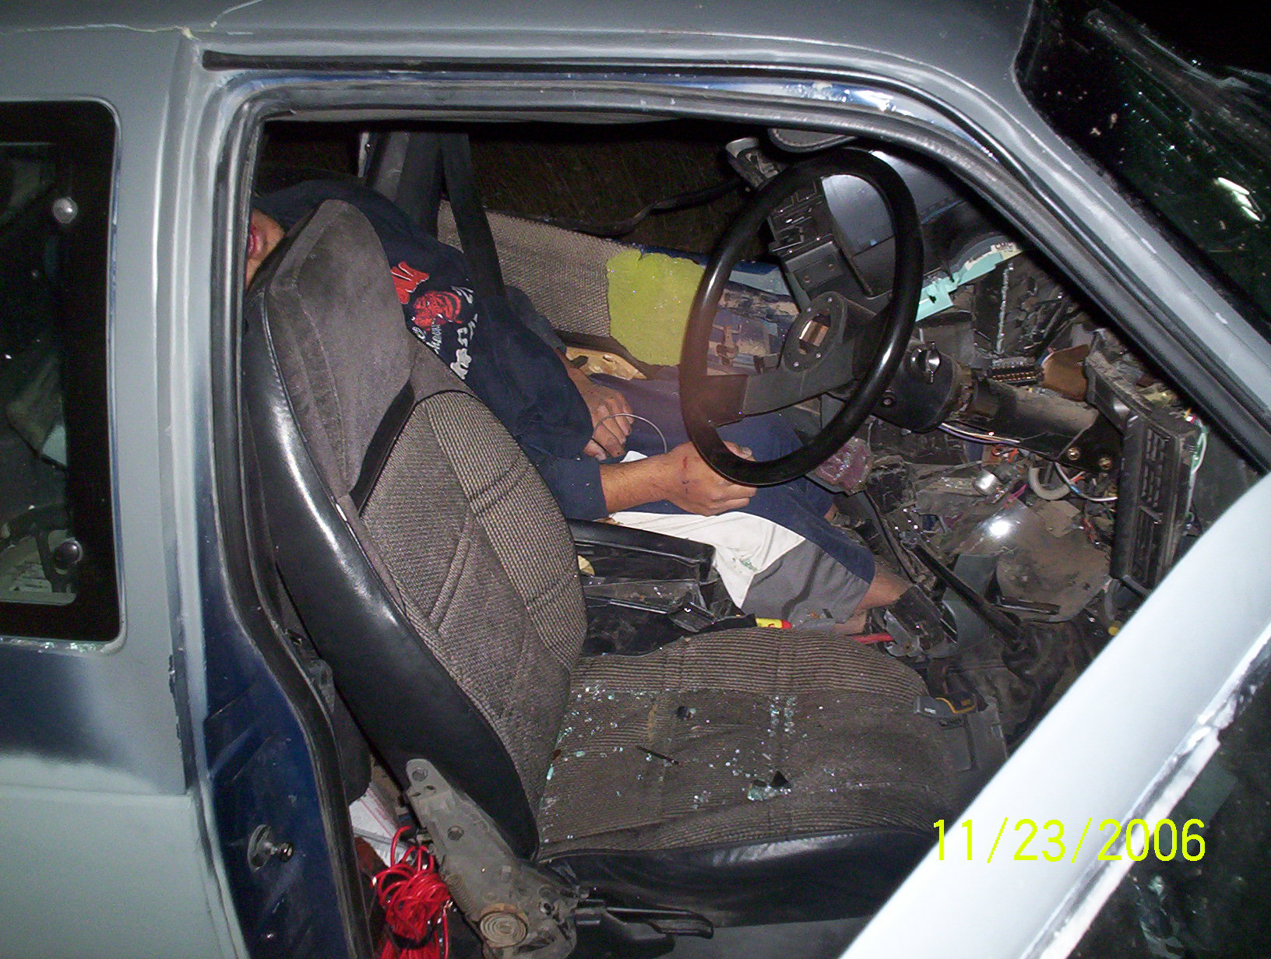
DUI Drugs Marijuana

Slide 31
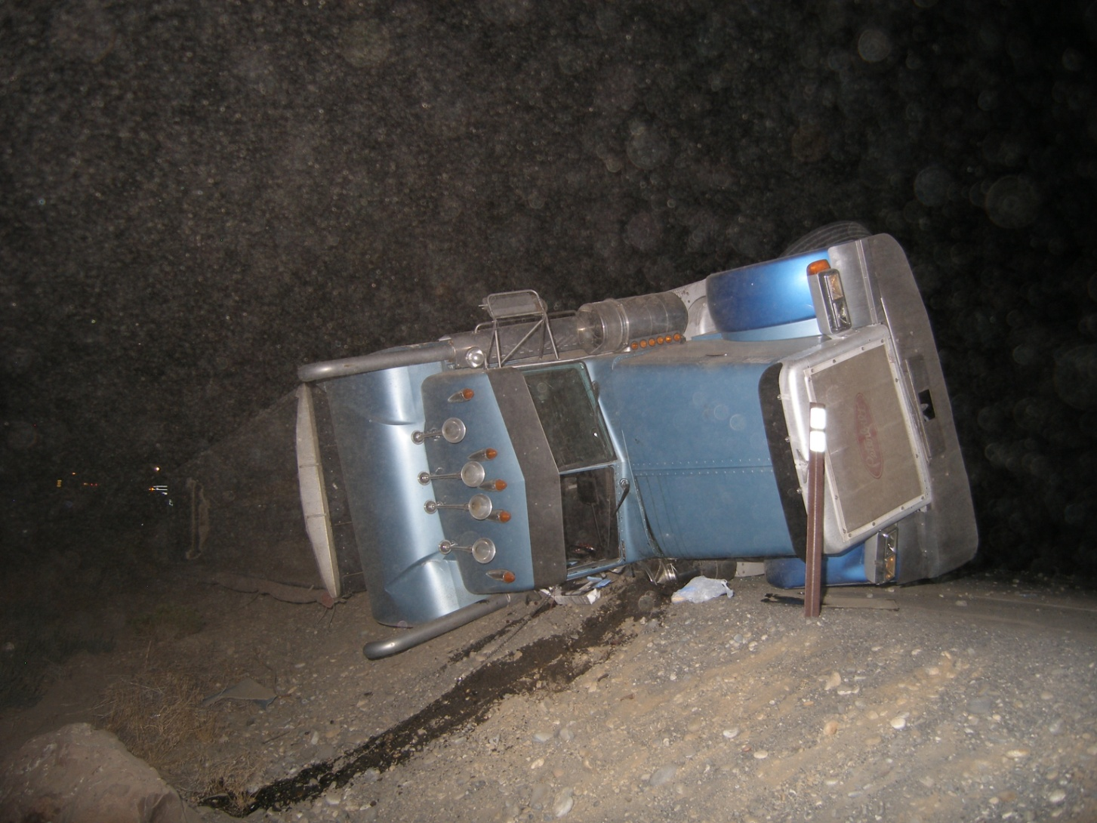
Vehicle vs. Semi
SR 243 @ Rd 24 SW, Mattawa
Notes:
31

Slide 32
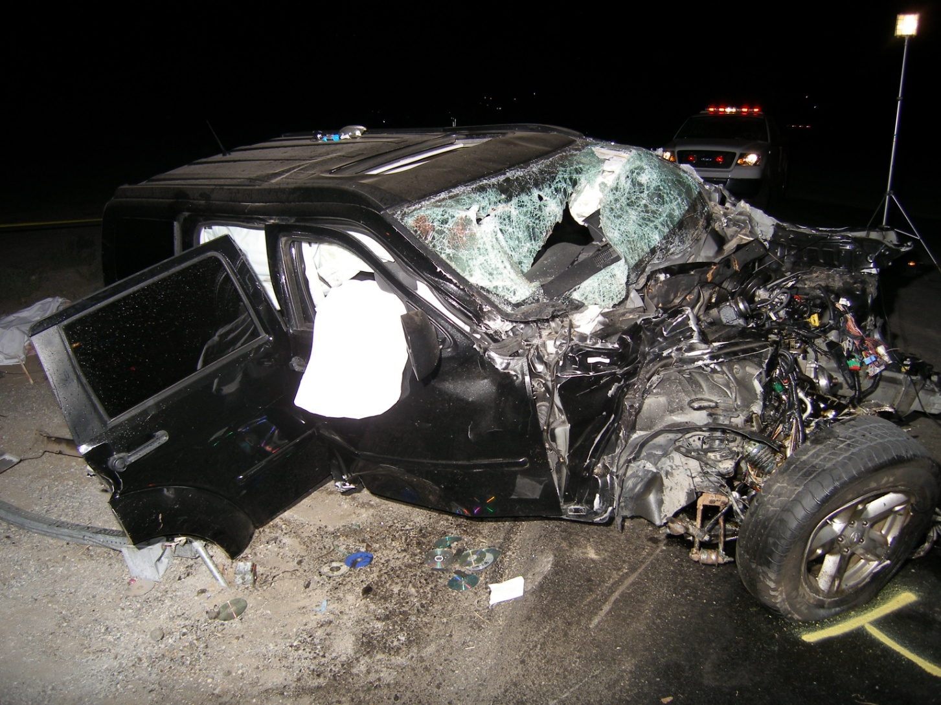
Vehicular Homicide Marijuana & Alcohol

Slide 33
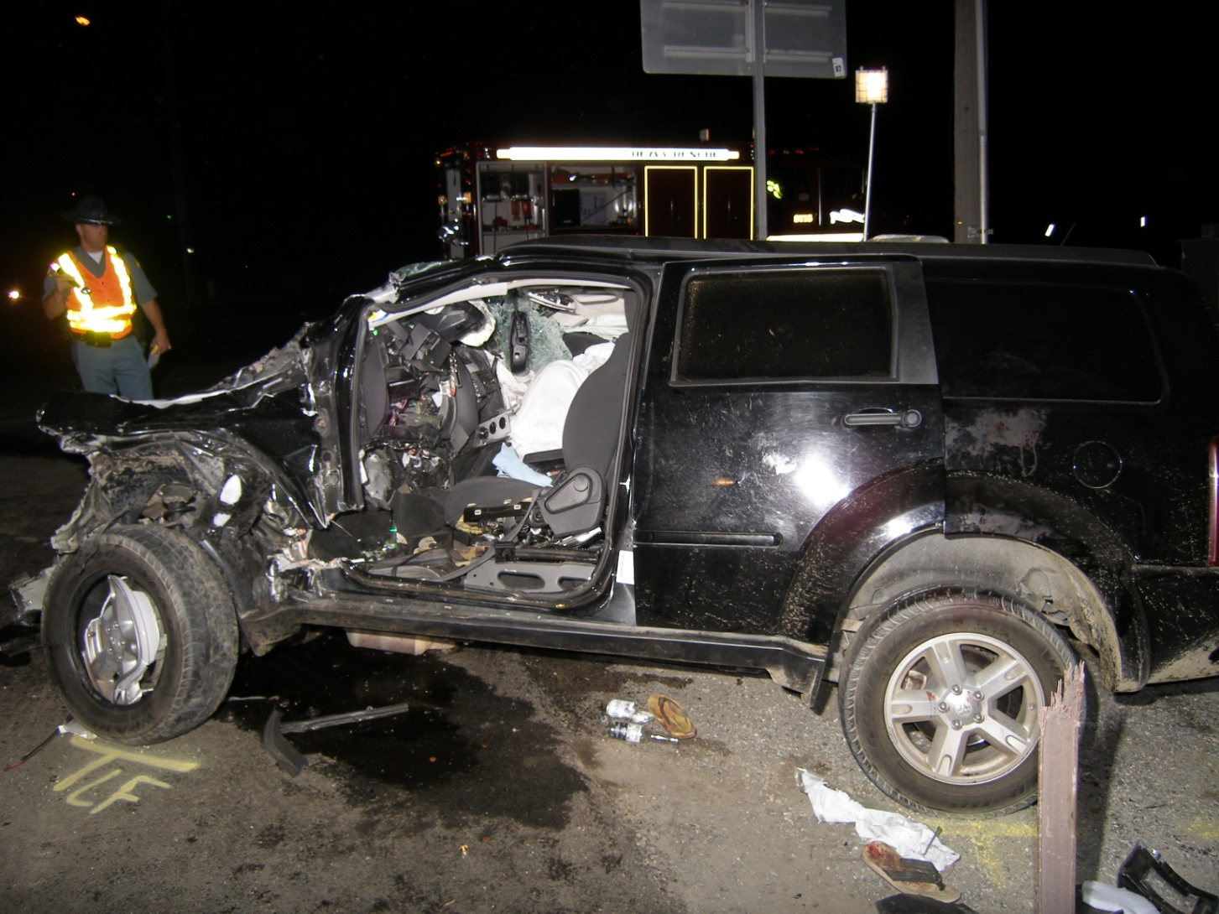
2 Fatalities & 3 Seriously Injured

Slide 34
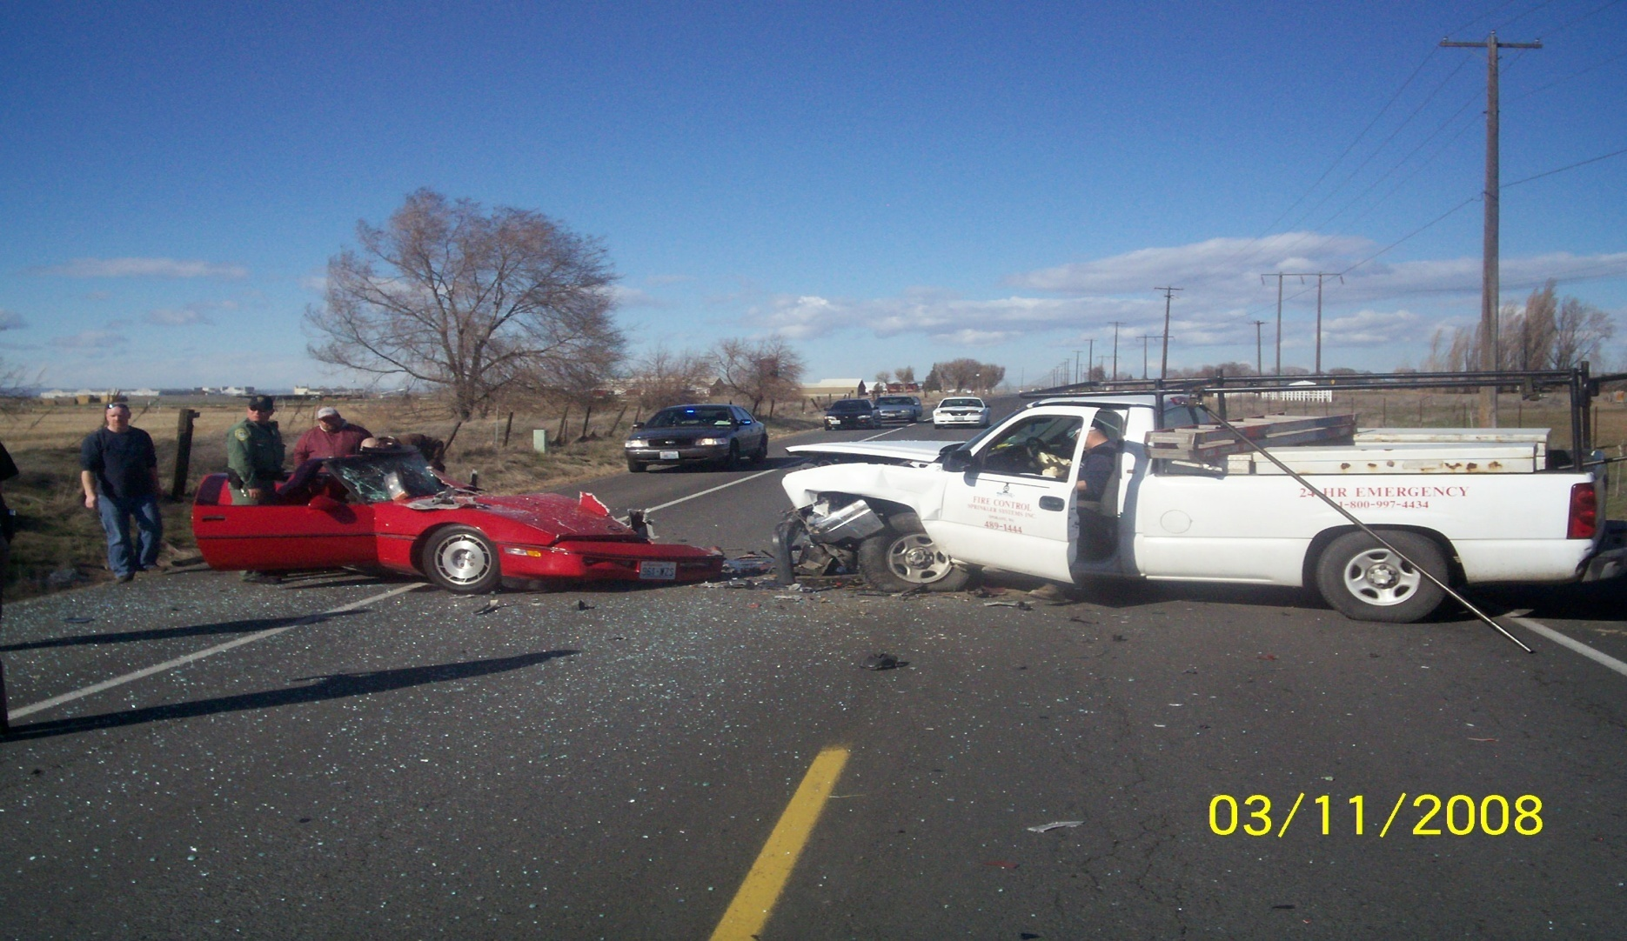
2 Vehicle Head-on
Stratford Rd @ Harris Rd, North of Moses Lake

Slide 35
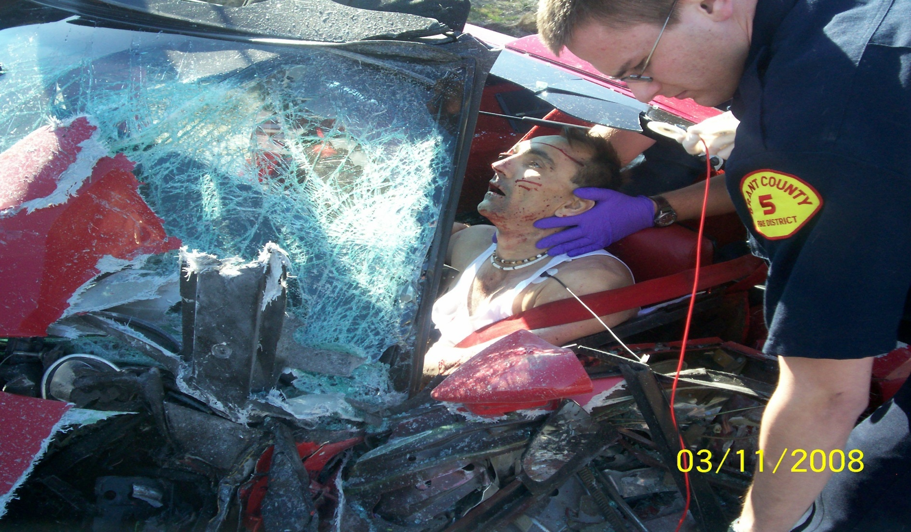
DUI Drugs Methamphetamine

Slide 36
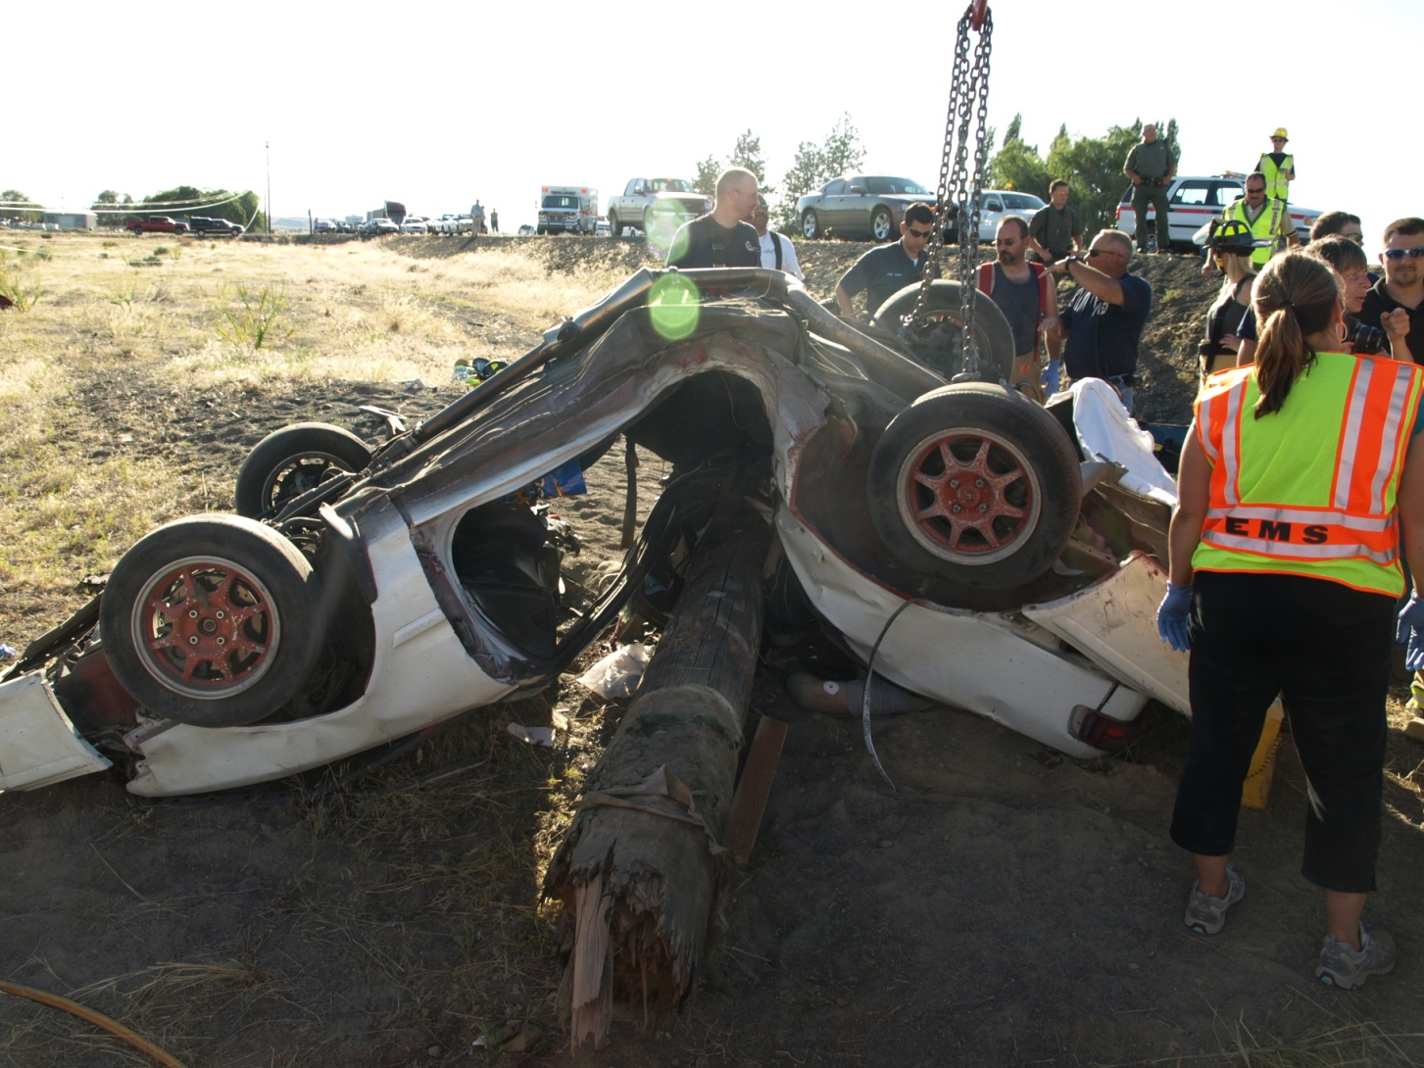
Vehicle vs. Power Pole 3 Fatalities
SR 28 between Soap Lake & Stratford
Notes:
36

Slide 37
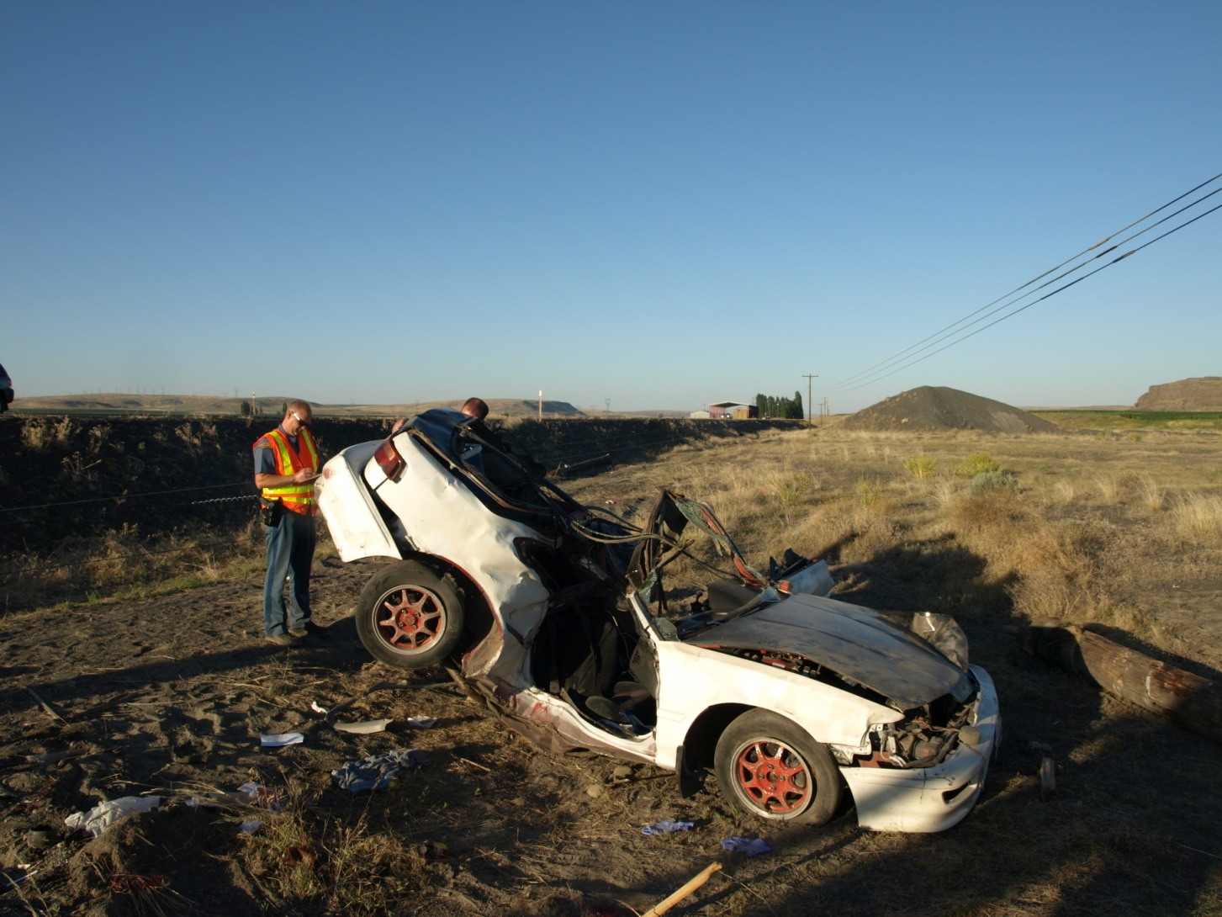
Marijuana & Speed

Slide 38
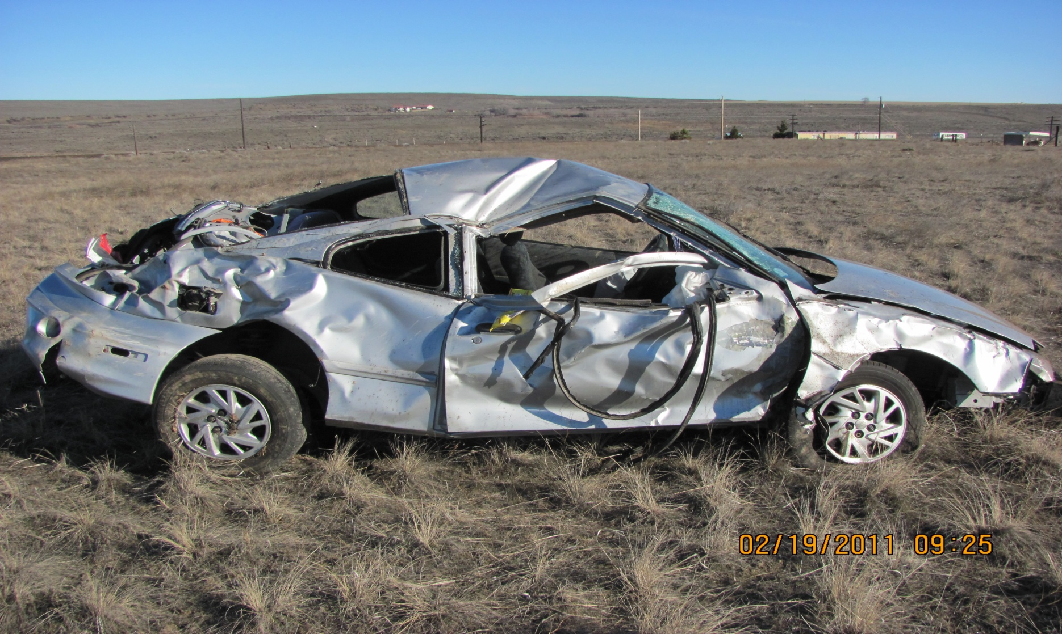
1 Vehicle Collision Alcohol, Prescription Drugs, & Speed
RD 20 NE, East of Soap Lake

Slide 39
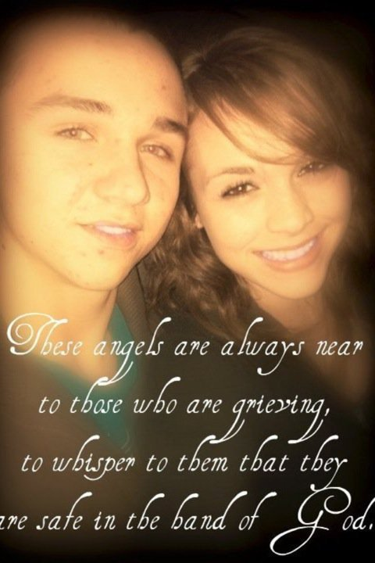
Victim’s

Slide 40
OUR REQUEST
PLEASE BUCKLE UP
PLEASE SLOW DOWN
USE THE BUDDY SYSTEM
THINK BEFORE YOU GET BEHIND THE WHEEL OR IN A VEHICLE WITH SOMEONE WHO HAS CONSUMED ALCOHOL AND/OR DRUGS

Slide 41
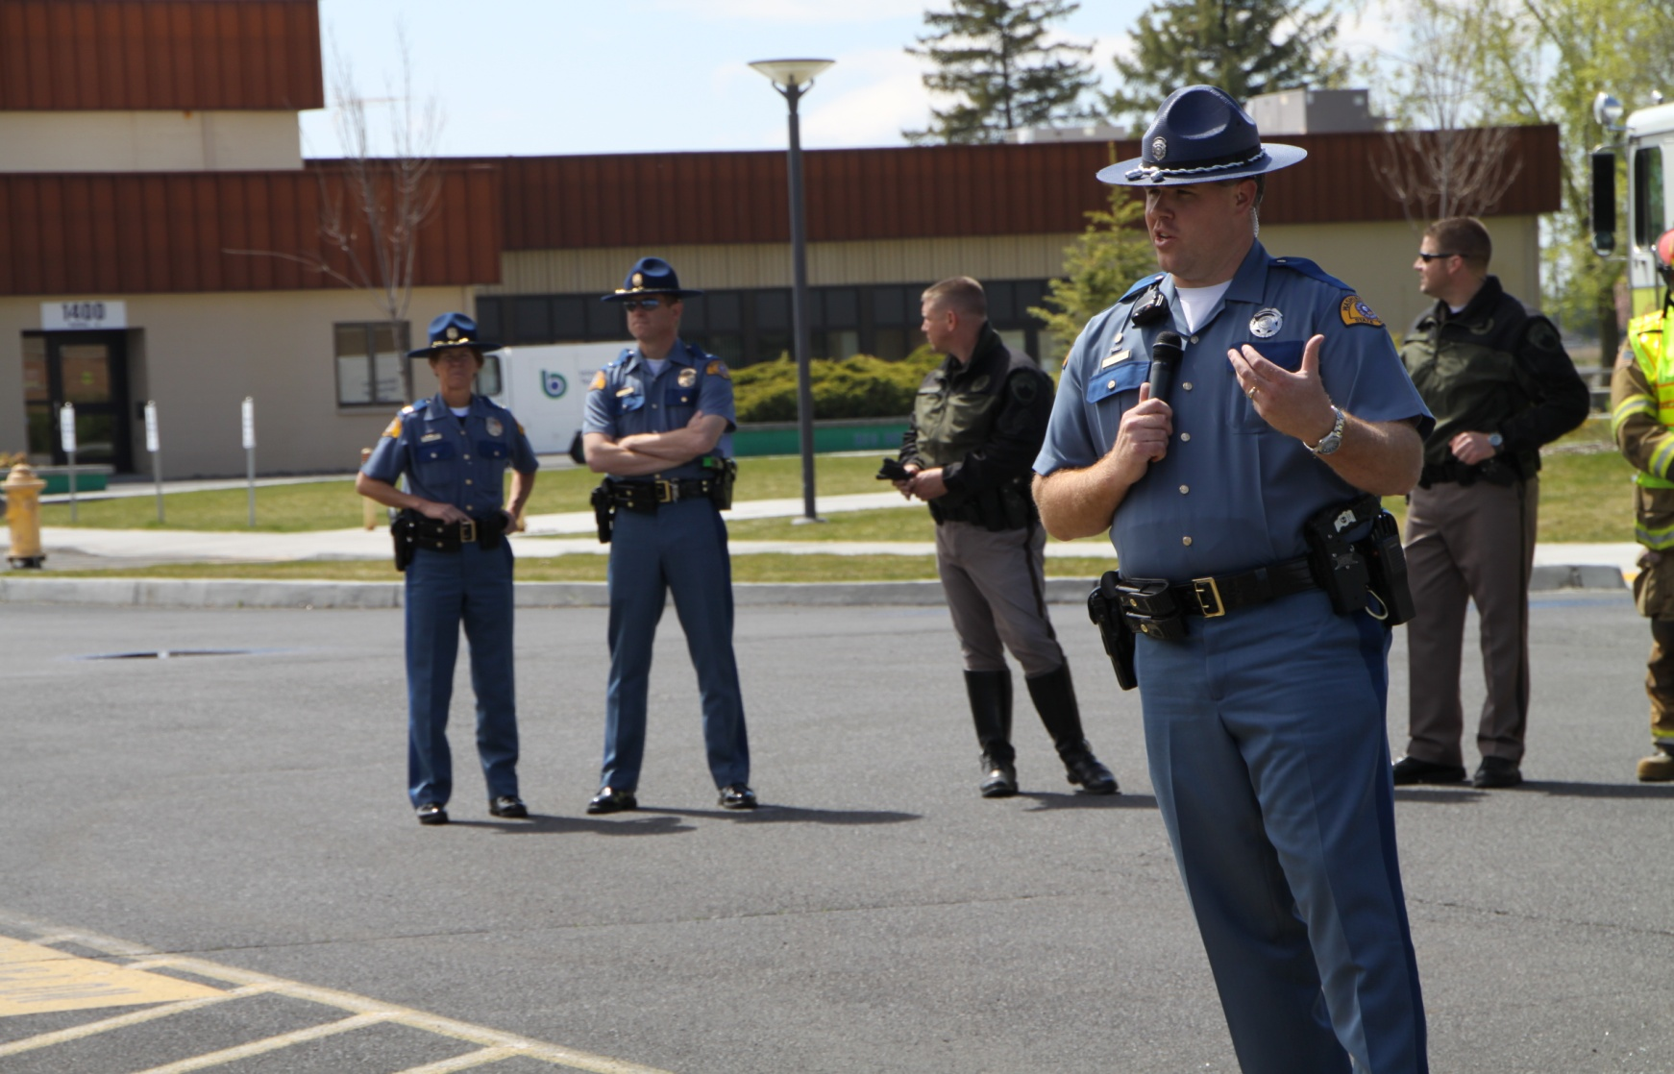
Big Bend CC

Slide 42
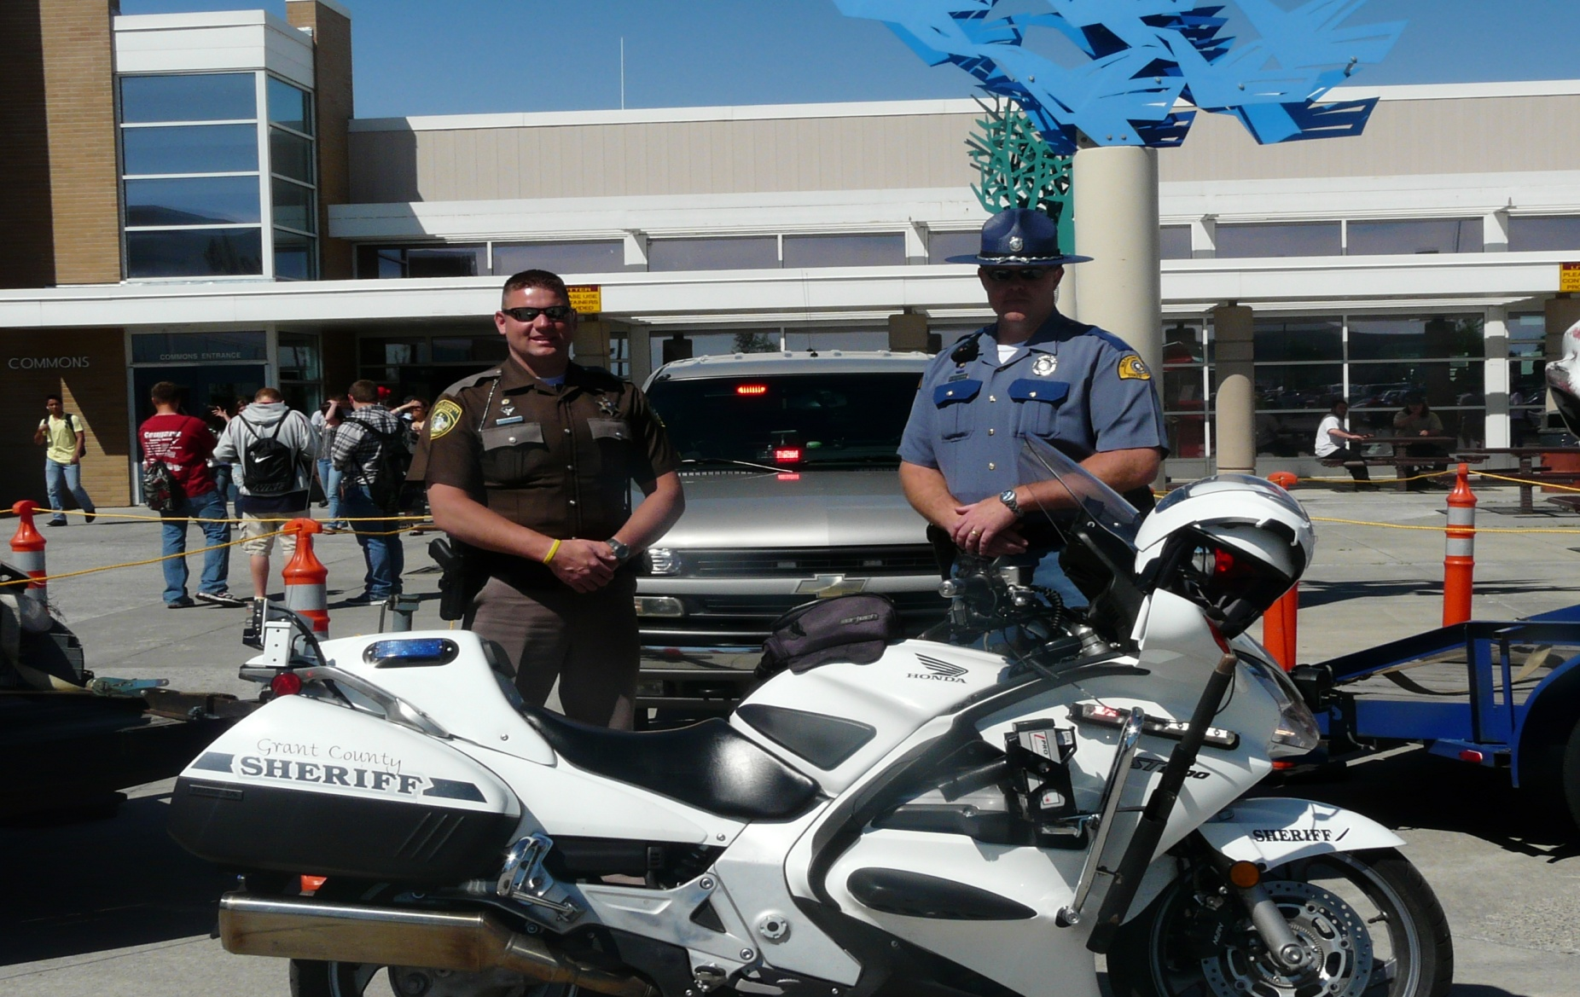
Moses Lake High School

Slide 43
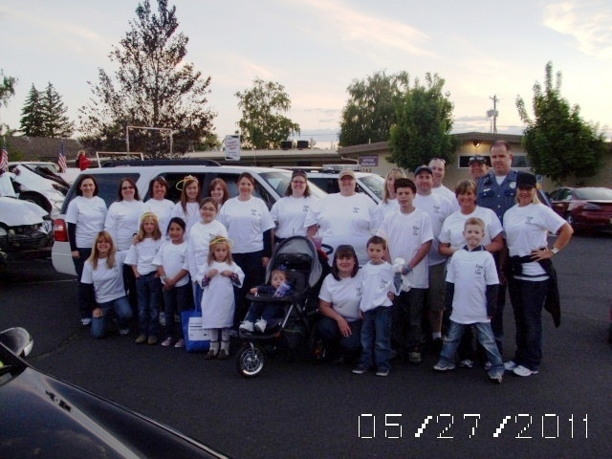
Moses Lake Memorial Day Parade

Slide 44
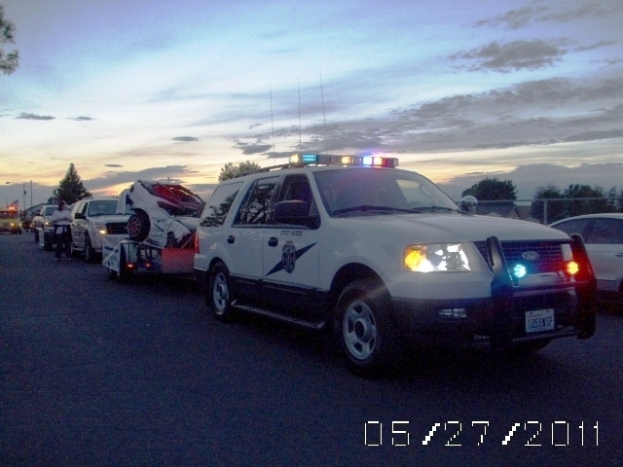
Moses Lake Memorial Day Parade

Slide 45
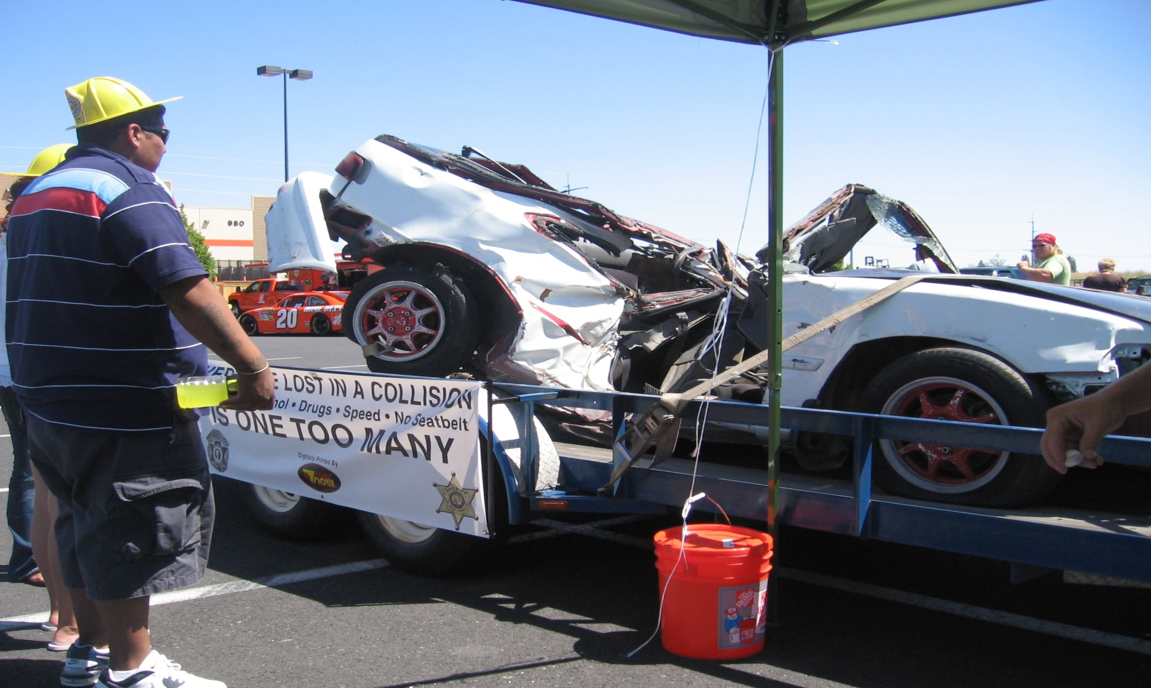
Home Depot in Moses Lake

Slide 46
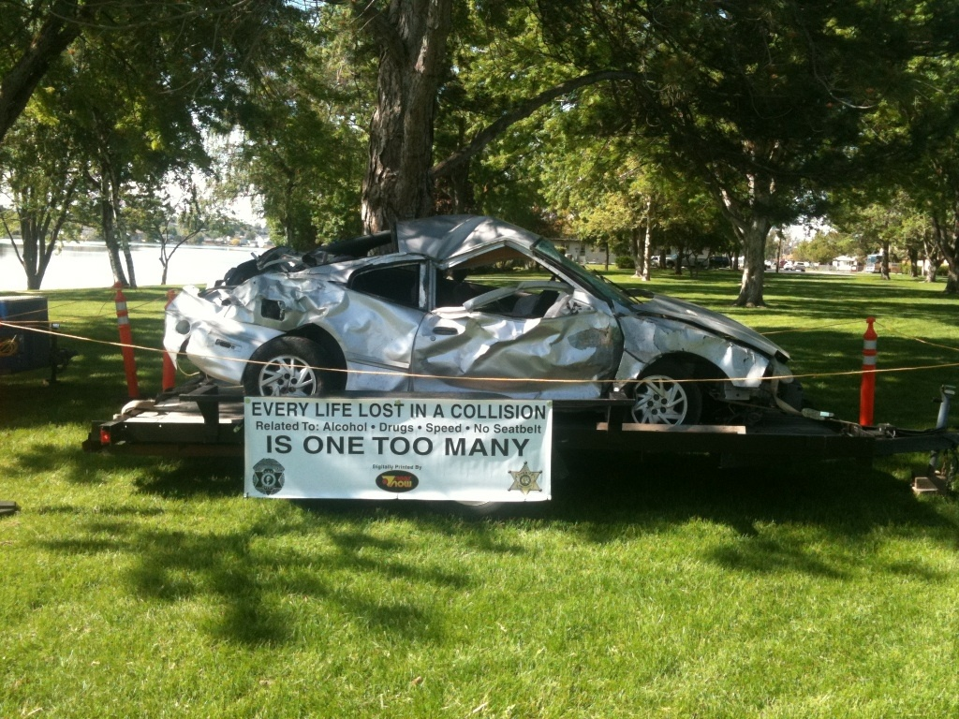
Education Tool

Slide 47
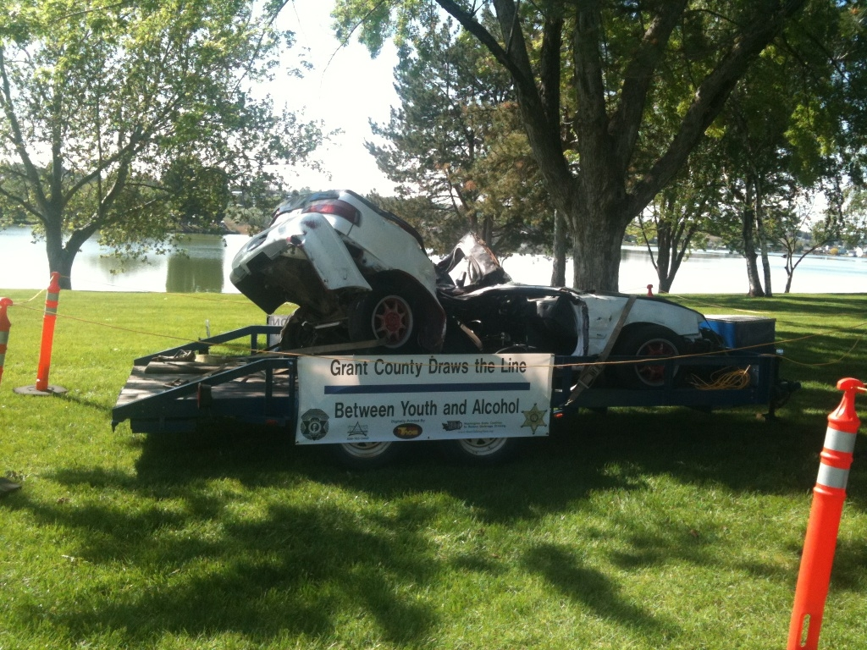
Educational Tool

Slide 48
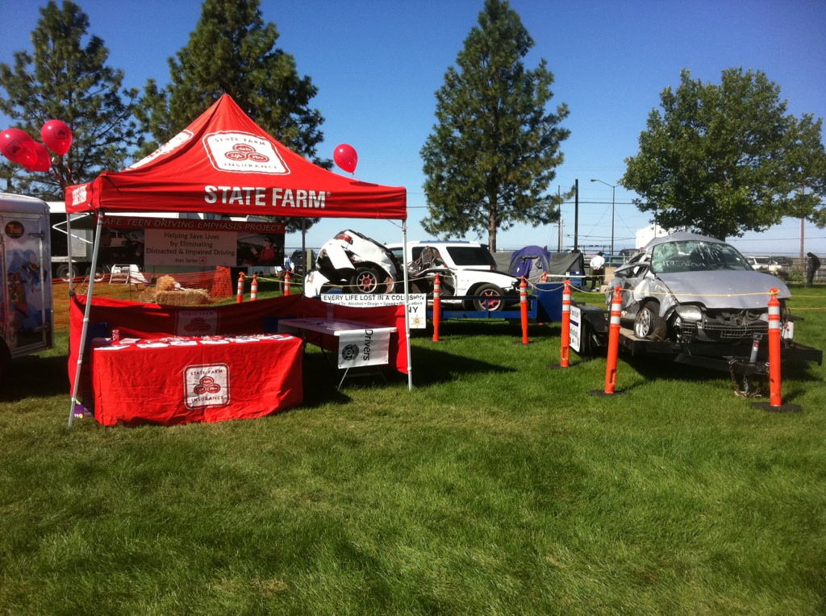
Grant County Fair

Slide 49

Grant Check

Slide 50
Contact Info
Trooper Ryan Raymond
ryan.raymond@wsp.wa.gov
509-989-0820
Sergeant Josh Sainsbury
jsainsbury@co.grant.wa.us
509-989-5442

Slide 51


THANK YOU
WASHINGTON STATE PATROL
&
GRANT COUNTY SHERIFF’S OFFICE

